Slide 1
Financial Wellness in Career Transition
John Payton
Merrill Lynch
Financial Advisor
Volunteer Coach, KCPL
paytonjohnr6@gmail.com
(513) 259-5034
Natalie Ruppert
Kenton County Public Library
MLIS, CWDP
Manager, Career & Job Services
natalie.ruppert@kentonlibrary.org
(859) 962-4099

Slide 2
Financial Concerns Keeping You Up at Night?
Today We Will:
Identify these obstacles
Uncover their reality
Develop a roadmap for mitigation

Slide 3
Topics to cover….
CASH MANAGEMENT
BUDGETING
401K
HEALTH INSURANCE

Slide 4
Cash Management
Make Your Cash Last Longer
High interest cash account
Turn off dividend reinvestment
Turn off auto distributions
Create Transition Financial Plan
Identify priority of sources

Slide 5
Cash Management
Create Transition Financial Plan
How will I cover living expenses for the next 12, 18, 24 months
Consider all options
Determine at what point to switch to the next option

Slide 6
Budgeting
Expense Reduction
Identify potential cuts
Turn unknown into known
Remember, this is temporary
Create a Budget
Credit cards, installment loans or home refinance
Insurance providers
Security monitoring, Internet provider, and Duke Energy
Contact Providers
Notes:
Respect the process and commit to it
plan the work
Vision - Reflect, understand the scope of the work, then commit to the process
Resources - Prepare, ask for help and determine how to feasibly get it done
Strategy - Think strategically, think milestones, work smart with no need to fret
Working the plan has specific steps and tools that we will discuss later
Let’s start with defining your vision.

Slide 7
Options for Your 401k/403b
401k/403b
+ Low administrative cost, increased protection
Leave assets at former employer
- Limited options, Limited access
+ Low administrative cost, increased protection, loan option
Move assets to new employer
- Limited options, Limited access
+ More options, more access, access to advice
Roll over to a traditional IRA
- Potentially higher costs, less protection
+ More options, more access, access to advice, tax free withdrawals after 59 1/2
Convert to a Roth IRA
- Potentially higher costs, less protection, *conversions taxed as income*
+ Immediate access
Withdraw (PENALTIES!!!!)
- Taxed at income plus 10% penalty if less than 59 ½, decreases retirement account

Slide 8
Cash Management
Unemployment Claims
-File now even if receiving severance
No Downside
Clock doesn’t start until you start receiving money
Take advantage of all means available to you
Worst Case
Your benefits are delayed until your severance ends
Notes:
Respect the process and commit to it
plan the work
Vision - Reflect, understand the scope of the work, then commit to the process
Resources - Prepare, ask for help and determine how to feasibly get it done
Strategy - Think strategically, think milestones, work smart with no need to fret
Working the plan has specific steps and tools that we will discuss later
Let’s start with defining your vision.

Slide 9
Cash Management
KENTUCKY 12 weeks of Unemployment Insurance 5 Work Search Requirements per week
OHIO
26 weeks of Unemployment Insurance
2 Work Search Requirements per week
INDIANA
26 weeks of Unemployment Insurance
2 Work Search Requirements per week
Notes:
Respect the process and commit to it
plan the work
Vision - Reflect, understand the scope of the work, then commit to the process
Resources - Prepare, ask for help and determine how to feasibly get it done
Strategy - Think strategically, think milestones, work smart with no need to fret
Working the plan has specific steps and tools that we will discuss later
Let’s start with defining your vision.

Slide 10
Save Money Using Library Resources
Volunteer Coaches, Resume Assistance, Interview Preparation
Marketing Tools (Marketing Plan, Spotlight Document, LinkedIn Profile)
STREAM CENTER and Covington Makerspace (Unique Gifts)
Entertainment (Concerts, Children’s Activities, Heath & Wellness, Book Clubs)
CHECK-OUT: Books, CD’s, DVDS (Physical or Online), Laptops, HOTSPOTS, Tools

Slide 11
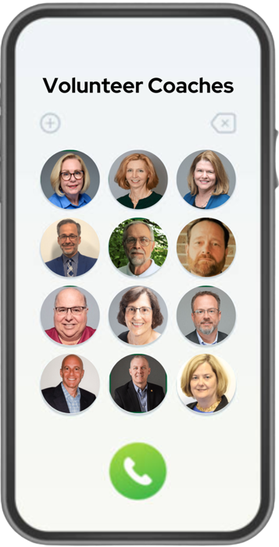
Save Money Using Library Resources
Volunteer Coaches, Resume Assistance, Interview Preparation

Slide 12
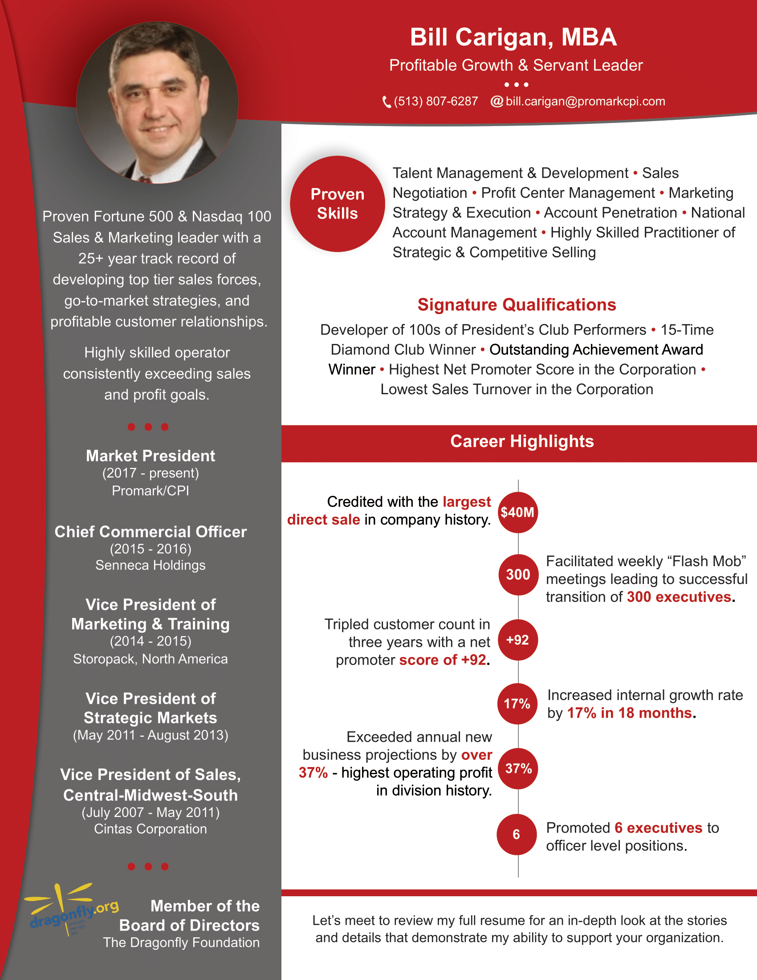
Save Money Using Library Resources
Marketing Tools (Marketing Plan, Spotlight Document, LinkedIn Profile)

Slide 13
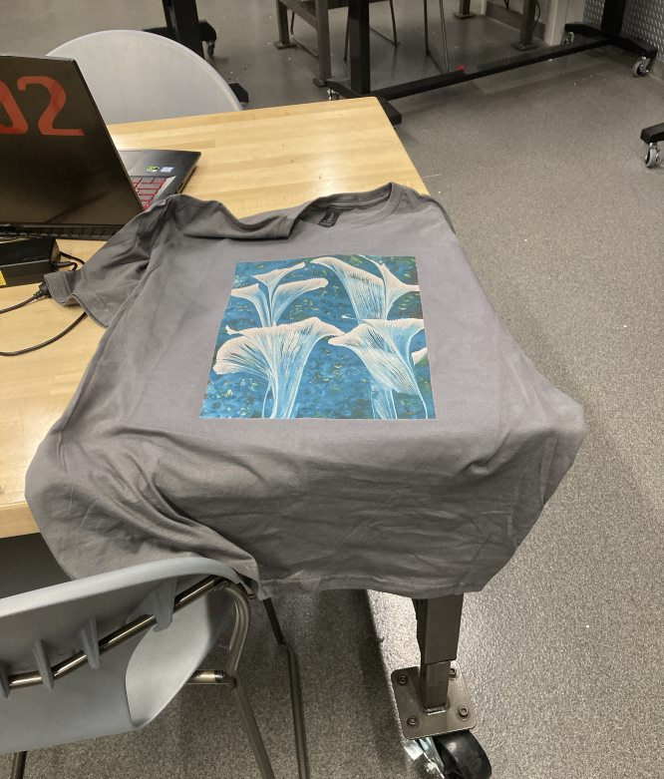
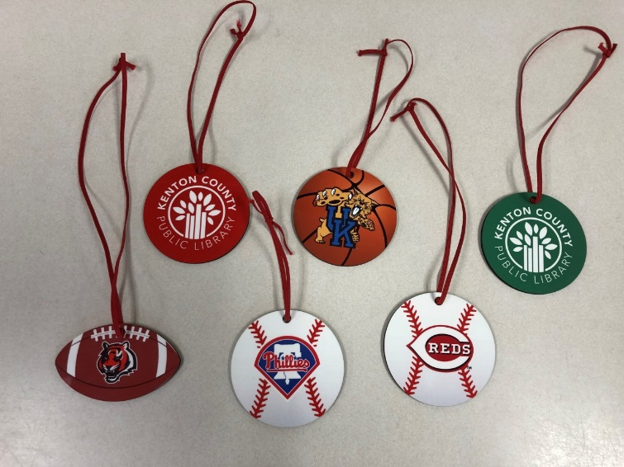
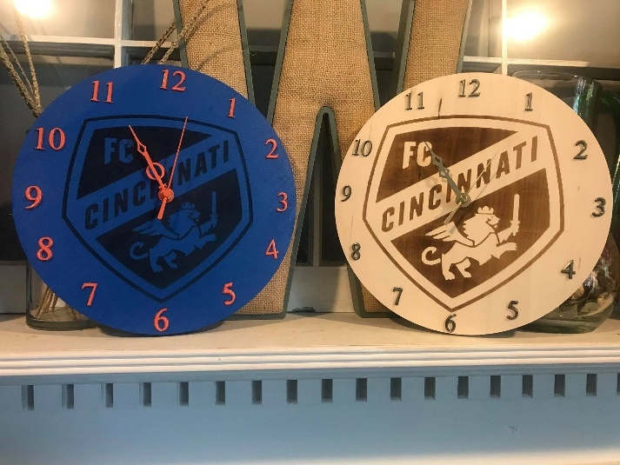
Save Money Using Library Resources
STREAM CENTER and Covington Makerspace (Unique Gifts)

Slide 14
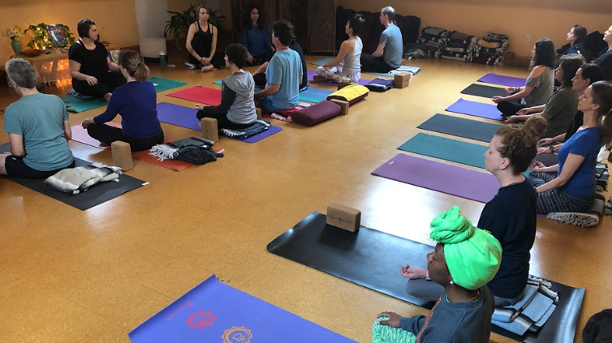
Save Money Using Library Resources
Entertainment (Concerts, Children’s Activities, Heath & Wellness, Book Clubs)

Slide 15
Save Money Using Library Resources
CHECK-OUT: Books, CD’s, DVDS (Physical or Online), HOTSPOTS, Tools

Slide 16
Other Library Resources to Save $$$
Free Notary Services (call library branch in advance for availability)
Free Meeting Spaces
EMPOWER TOOLS
One-on-One Technology Assistance
Learn a foreign language with Mango Languages
Gale Courses and Learning Express

Slide 17
Enhance Your Value
Gale Courses offers a wide range of 375+ interactive, instructor led courses that you
can take entirely online. As a library card holder in good standing, you are entitled
to these courses at no cost. Courses run for six weeks, and new sessions begin every month.
On demand instructional videos, test prep, and tutorials. Access free with
Kenton County Library card.

Slide 18
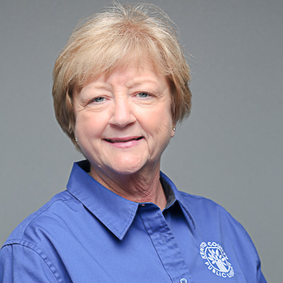
Introduction to Online Learning
Thursday, February 16th • 1:00 – 2:00 PM
Discover all the great classes you can take for free online at KCPL.
Explore careers, expand your computer skills, and try out new techniques from the comfort of your home.
We'll cover Learning Express, Gale Course, and online Microsoft Office training.
Taught by our patient System Technician and Instructor Pam Baker.

Slide 19
Consider a Contract or Survival Job
Amazon
Fidelity Investments
Lexus River Center
Norwalk Tours
Fedex, UPS, DHL
Public School Systems (Substitute Teaching, Bus Driver)
Leslie Deshler, Bullseye Talent Solutions, 513-676-2439

Slide 21
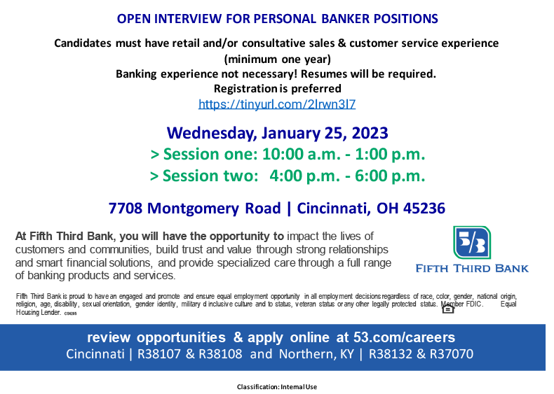

Slide 22
Health Insurance
65 yrs
under
over
Professional Association
Affordable Care Act
Veteran
Medicade
Cobra
Private Short
Term
Medicare
Spousal
Medi-Share

Slide 23
Financial Wellness in Job Transition
Identify your greatest concerns
Take steps to mitigate those concerns
Get better sleep!

Slide 24
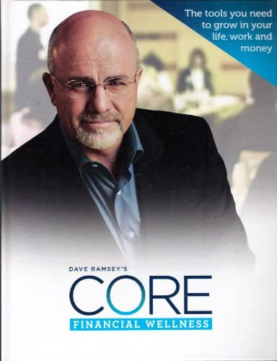
Additional Resources
Unemployment Compensation:
https://unemployment.ohio.gov/PublicSelfServiceChoice.html
https://uiclaims.des.ky.gov/ebenefit/
Ohio Unemployment Enrollment Timeline and other FAQs:
http://jfs.ohio.gov/unemp_comp_faq/faq_elig_definitions1.stm
Online Budgeting Tools:
https://www.goodfinancialcents.com/best-free-online-budgeting-tools
Affordable Care Act:
WWW.Healthcare.Gov
Over 65 Years Old (Medicare):
WWW.Medicare.Gov
Veterans Insurance:
https://www.va.gov/health
Faith Based Insurance:
https://www.healthcare.com/info/Obamacare-alternatives/what-is-faith-based-healthcare

Slide 25
Questions?
Visit the Library online for resources to help in your job search:
www.kentonlibrary.org/job-search-central
John Payton, paytonjohnr6@gmail.com, 513-259-5034
www.kentonlibrary.org
859-962-4000
Covington Branch
502 Scott Blvd.
Covington, KY 41011
Erlanger Branch
401 Kenton Lands Road
Erlanger, KY 41018
William E. Durr Branch
1992 Walton-Nicholson Road
Independence, KY 41051

