Slide 1
CybERSECURIty
FOR THE REAL WORLD
Dave Hatter, CISSP, CCSP, CSSLP, CISA, Security +, Network+, PMP, ITIL V3
Cyber Security Consultant
Intrust IT
linkedin.com/in/davehatter
twitter.com/davehatter
www.youtube.com/user/davidlhatter

Slide 2
My goals for today
Educate you
Motivate you
Provide actionable advice
Have fun
Notes:
Scare the crap out of you!
https://www.zdnet.com/article/the-scariest-hacks-and-vulnerabilities-of-2019/

Slide 3
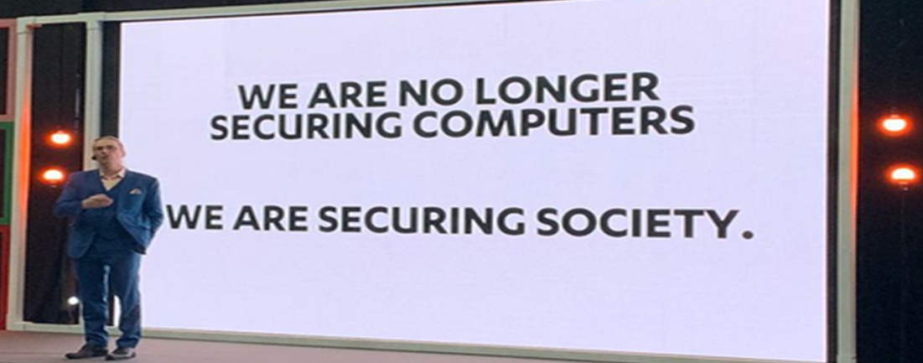
Notes:
Mikko

Slide 4
Notes:
Warnings from WH, FBI, DHS

Slide 5
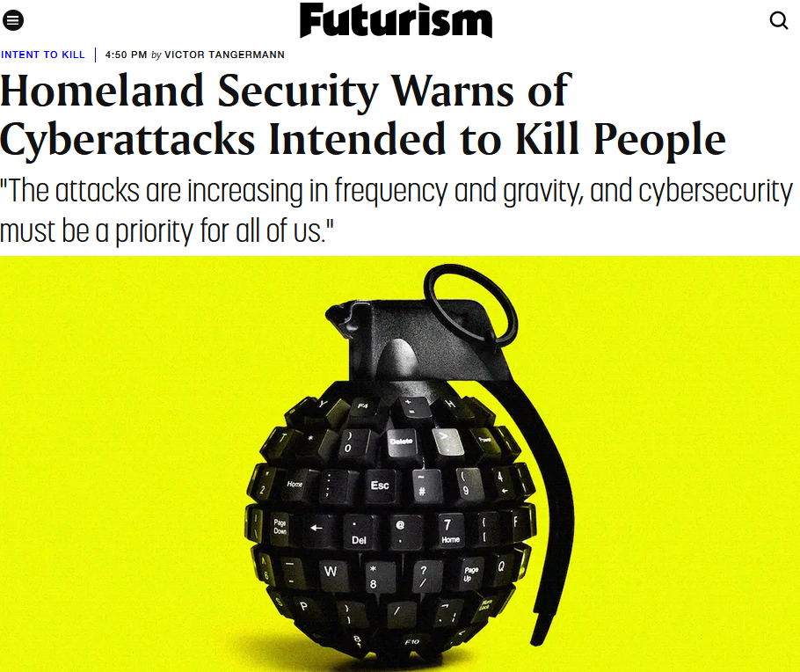
Notes:
Warnings from WH, FBI, DHS

Slide 6
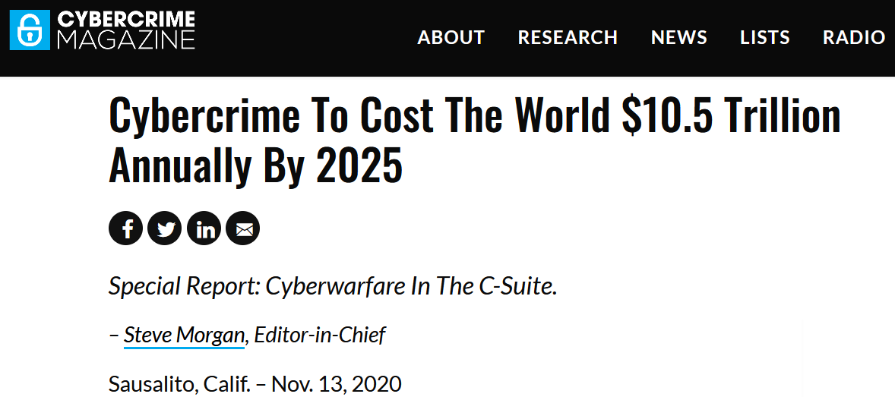
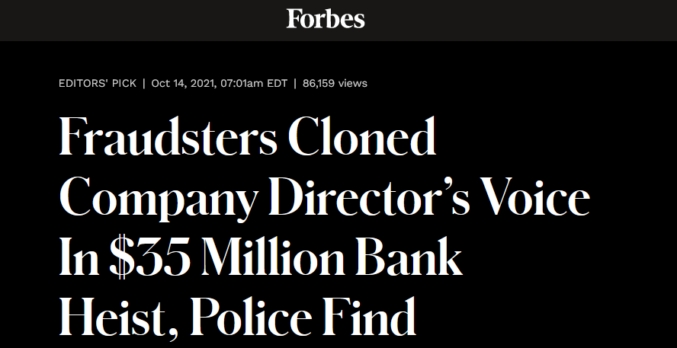
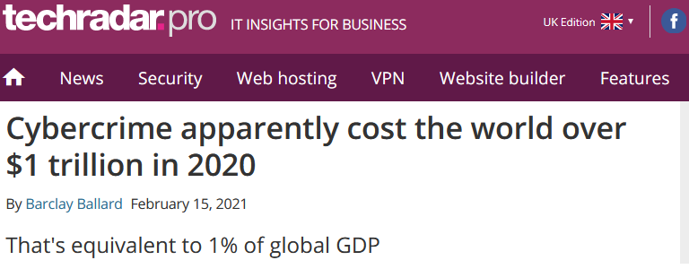
Ripped from the headlines…
Notes:
ransomware attacks globally surged 40 per cent to reach 199.7 million hits in the third quarter of this year, according to a report from cybersecurity firm SonicWall.
https://phoenixnap.com/blog/ransomware-statistics-facts

Slide 7
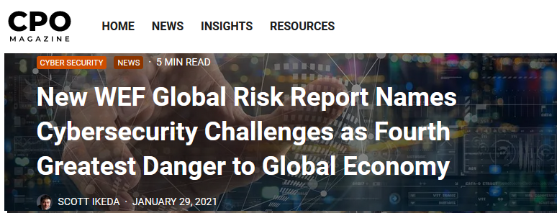
Ripped from the headlines…

Slide 8
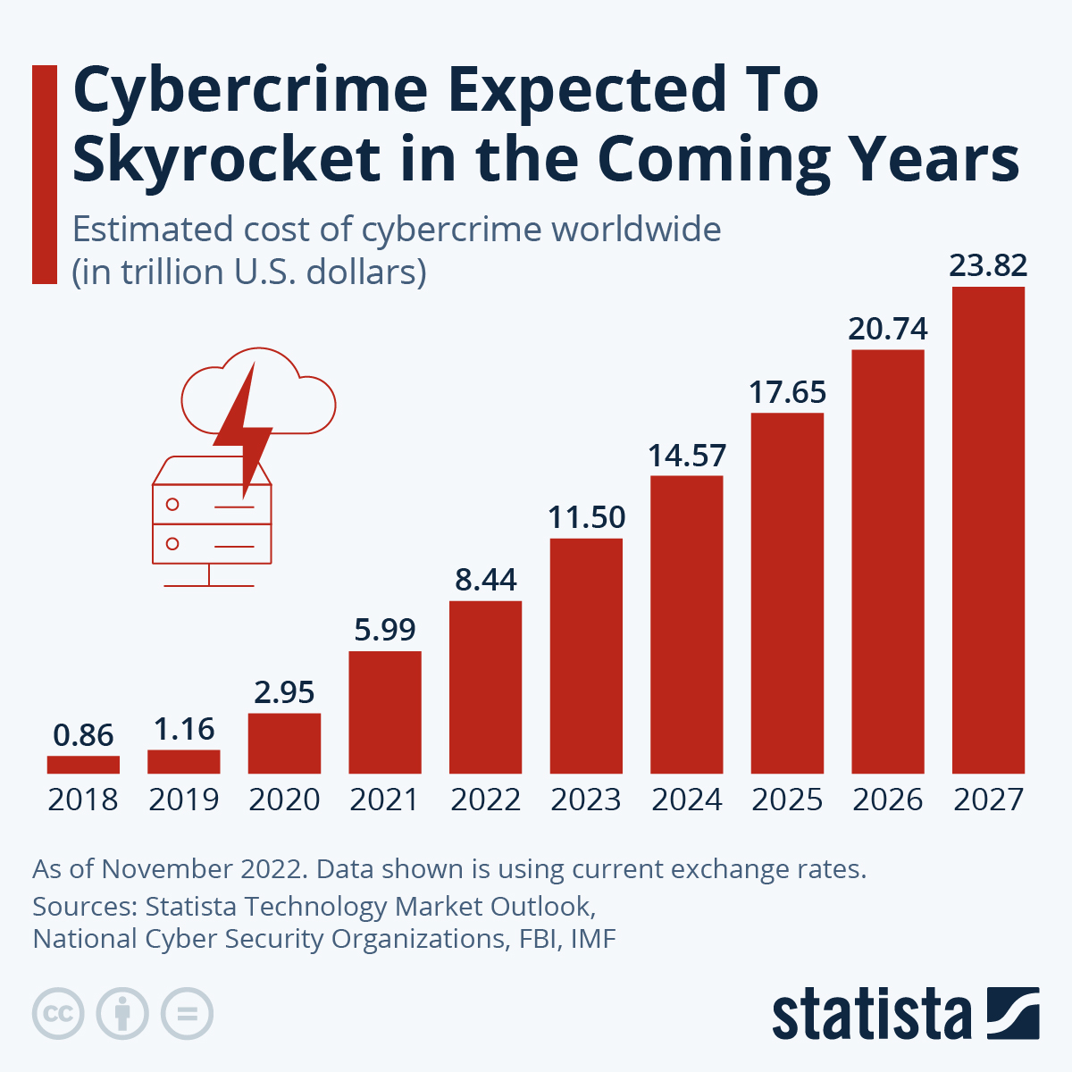
By the numbers…

Slide 9
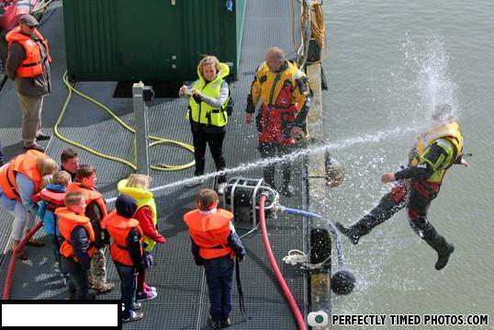
Notes:
Buckle up!

Slide 10
Cybersecurity myths
My organization is too small or insignificant to be a target
My data (or the data I have access to) isn’t valuable
Attacks are always sophisticated or technically complex
New software and devices are secure out-of-the-box
Cybersecurity requires a huge financial investment

Slide 11
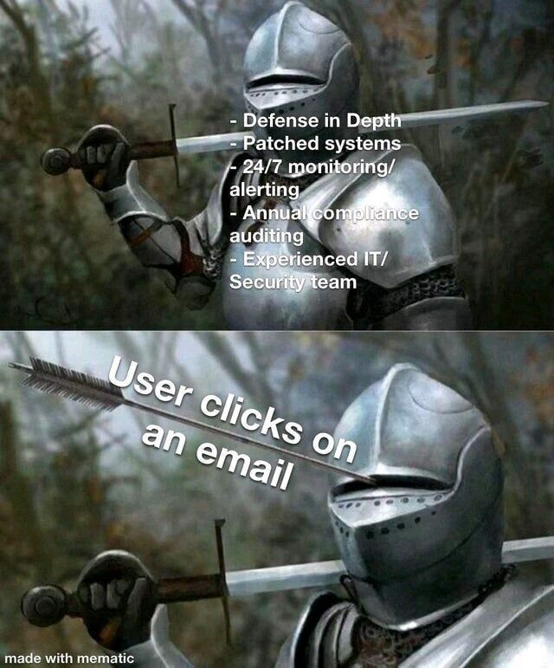

Slide 12
Why this is happening now
Increasing use of technology in all facets of our lives
Scalable computing resources on-demand (cloud)
Untraceable worldwide communications (encryption)
Virtual international currency (cryptocurrency)
And…

Slide 13
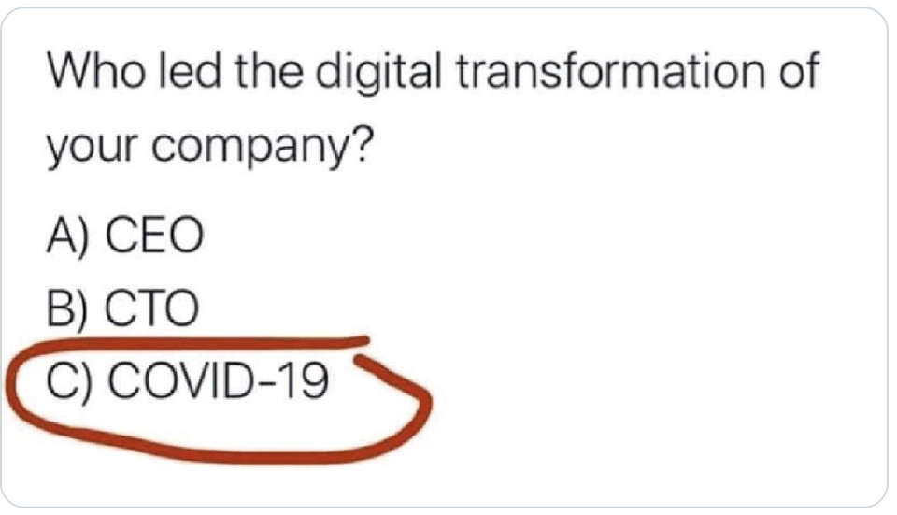
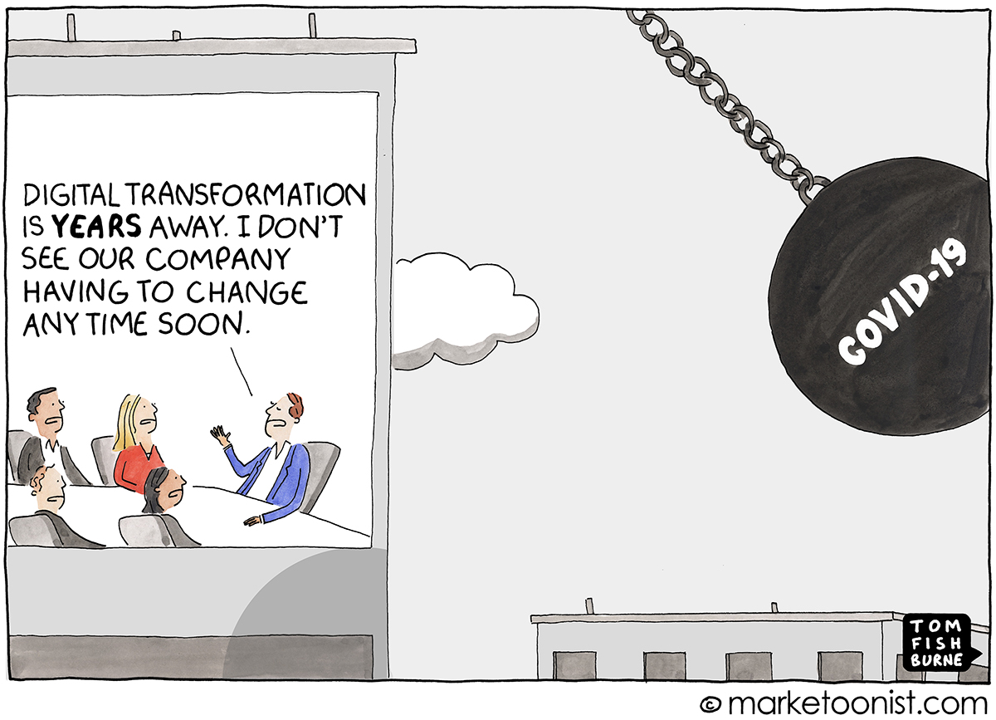
...Digital transformation is upon us

Slide 14
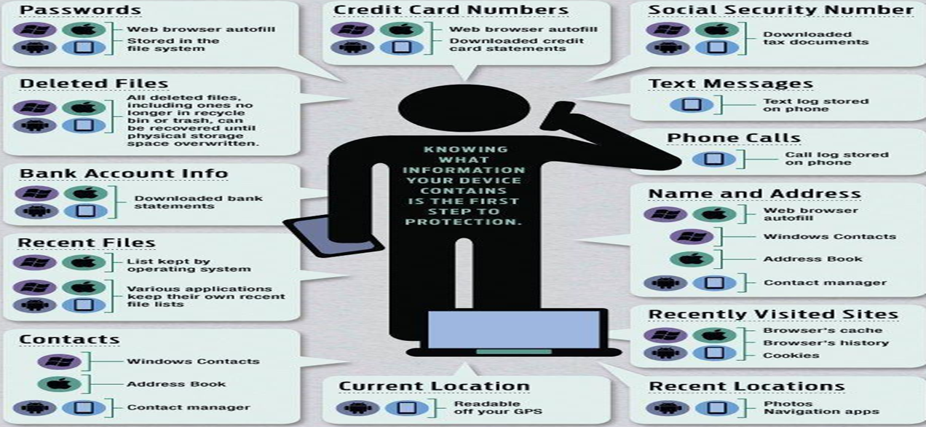
…Surveillance Capitalism
Notes:
https://www.thecybersecurityhub.com/

Slide 15
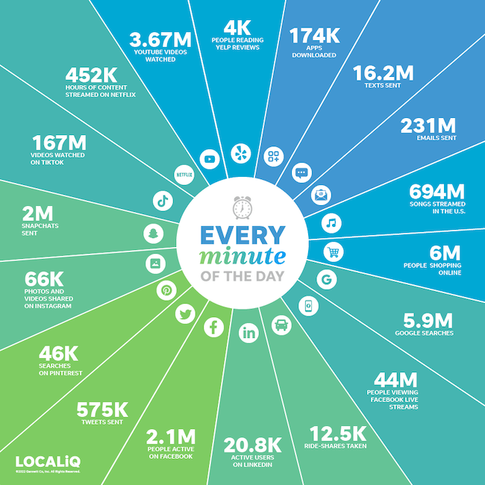
And… 2022 Internet Minute
Notes:
“Over 2.5 quintillion bytes of data are created every single day, and it’s only going to grow from there. By 2020, it’s estimated that 1.7MB of data will be created every second for every person on earth.” – Sixth Annual Domo report

Slide 16
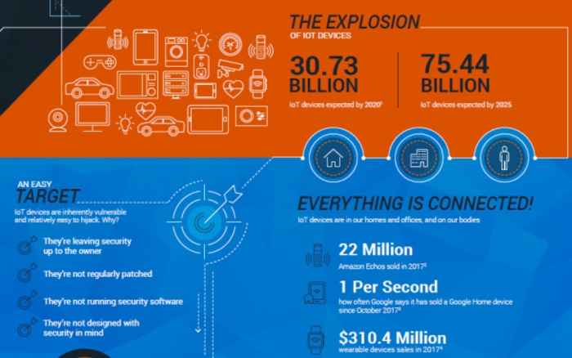
…The attack surface grows daily

Slide 17
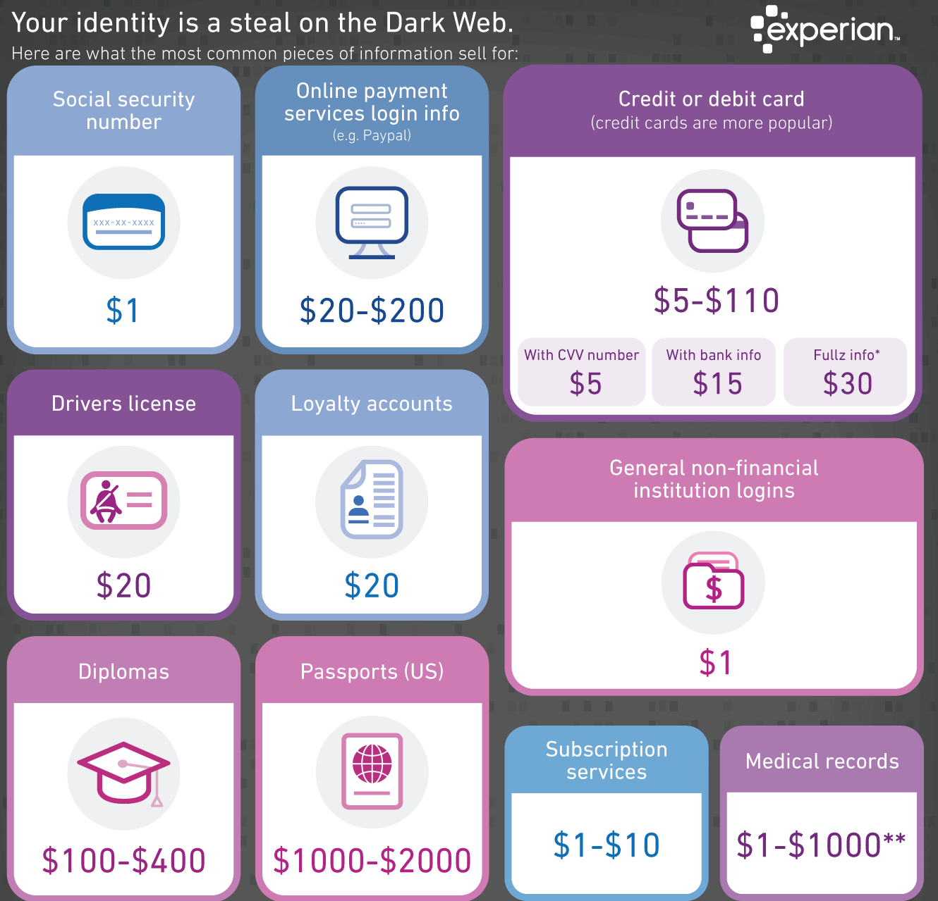
…Data is increasingly valuable

Slide 18
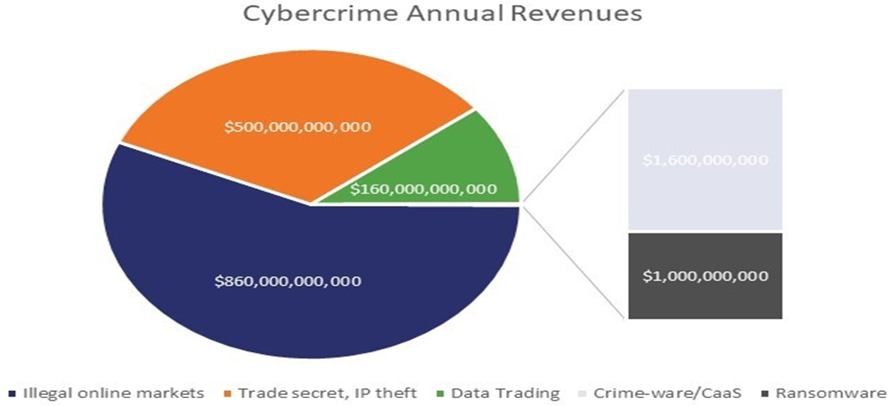
…Crime has gone digital
Cyberattacks are increasing in frequency, sophistication, impact and cost
A study by Dr. Michael McGuire puts value of the cybercrime economy at $1.5 trillion
Cybercriminals are rarely prosecuted
Notes:
In their 2020 Global Risks Report, WEF said that in the US, the likelihood of catching cybercrime actors and hauling them into court is estimated to be as low as 0.05%.
Walmart, generated mind-blowing $514 billion in revenue in 2019
Cybercrime earns 12 times that
More than Tesla, Facebook, Microsoft, Apple, Amazon, and Walmart combined - $1.28 trillion

Slide 19
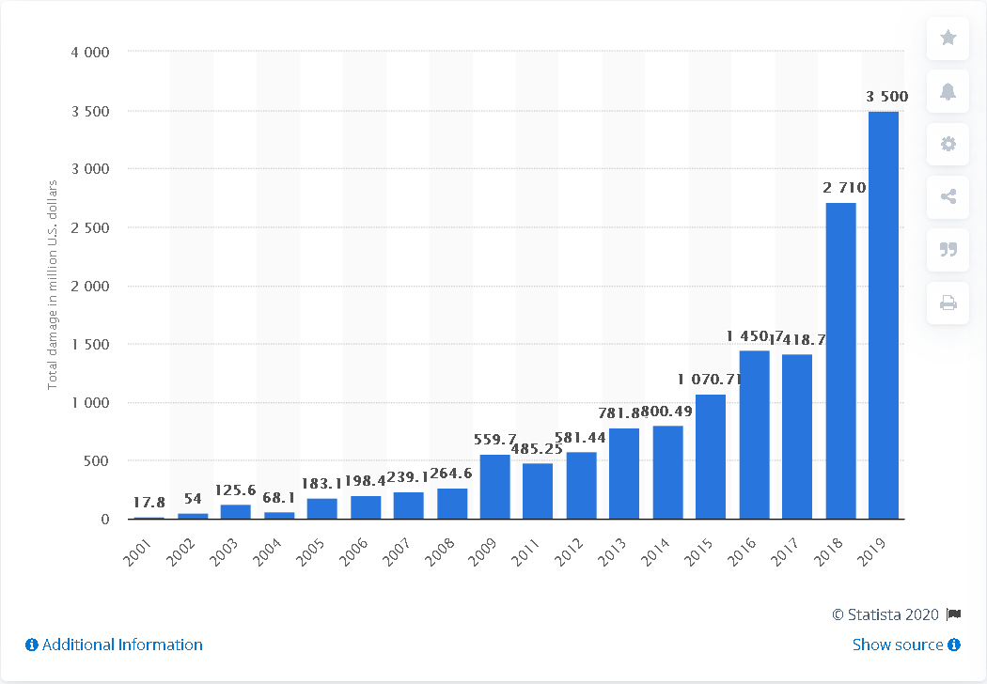
Cybercrime damage in $ per IC3

Slide 20
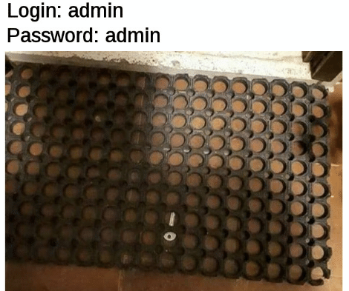
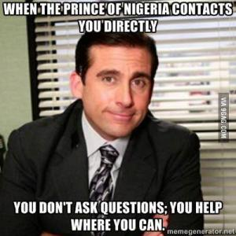
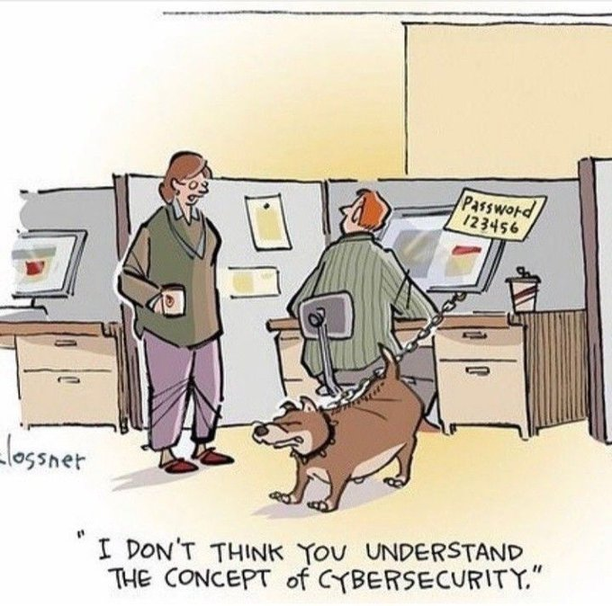
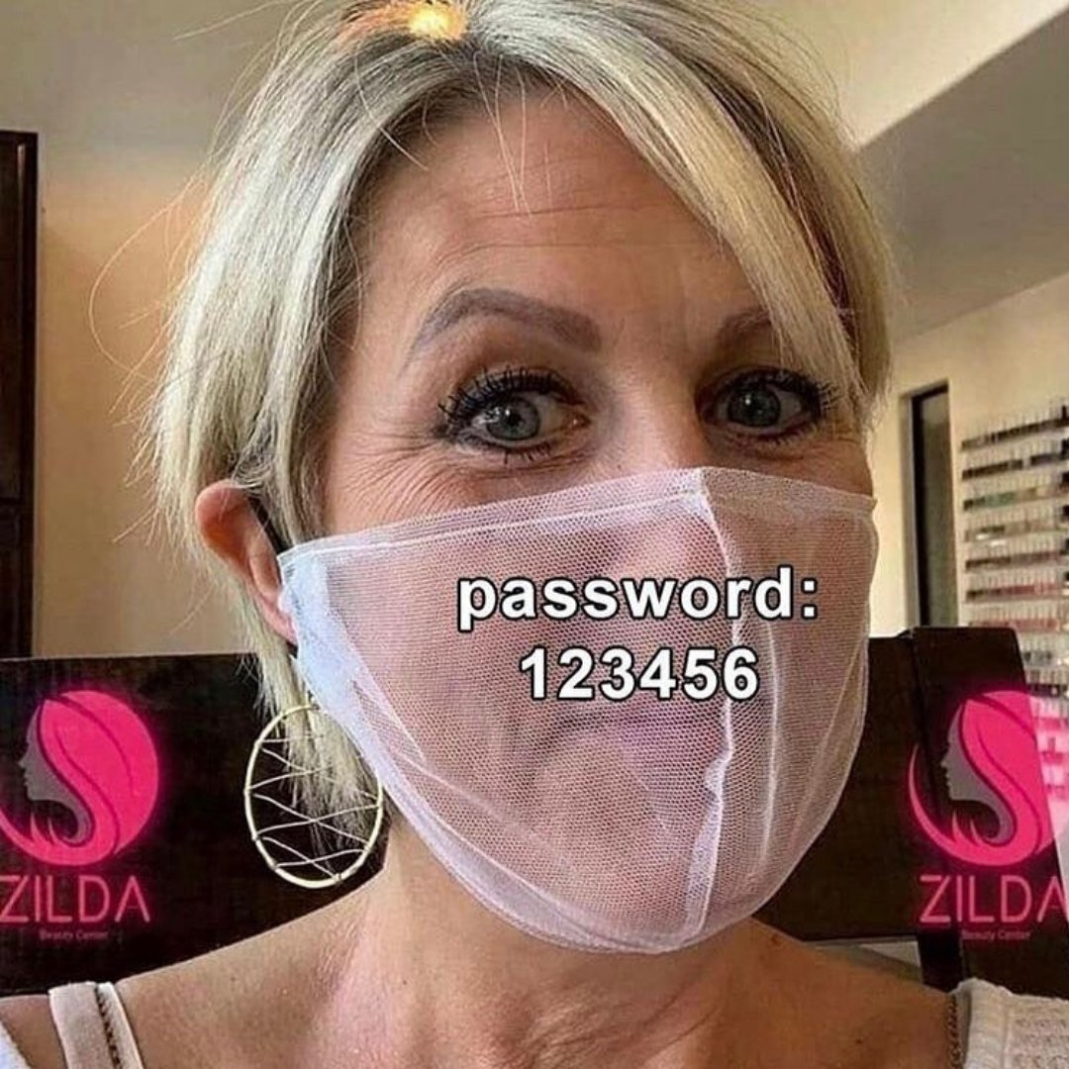
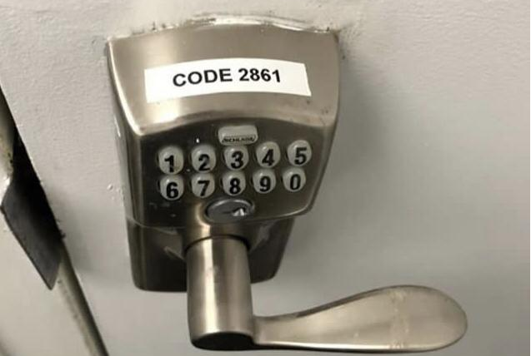
…People are the weakest link

Slide 21
Guiding principals of security
Impenetrable security is nearly impossible and very expensive
Focus on risk
Take a layered approach
Threats emerge and evolve constantly
Education and awareness are critical
Maintain a very healthy dose of skepticism/paranoia
Notes:
Just because you’re paranoid doesn’t mean they’re not out to get you
“Attackers flow like water and follow the path of least resistance” Forrester’s Jeff Pollard.
If you’re not paying with money, you’re paying with data

Slide 22
3 simple steps to remember
Stop
Think
Protect – Be a human firewall
Notes:
Ask yourself: ‘Is what I’m being asked to do normal?’, ‘Is there anything strange about this email / instruction?’

Slide 23
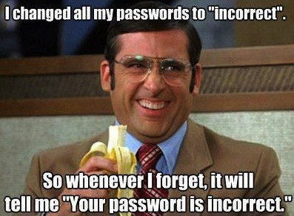
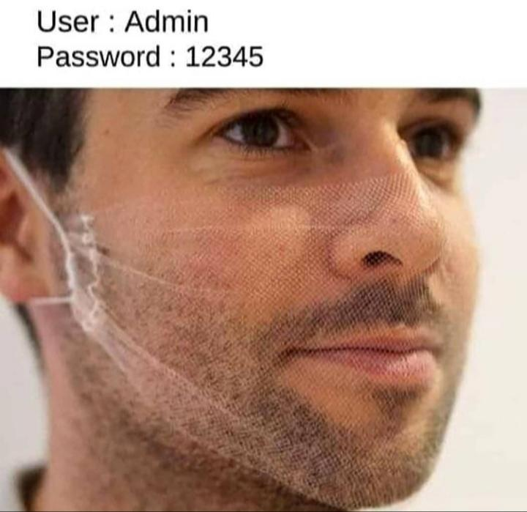
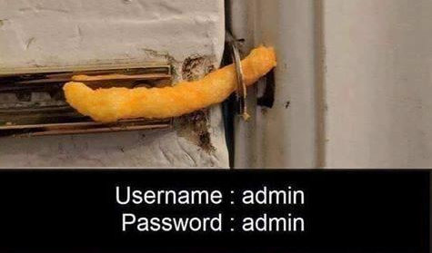
Threats: Poor credential management
The recent Verizon Data Breach Investigations Report says compromised passwords are responsible for 81% of hacking-related breaches
Notes:
Average 8 character password can be breached under 2 hours

Slide 24
Threats: Unpatched Software
A Ponemon Institute survey found 57% of security breaches were due to vulnerabilities in unpatched software
34% of these cybercrime victims were aware of holes but didn’t patch them in time.
37% of breach victims don’t perform regular scans to find vulnerabilities in their own systems
Patching gaps are an issue:
Some IT teams are unaware of the updates that are available
Some know these updates are available, but don’t have the resources or strategies implement the patches

Slide 25
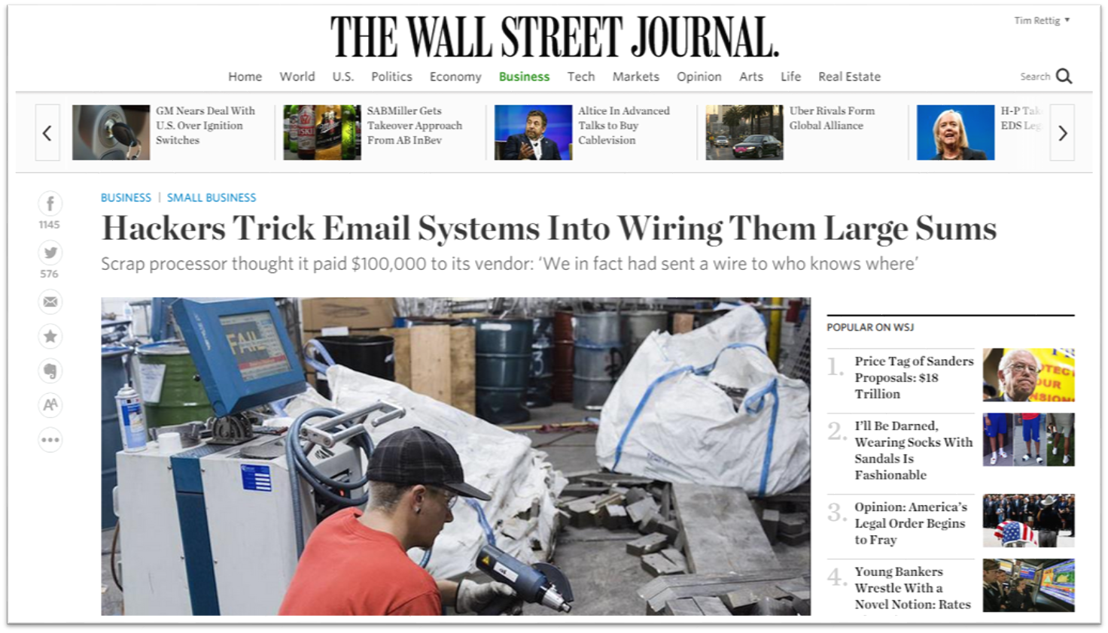
Threats: Spoofing
"Spoofing, in general, is a fraudulent or malicious practice in which communication is sent from an unknown source disguised as a source known to the receiver. Spoofing is most prevalent in communication mechanisms that lack a high level of security." – Techopedia
Spoofing leads to:
Phishing
Vishing (Voice based)
Smishing (Text based)
Doppleganger or Lookalike sites

Slide 26
Threats: Synthetic Media
"Synthetic media (also known as AI-generated media, generative AI, personalized media, and colloquially as deepfakes) is a catch-all term for the artificial production, manipulation, and modification of data and media by automated means, especially through the use of artificial intelligence algorithms, such as for the purpose of misleading people or changing an original meaning.” - Wikipedia
Examples:
thispersondoesnotexist.com
www.youtube.com/@TheFakening
https://news.mit.edu/2020/mit-tackles-misinformation-in-event-of-moon-disaster-0720
ChatGPT
VALL-E

Slide 27
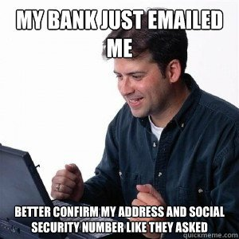
Threats: Phishing
“Cybercrime in which a target or targets are contacted by email, telephone or text message by someone posing as a legitimate institution to lure individuals into providing sensitive data such as personally identifiable information, banking and credit card details, and passwords.” – Phishing.org
Types of Phishing include:
Spear phishing
Whaling
Vishing
Smishing
Notes:
Spear phishing personalized and socially engineered
91% of attacks Whaling specific targeting
Social engineering including Deepfakes makes this even more of a threat
https://youtu.be/6gQX2duuJJQ

Slide 28
Threats: Phishing
Notes:
Not many obvious red flags here
Hover over links
Out-of-band verification

Slide 29
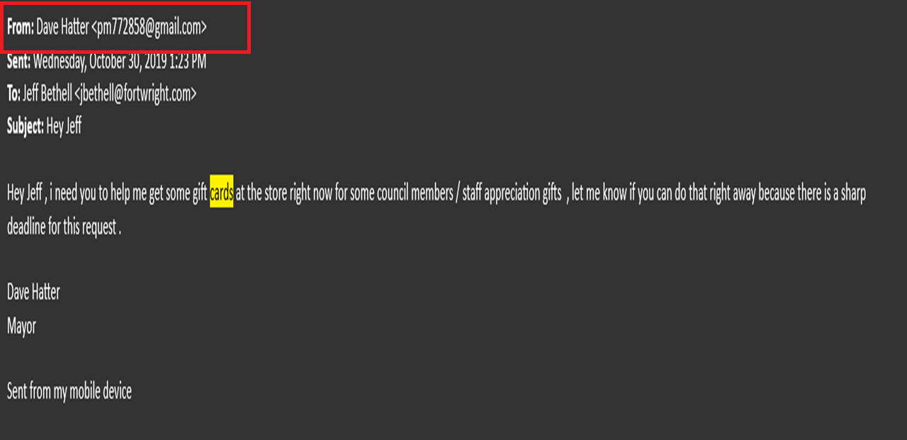
Threats: Phishing

Slide 30
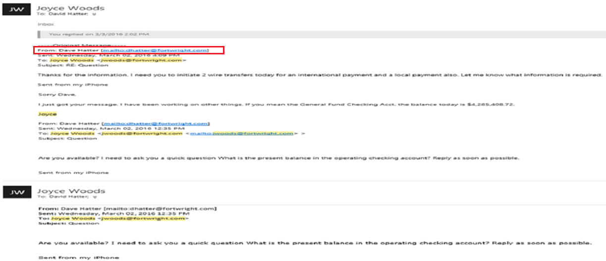
Threats: Phishing

Slide 31
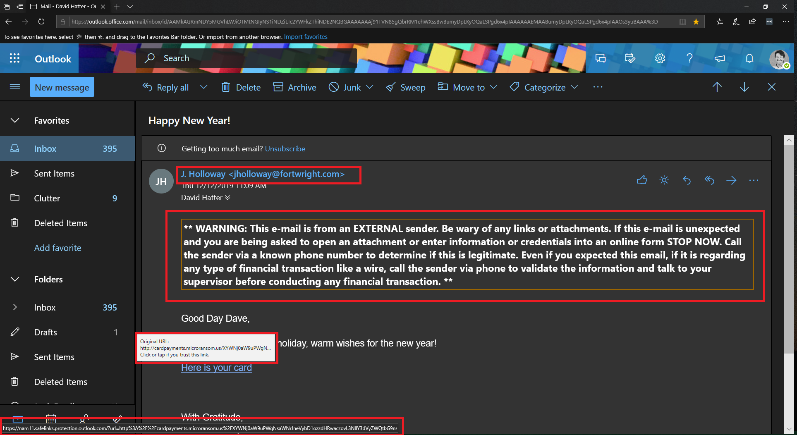
Threats: Phishing

Slide 32
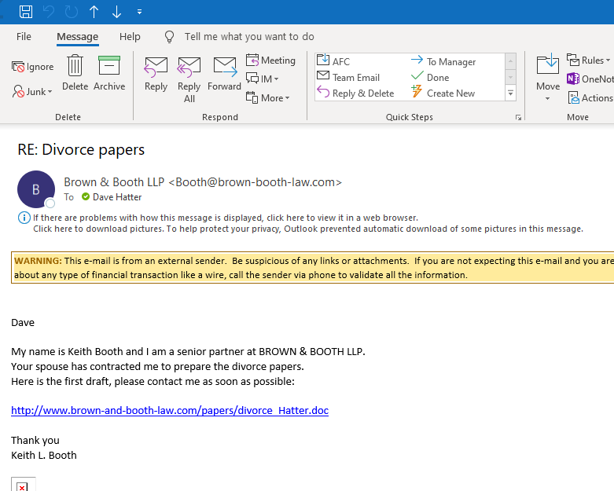
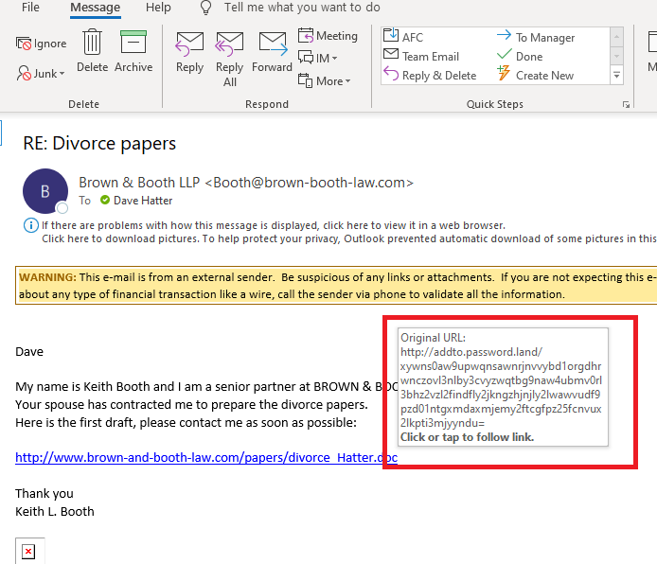
Threats: Phishing

Slide 33
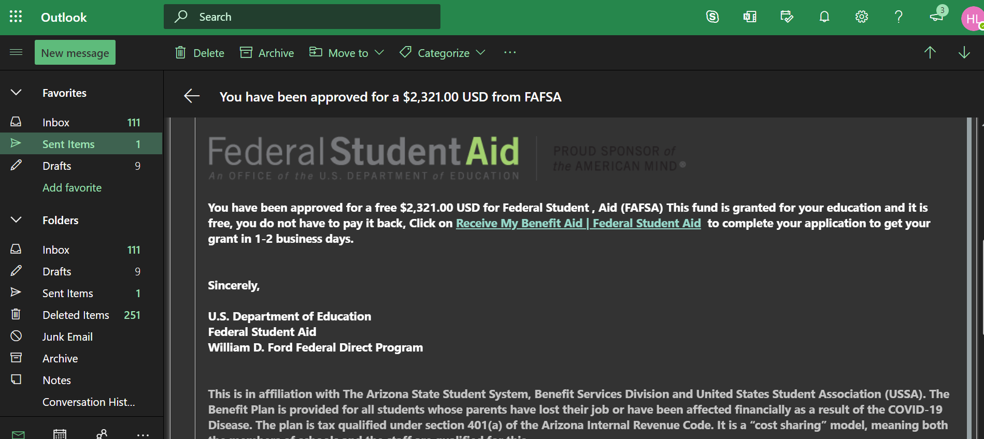
Threats: Phishing
Notes:
Not many obvious red flags here
Hover over links
Out-of-band verification

Slide 34
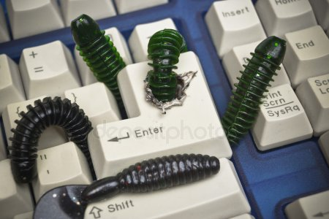
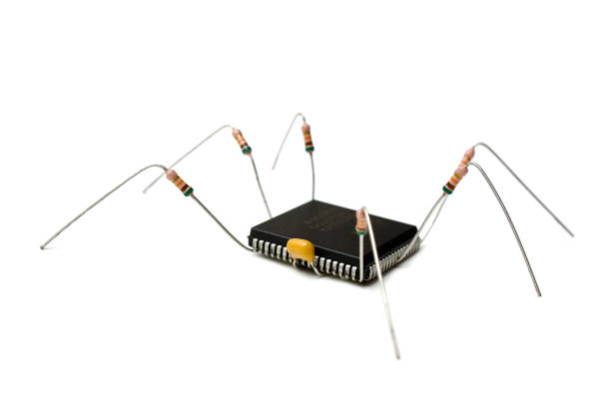
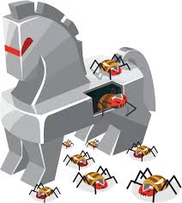
Threats: Malware
Viruses
Worms
Rootkits
Keystroke Loggers
Adware
Bots
Zombies
Crypto miners
Notes:
Adware – istock
Beware macros

Slide 35
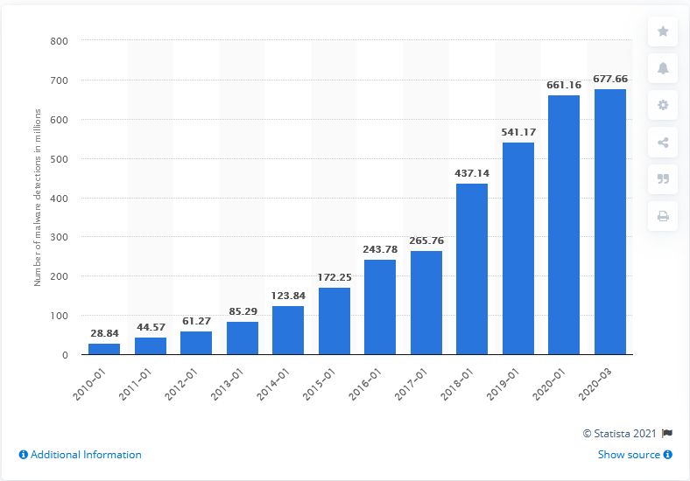
Malware growth
Notes:
There are well over a dozen operators in the ransomware-as-a-service (RaaS) game, each with a host of affiliates that focus on enterprise targets across the world.
https://www.statista.com/statistics/680953/global-malware-volume/

Slide 36
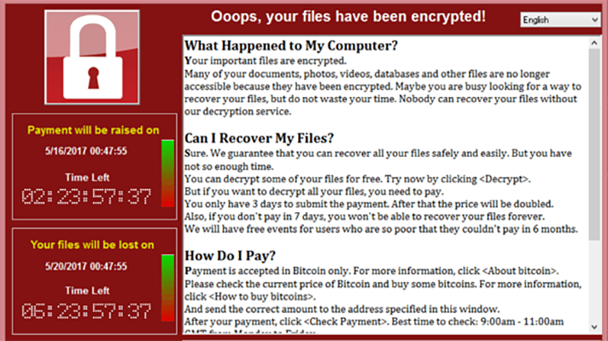
Threats: Ransomware
Malware that encrypts data and demands a ransom
The losses from ransomware attacks have increased significantly, according to complaints received by IC3 and FBI case information
Ransom demands increased more than 10 times in one year
Exfiltration/Doxxing Threat
Delivered many ways:
Phishing
Infected web sites
Compromised devices
Open ports
Notes:
77% of Ransomware Attacks Involved the Threat to Leak Exfiltrated Data (+10% From Q4 2020)
The average ransom tops $1.4 million and the average cost of recovery is more than $700,000 for organizations that did not pay a ransom, according to Sophos' May survey.
"RDP is still 70-80% of the initial foothold that ransomware actors use," said FBI Special Agent Joel DeCapua.
FBI: Don’t pay the ransom
May be illegal to pay the ransom
https://www.nomoreransom.org/

Slide 37
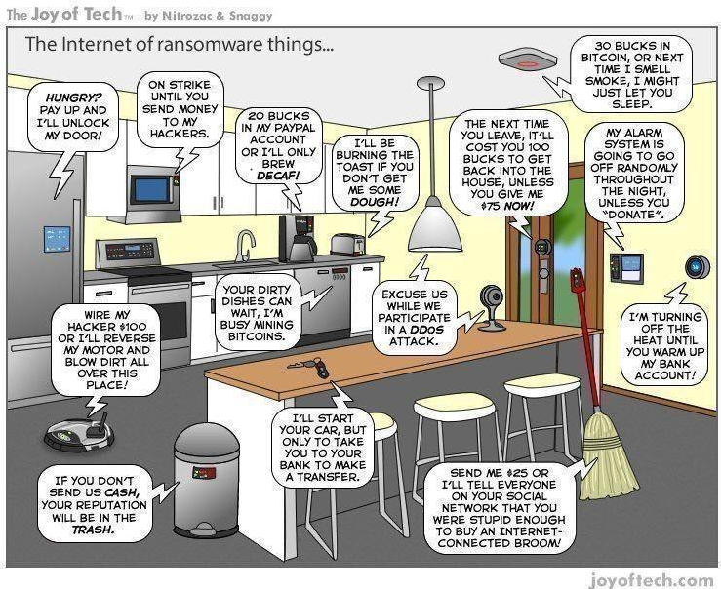
Threats: Internet of Things (IoT)
75 billion devices by 2025
Often not designed with security in mind
Vector to attack a network
Can be used to spy on you and your organization
Can host malware
Notes:
Understand risks/rewards before adding them to your network

Slide 38
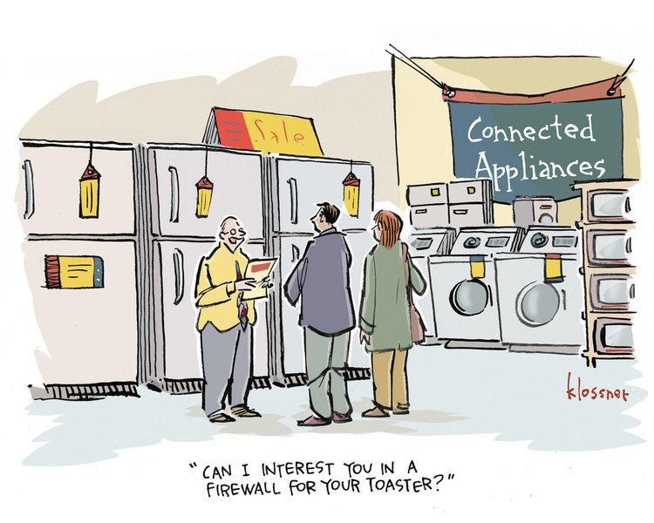
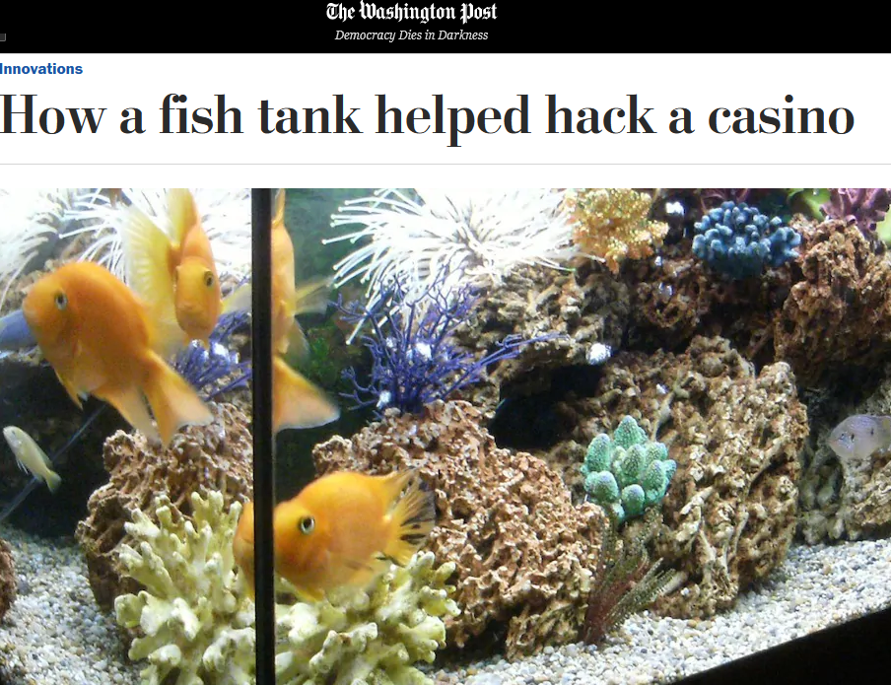
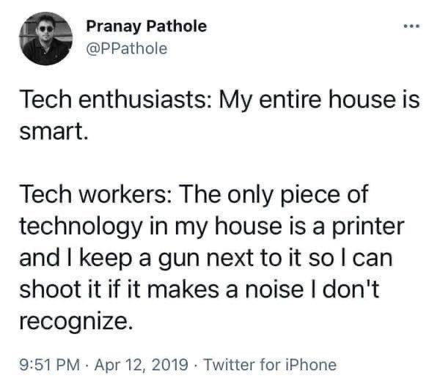
“Smart” devices…

Slide 39
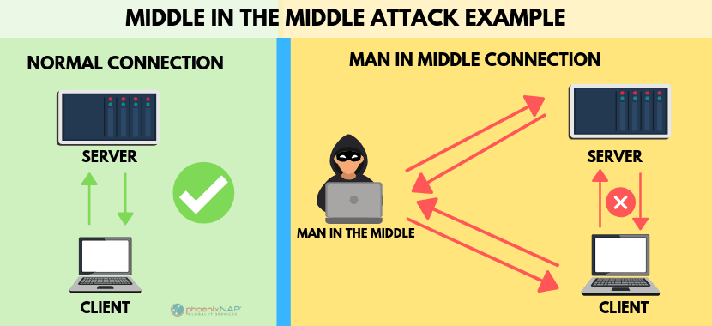
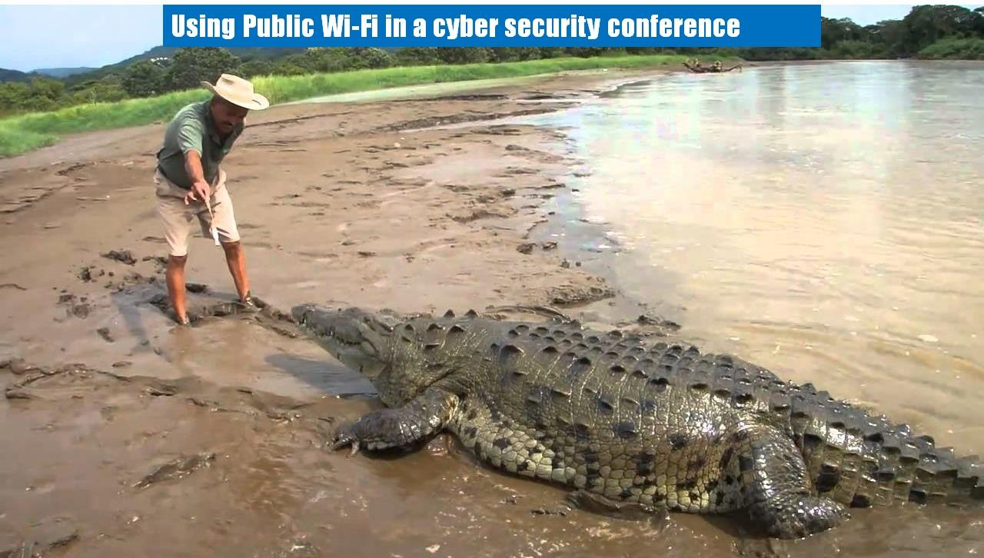
Threats: Public Wi-Fi
Information can be stolen
Malware can be planted
Notes:
“We’re concerned that people are trading security for convenience…People are doing things on free Wi-Fi that are really alarming” ― Doug Shadel
https://phoenixnap.com/blog/man-in-the-middle-attacks-prevention

Slide 40
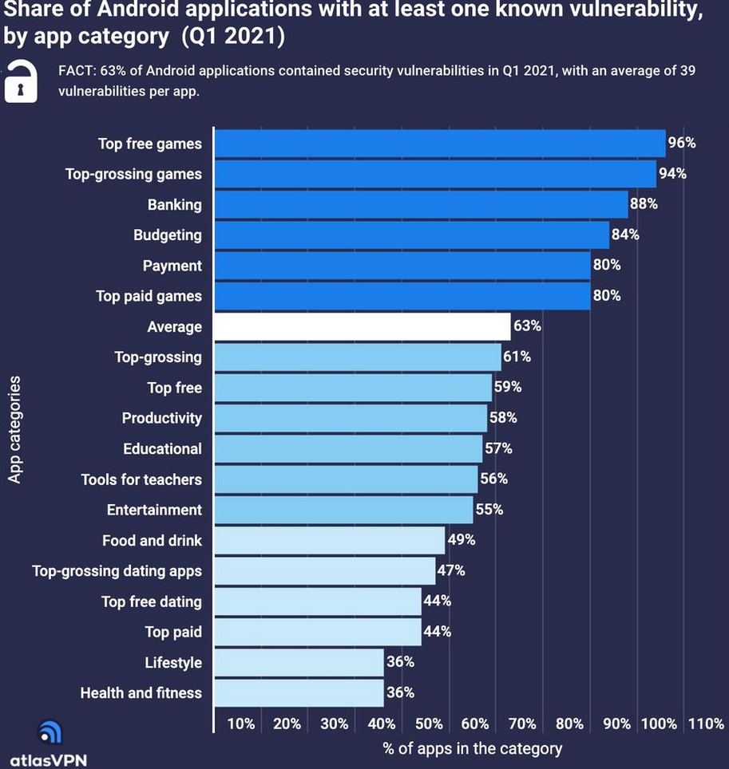
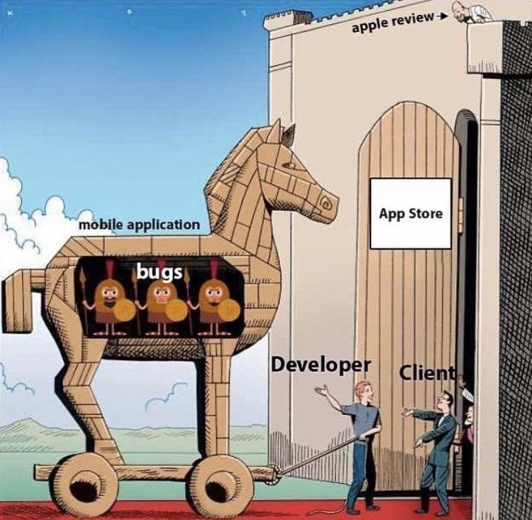
Threats: “Free” software
Many free apps are thinly veiled malware
172 malicious apps hosted on Google Play were installed more than 335 million times in September of 2019 and have been found in the Apple store too
Subscription scams
Data leakage
Notes:
Google also said it removed 700,000 bad apps in 2017
ZDNet, Cnet, PCMagazine, Consumer Reports
Read reviews
If you’re not paying with money you’re paying with data, You’re the product NOT the customer

Slide 41
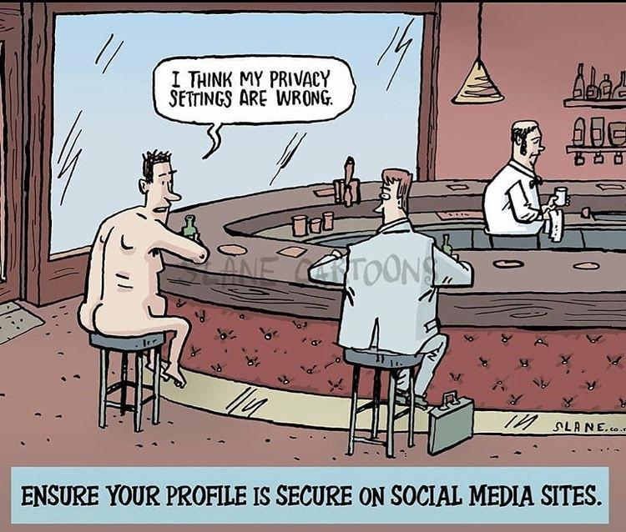
Threats: Social Media
New channels for attack
Conduit to deliver malware
Users freely share information that can be used for hacking and social engineering
Data loss
Billions of targets!
OSINT

Slide 42
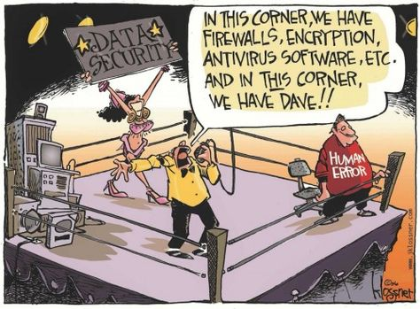
Defenses: Don’t be a “Dave”
Notes:
New research from Proofpoint has revealed that more than 99 percent of cyberattacks require human interaction to execute.

Slide 43
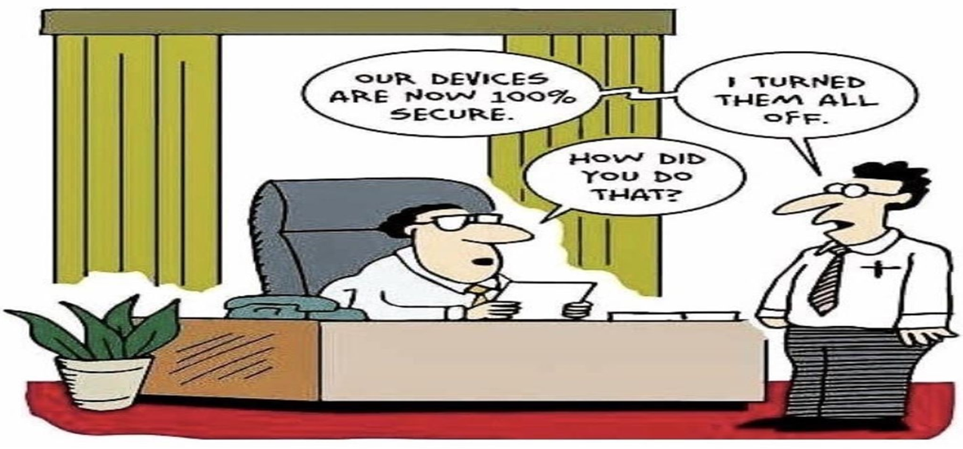
Defenses
Notes:
New research from Proofpoint has revealed that more than 99 percent of cyberattacks require human interaction to execute.

Slide 44
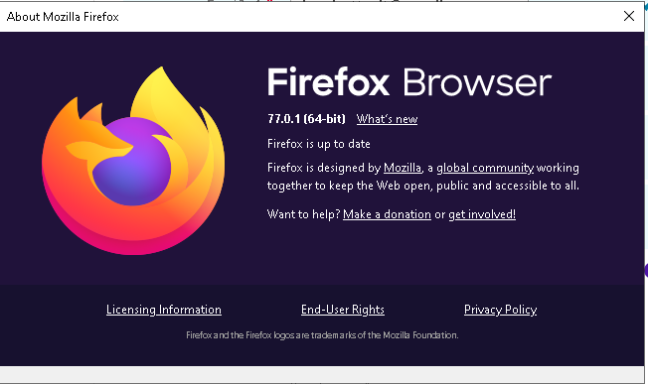
Defenses: Software updates
Vendors regularly release updates
Updates may contain productivity and/or security fixes
ALL devices that contain software should be updated
Automate this process if you can
Notes:
Microsoft and Google have both recently indicated the MFA can stop 99% of all automated attacks

Slide 45
Defenses: Password Hygiene
Use strong, unique passwords for every account
A passphrase is better. e.g. “1 l0ve pizz@ with 0ni0ns”
Use a password manager with MFA.
Check the Dark Web for leaked creds
Notes:
Microsoft and Google have both recently indicated the MFA can stop 99% of all automated attacks
Some of the best include LastPass, Dashlane & Keeper
Easy to Remember, Hard to Guess
https://spycloud.com/new-nist-guidelines/

Slide 46
Defenses: Multi-factor Authentication
Aka Two-factor Authentication or Two-Step Verification
Microsoft and Google have recently indicated MFA can stop 99% of all automated attacks
Enable MFA everywhere
Use an authenticator app like Authy rather than SMS based OTPs
Notes:
Microsoft and Google have both recently indicated the MFA can stop 99% of all automated attacks.
“Multi-factor Authentication (MFA) is the least you can do if you are at all serious about protecting your accounts. Use of anything beyond the password significantly increases the costs for attackers, which is why the rate of compromise of accounts using any type of MFA is less than 0.1% of the general population.” - Microsoft

Slide 47
Defenses: Endpoint Protection
Vendors regularly release updates
Also known as anti-malware or anti-virus software
Update definitions
Disable everything and enable functionality as required
Consider more than one
Notes:
Microsoft and Google have both recently indicated the MFA can stop 99% of all automated attacks

Slide 48
Defenses: Firewall
Use a firewall to protect your device / network
Your router can be configured to be a firewall
Windows comes with a software firewall
Notes:
Microsoft and Google have both recently indicated the MFA can stop 99% of all automated attacks

Slide 49
Defenses: Encryption
Encryption scrambles data so that it can only be unscrambled with the appropriate key
Use Encryption (at rest and in motion)
Enable BitLocker for data a rest
Look for https:// in the browser
Use encryption to protect email
Use encryption to protect messaging
Notes:
Microsoft and Google have both recently indicated the MFA can stop 99% of all automated attacks

Slide 50
Defenses: Virtual Private Network
A VPN creates an encrypted connection
May not be required if all your apps are cloud based
Never use public Wi-Fi without a VPN
The best include NordVPN, IPVanish and TunnelBear
Vet the VPN software carefully!
Notes:
Microsoft and Google have both recently indicated the MFA can stop 99% of all automated attacks

Slide 51
Defenses: Router
Change default password to a strong password
Enable WPA2 or higher encryption
Enable firewall
Update regularly
Use a guest network
Notes:
Microsoft and Google have both recently indicated the MFA can stop 99% of all automated attacks

Slide 52
Defenses: Vet software carefully
Do your homework and vet apps
Don’t download the latest viral thing
This applies to desktop apps, mobile apps, and browser extensions
Delete apps you don’t need
Use privacy friendly platforms & apps
Notes:
Microsoft and Google have both recently indicated the MFA can stop 99% of all automated attacks

Slide 53
Defenses: Backup
Backup data and verify the backup integrity
3-2-1 rule: At least three versions of your data on two different media, one of which is off-site
Look for a service that allows you to define a personal encryption key. If not, read the privacy policy carefully
Tools like OneDrive can be a basic backup
iDrive and BackBlaze rate highly
Notes:
Microsoft and Google have both recently indicated the MFA can stop 99% of all automated attacks

Slide 54
Defenses: Hardening
Configuring systems to make them more difficult to hack
For example, change default passwords and remove unnecessary accounts
Lock the screen when not in use
Don’t make work devices visible on the network
Check out the CIS Benchmarks
Notes:
Microsoft and Google have both recently indicated the MFA can stop 99% of all automated attacks

Slide 55
Defenses: Limit digital footprint
Delete old unused email accounts and/or old emails
Delete old content from social media platforms
Disconnect apps and platforms to stop information leakage
Lock down social media and understand the privacy settings
Use a Virtual Private network (VPN)
Use privacy friendly platforms and tools:
DuckDuckGo (search)
Tor
Firefox
Brave
Lock down your browser and use extensions to limit tracking

Slide 56
Defenses: Limit digital footprint
Create "burner" accounts
Turn off services like location and Bluetooth when not needed
Ensure that cloud-based backups are secured with a password, MFA where possible, and encrypted
Do Darkweb searches for leaked data
Use Google Alerts to find information online
Work with a company like Delete Me who for a fee will provide annual "protection plans" that guarantee removal of your personal data from data-broker services
Understand that old content may be archived somewhere like the Wayback Machine: https://archive.org/web/web.php

Slide 57
Defenses: Employment Scams
Red flags:
You get an offer with no application, interview, or discussion
You’re asked to wire money or for credit card information
You’re told to pay for training and/or equipment but will be reimbursed
You’re asked to pay for a credit report as part of the process
You’re asked for sensitive information like your social security number or driver's license number early in the process
You are promised high pay for not much work or work at home
You're asked to cash a check and forward some of the money to a third party
You never have the option to meet with people in person
You can’t find a company website or contact information
Notes:
Tell JR’s story
Go out of band

Slide 58
Be vigilant and keep learning!
Notes:
“The methods that will most effectively minimize the ability of intruders to compromise information security are comprehensive user training and education. Enacting policies and procedures simply won't suffice. Even with oversight the policies and procedures may not be effective: my access to Motorola, Nokia, ATT, Sun depended upon the willingness of people to bypass policies and procedures that were in place for years before I compromised them successfully” ― Kevin Mitnick

Slide 59
Cybersecurity myths dispelled
My organization is too small or insignificant to be a target
My data (or the data I have access to) isn’t valuable
Attacks are always sophisticated or technically complex
New software and devices are secure out-of-the-box
Cybersecurity requires a huge financial investment

Slide 60
Hope and denial are NOT a strategy!
Remember the 3 simple steps
Stop
Think
Protect – Be a human firewall

Slide 61
Skepticism and Security
Notes:
“If you spend more on coffee than on IT security, you will be hacked. What's more, you deserve to be hacked” - Richard Clarke, Special Advisor to the President on cybersecurity and cyberterrorism, Bush Administration

Slide 62
For more information follow:
Bruce Schneier:@schneierblog
Kevin Mitnick: @kevinmitnick
US-CERT: @USCERT_gov
SecurityWeek: @SecurityWeek
Center for Internet Security: @CISecurity
MSRC: @msftsecresponse
NIST Cyber: @NISTcyber
Intrust IT: @IntrustIT
MSRC: @msftsecresponse
Microsoft Secure: @msftsecurity
RSA: @RSAsecurity
Mikko Hypponen: @mikko
Troy Hunt: @troyhunt
CSOnline: @CSOonline
Me: @DaveHatter

Slide 63
Additional Resources
www.mcaffee.com
www.symantec.com
www.twofactorauth.org
www.safer-networking.org
www.webopedia.com
www.opendns.com/
www.hackerwatch.org
www.haveibeenpwned.com
www.twofactorauth.org
www.knowbe4.com
www.antiphishing.org
www.microsoft.com/security
www.idtheftcenter.org/facts.shtml
www.ic3.gov/default.aspx
www.ftc.gov/bcp/conline/pubs/alerts/phishingalrt.htm
enterprise.verizon.com/resources/reports/dbir/
www.sans.org/critical-security-controls/
https://www.us-cert.gov/ncas/current-activity/2019/11/06/cisa-launches-cyber-essentials-small-businesses-and-small-sltt
www.nist.gov/cyberframework
https://www.cisecurity.org/blog/cyber-hygiene-guidance-for-windows-10/
www.ftc.gov/tips-advice/business-center/small-businesses/cybersecurity
https://www.pcmag.com/roundup/256703/the-best-antivirus-protection
https://www.pcmag.com/roundup/296955/the-best-vpn-services
https://www.zdnet.com
http://www.cnet.com

Slide 64
Q & A
“It’s time for a cybersecurity zeitgeist in the West where cyber hygiene is a meme that is aggressively distributed by those who have mastered it and encouraged to be imitated by those who have experienced it.” - James Scott
Notes:
“You are an essential ingredient in our ongoing effort to reduce Security Risk.”― Kirsten Manthorne

Slide 65
Thank You!
Dave Hatter, CISSP, CCSP, CCSLP, CISA, Security +, Network+, PMP, ITIL V3
Intrust IT
linkedin.com/in/davehatter
twitter.com/davehatter
www.youtube.com/user/davidlhatter
Catch Tech Friday live on 55KRC at 6:30 AM every Friday on 550 AM or http://55krc.iheart.com
Catch Cyber Monday live on WTVG at 6:30 AM every Monday on 13 ABC or https://www.13abc.com/

