Slide 1
WHAT IS CHATGPT?
Dave Hatter, CISSP, CISA, CCSP, CSSLP, Security +, Network+, PMP, ITIL V3
Director of Business Growth
Intrust IT
linkedin.com/in/davehatter
twitter.com/davehatter
www.youtube.com/user/davidlhatter

Slide 2
Agenda
Where are we?
How’d we get here?
Threats
Defenses
Q&A
Notes:
Scare the crap out of you!
https://www.zdnet.com/article/the-scariest-hacks-and-vulnerabilities-of-2019/

Slide 3
My goals for today
Educate you
Motivate you
Provide actionable advice
Have fun
Notes:
Scare the crap out of you!
https://www.zdnet.com/article/the-scariest-hacks-and-vulnerabilities-of-2019/

Slide 4
“Machine intelligence is the last invention that humanity will ever need to make.” - Nick Bostrom
“Within a few decades, machine intelligence will surpass human intelligence, leading to The Singularity — technological change so rapid and profound it represents a rupture in the fabric of human history.” - Ray Kurzweil
Notes:
Scare the crap out of you!
https://www.zdnet.com/article/the-scariest-hacks-and-vulnerabilities-of-2019/

Slide 5
Intelligence
“The capacity for abstraction, logic, understanding, self-awareness, learning, emotional knowledge, reasoning, planning, creativity, critical thinking, and problem-solving. More generally, it can be described as the ability to perceive or infer information, and to retain it as knowledge to be applied towards adaptive behaviors within an environment or context.” - Wikipedia
Notes:
Scare the crap out of you!
https://www.zdnet.com/article/the-scariest-hacks-and-vulnerabilities-of-2019/

Slide 6
Artificial Intelligence (AI)
“perceiving, synthesizing, and inferring information—demonstrated by machines, as opposed to intelligence displayed by humans or by other animals. Example tasks in which this is done include speech recognition, computer vision, translation between (natural) languages, as well as other mappings of inputs.” - Wikipedia
Notes:
Scare the crap out of you!
https://www.zdnet.com/article/the-scariest-hacks-and-vulnerabilities-of-2019/

Slide 7
Artificial General Intelligence (AGI)
“a type of hypothetical intelligent agent. The AGI concept is that it can learn to accomplish any intellectual task that human beings or other animals can perform. Alternatively, AGI has been defined as an autonomous system that surpasses human capabilities in the majority of economically valuable tasks.” - Wikipedia
Notes:
Scare the crap out of you!
https://www.zdnet.com/article/the-scariest-hacks-and-vulnerabilities-of-2019/

Slide 8
Superintelligence
“a hypothetical agent that possesses intelligence far surpassing that of the brightest and most gifted human minds. "Superintelligence" may also refer to a property of problem-solving systems (e.g., superintelligent language translators or engineering assistants) whether or not these high-level intellectual competencies are embodied in agents that act in the world.” - Wikipedia
Notes:
Scare the crap out of you!
https://www.zdnet.com/article/the-scariest-hacks-and-vulnerabilities-of-2019/

Slide 9
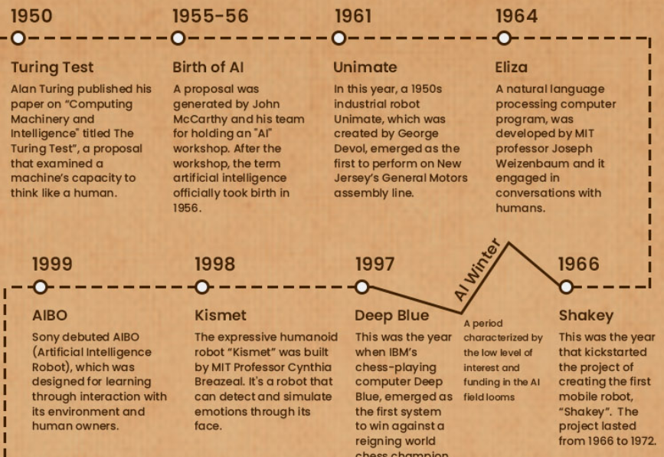
Timeline
Notes:
Scare the crap out of you!
https://www.zdnet.com/article/the-scariest-hacks-and-vulnerabilities-of-2019/

Slide 10
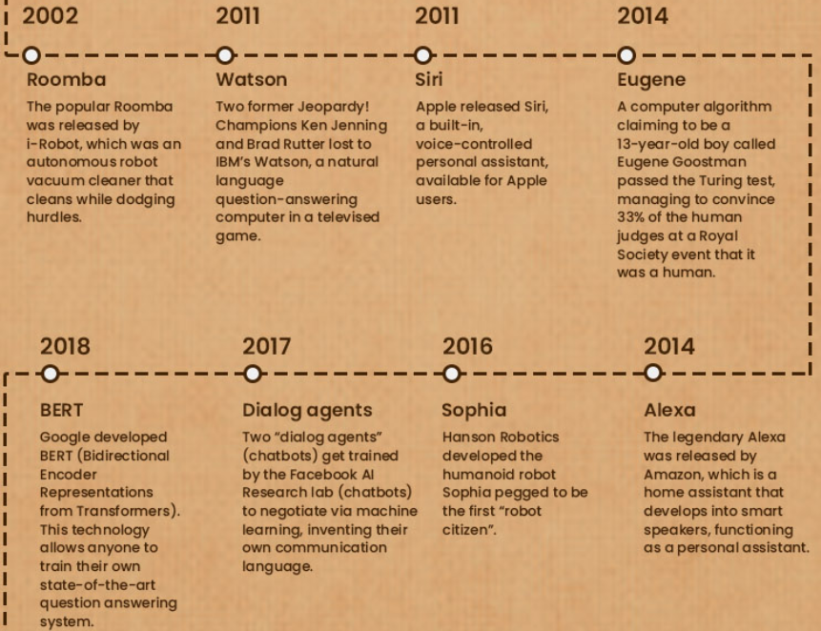
Timeline
Notes:
Scare the crap out of you!
https://www.zdnet.com/article/the-scariest-hacks-and-vulnerabilities-of-2019/

Slide 11
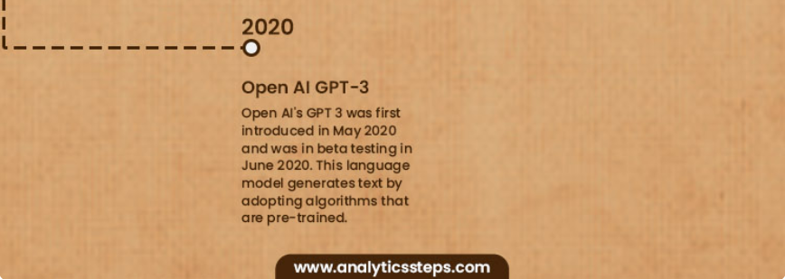
Timeline
Notes:
Scare the crap out of you!
https://www.zdnet.com/article/the-scariest-hacks-and-vulnerabilities-of-2019/

Slide 12
AI Benefits
Productivity gains
New capabilities
Better customer service
Improved monitoring
Reduction in human error
Industry specific improvements

Slide 13
AI Dangers

Slide 14
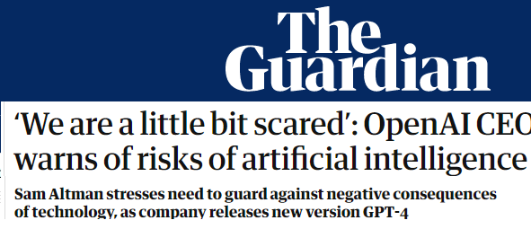
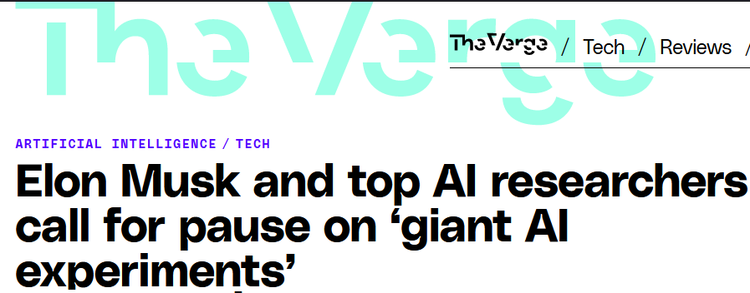
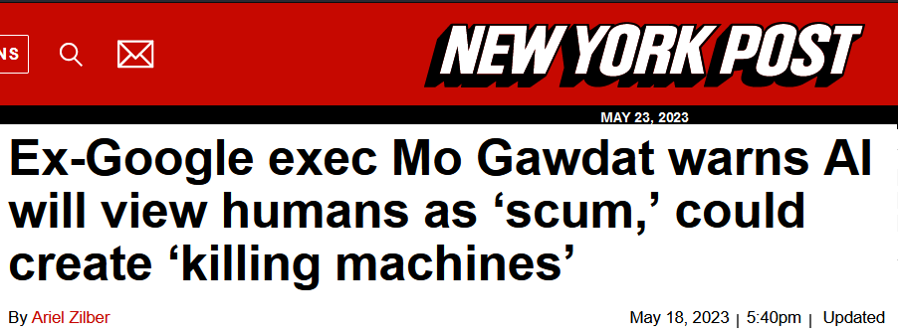
AI Dangers

Slide 15
AI Dangers
Job loss
Disinformation
Propaganda
Bias
Cybercrime
Copyright

Slide 16
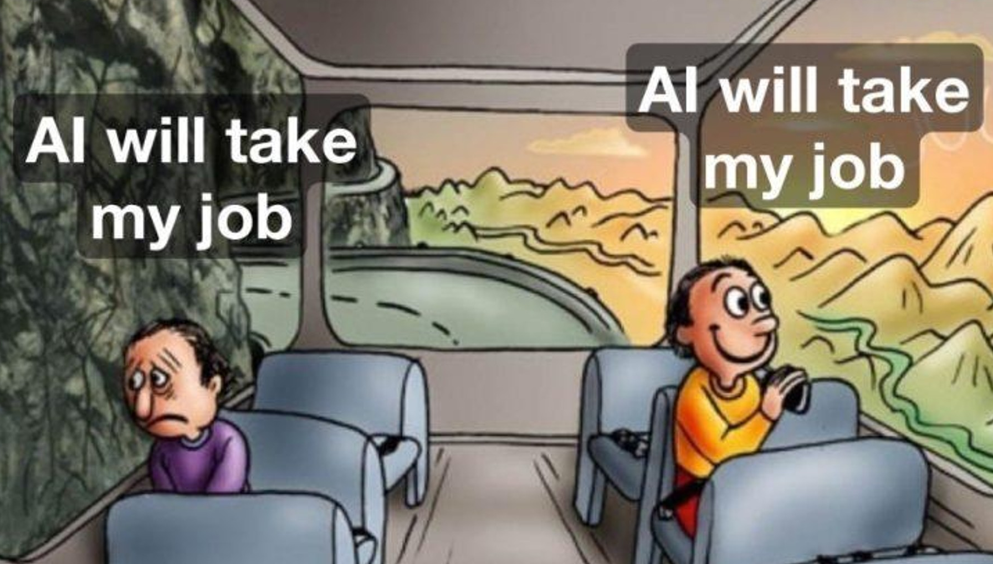
Notes:
Someone that learns to use AI might…

Slide 17
Generative AI
“is a type of artificial intelligence (AI) system capable of generating text, images, or other media in response to prompts Generative AI models learn the patterns and structure of their input training data, and then generate new data that has similar characteristics.” - Wikipedia

Slide 18
Generative AI
“Notable generative AI systems include ChatGPT (and its variant Bing Chat), a chatbot built by OpenAI using their GPT-3 and GPT-4 foundational large language models, and Bard, a chatbot built by Google using their LaMDA foundation model. Other generative AI models include artificial intelligence art systems such as Stable Diffusion, Midjourney, and DALL-E.”

Slide 19
Generative AI Types
Text
Audio
Video
Photos

Slide 20
ChatGPT
GPT = Generative Pre-trained Transformer
2015: Founded as a non-profit with $1Billion pledged
CEO: Sam Altman
Notable investors include Elon Musk, Peter Thiel, and Amazon Web Services
2018: Musk resigned from the board, but remained a donor
2019: Transitioned to a “capped” for-profit to attract/retain talent
Microsoft invested $1Billion
Announced its intention to commercially license its technologies
The non-profit entity is the sole controlling shareholder of the for-profit entity
2020: Announced GPT-3 and the API
2021: Introduced DALL-E, an image generating AI
November 2022: Launched free preview of ChatGPT 3.5
Achieved over a million sign ups in the first 5 days
January 2023: Microsoft announced commitment of $10 Billion
Estimated 100 million daily users
Investment valued the company at $29 Billion
Forecast $200M in revenue in 2023, $1B+ in 2024
February 2023: Microsoft announces it’s building ChatGPT into its product
ChatGPT 4 released March 14th, 2023.
Notes:
GPT3 – 175 billion parameters
GPT 4 – 170 trillion parameters – Internet access

Slide 21
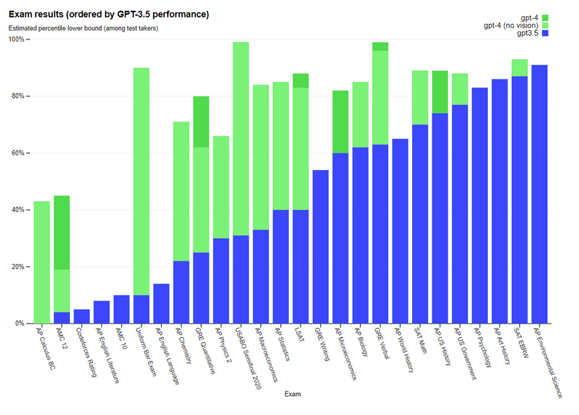
Comparison
Notes:
GPT3 – 175 billion parameters
GPT 4 – 170 trillion parameters – Internet access

Slide 22
What can you do with ChatGPT?
Generate ideas
Understand complex topics
Write copy
Summarize research
Get coding assistance
Translate text
Write a book
Advance in your career
Find data sets

Slide 24
Ways to use ChatGPT
UI
Apps
Plugins
ChatGPT Plus users can now access 70+ plugins
Application Programming Interface (API)

Slide 25
How Intrust Uses AI
Writing
Idea Generation
Automation
Code generation
Autoresponder
Intrust Man
Call resolution
Augment Robotic Process Automation (RPA)

Slide 26
Remember:
Use for general research and non-proprietary ideation
Do not provide personal information of customers or employees
Do not provide any proprietary data
It can “hallucinate”
It may confidently provide wrong answers
To vet third-parties

Slide 27
C.R.E.A.T.E. Process
Context: Give ChatGPT clear and concise context
Result: Tell it what you want it to produce for you
Explain: Give it more details
Audience: Tell it who you are making the content for
Tone: If necessary, add a speaking tone to spice up the output
Expand: Expand, elaborate and edit
Notes:
Prompt Engineering

Slide 28
ChatGPT Demos
Context: Give ChatGPT clear and concise context
Result: Tell it what you want it to produce for you
Explain: Give it more details
Audience: Tell it who you are making the content for
Tone: If necessary, add a speaking tone to spice up the output
Expand: Expand, elaborate and edit
Notes:
Clear and Concise Context
Act as an (expert): "Act as a financial advisor” "Act as a travel guide for a specific city”
Pretend you are a (real person): "Pretend you are a renowned scientist”
Let’s play a game: "Let's play a game where you are a detective solving a crime”
Assume you are a (role): "Assume you are a character in a fantasy world"

Slide 29
Voice Cloning
Example

Slide 30
For more information follow:
Bruce Schneier:@schneierblog
Kevin Mitnick: @kevinmitnick
US-CERT: @USCERT_gov
SecurityWeek: @SecurityWeek
Center for Internet Security: @CISecurity
MSRC: @msftsecresponse
NIST Cyber: @NISTcyber
Intrust IT: @IntrustIT
CISA: CISAgov
MSRC: @msftsecresponse
Microsoft Secure: @msftsecurity
RSA: @RSAsecurity
Mikko Hypponen: @mikko
Troy Hunt: @troyhunt
CSOnline: @CSOonline
Me: @DaveHatter

Slide 31
Additional Resources
https://openai.com/
https://bard.google.com/
https://www.zdnet.com/article/best-ai-chatbot/
https://www.forbes.com/sites/bernardmarr/2023/02/28/beyond-chatgpt-14-mind-blowing-ai-tools-everyone-should-be-trying-out-now/?sh=1451240e7a1b
https://www.techradar.com/news/what-is-ai-everything-you-need-to-know
https://www.mckinsey.com/featured-insights/mckinsey-explainers/what-is-ai
https://news.yahoo.com/superintelligence-ai-could-replace-humans-084735136.html
https://www.pcmag.com/how-to/ai-on-the-go-how-to-use-chatgpt-from-your-mobile-device
https://www.pcmag.com/news/chatgpt-adding-bing-as-its-default-search-experience
https://www.amazon.com/Superintelligence-Dangers-Strategies-Nick-Bostrom/dp/1501227742/ref=asc_df_1501227742

Slide 32
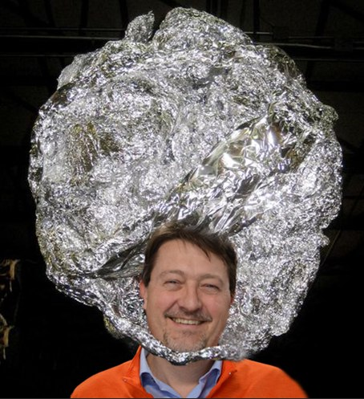
Q & A
“Success in creating effective AI, could be the biggest event in the history of our civilization. Or the worst. We just don’t know. So, we cannot know if we will be infinitely helped by AI, or ignored by it and side-lined, or conceivably destroyed by it.” - Dr. Stephen Hawking

Slide 33
Thank You!
Dave Hatter, CISSP, CISA, CCSP, CCSLP, Security +, Network+, PMP, ITIL V3
Intrust IT
linkedin.com/in/davehatter
twitter.com/davehatter
Get our checklist: https://www.intrust-it.com/cyber-security/cyber-essentials-checklist/
Catch Tech Friday live on 55KRC at 6:30 AM every Friday on 550 AM or http://55krc.iheart.com
Catch Cyber Monday live on WTVG at 6:30 AM every Monday on 13 ABC or https://www.13abc.com/

