Slide 1
Stress
How to manage it
before it manages you

Slide 2
“Disclaimer”
I’m not an expert
Tips and thoughts
Chime in…
Disagree
Goal – walk out with three thoughts relevant to you

Slide 3


Stress vs. Anxiety
There’s a fine line between stress and anxiety. Both are emotional responses, but stress is typically caused by an external trigger. The trigger can be short-term, such as a work deadline or a fight with a loved one or long-term, such as being unable to work, discrimination, or chronic illness.
Anxiety, on the other hand, is defined by persistent, excessive worries that don’t go away even in the absence of a stressor.
Source: American Psychological Association

Slide 4
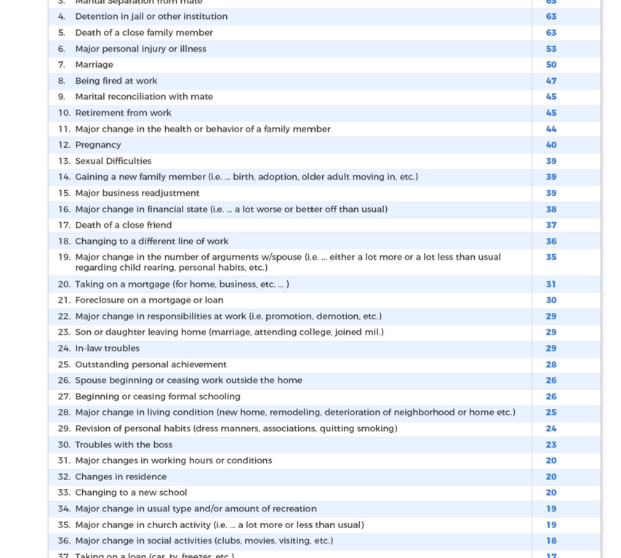
Are you Off the Chart?
Holmes Rahe Stress Inventory

Slide 5
Recognizing it’s stress
Signs (Source: Nirvana Foundation)
  Fly off the handle easily
  Tired all the time
  General aches and pains
  Sweaty
  Can’t sit still
  Nerves on edge
  Constant Fidgeting
  Headache
Wait – I just want to sleep all the time…

Slide 6
Recognizing it’s stress…
Symptoms (Source: Nirvana Foundation)
  Achy joints
  Feeling feverish
  Lack of appetite
  Can’t stop eating
  Chocolate cravings
  Upset stomach
  Mild chest pain
  Decreased sexual desire
Wait – Is everything that happens to me stress??

Slide 7
Recognizing it’s stress…
Effects (Source: Nirvana Foundation)
  Confusion
  Cry easily
  Sudden anger
  Erratic decisions
  Nothing seems to be going right
  Loneliness
Wait – Am I back in high school?

Slide 8
Recognizing it’s stress…
Basically –
  How you experience stress is a very individualized thing
  Are you feeling/acting differently
  Is it possible that it’s stress
Is it “good” stress?
  Fight or flight response
  Adrenaline flowing
  Moves you to action

Slide 9
What to do about it – in the moment
Name it – say it out loud
Tell the people most likely to be impacted by your stress
Be “gentle with yourself”
Be gentle with others

Slide 10
Ways to be gentle with yourself
Eat right
  More protein
  Less sugar
  Less caffeine
  Less alcohol
Exercise (I know…)
  Take a walk
  Stretch
Take a treat
  Cup of tea
  Nap
  One hour for yourself

Slide 11
What to do about it – chronic stress
Stress that lasts for months or outlives the situational cause is chronic stress
  Heart attack
  Stroke
  Hypertension
  Obesity
  Diabetes
  Addiction
  Chronic disease

Slide 12
What to do about it – chronic stress
The Four “A’s” of Stress Management
  Avoid
  Alter
  Adapt
  Accept
Plus One More “A”
  Assert
  Holmes-Rahe Stress Inventory

Slide 13
What to do about it – chronic stress
Seek medical attention
  Therapy
  Medical doctor
Make changes
  Job
  Diet
  Routine sleep
  Exercise routine
  Personal relationships
  Time management

Slide 14
What to do about it – chronic stress
A word about time management
  This is a place where you have control
  There are lots of tips you can try to get better control of your time
    Let’s discuss

Slide 15
What to do about it – chronic stress
Relaxation techniques
  Breathing exercises
  Yoga
  Meditation
  Mindfulness

Slide 16
What to do about it – chronic stress
Set realistic goals
Set realistic expectations
Keep your eyes on your own “paper”
  Drop “supposed to” from your vocabulary
Find You – Be You – Love You

Slide 17
Your thoughts…

Slide 18



Thank you
Vicki Berling
Vicki@buildersnky.com
BuildingInstitute.com

