Slide 1
It starts with the…

Slide 2
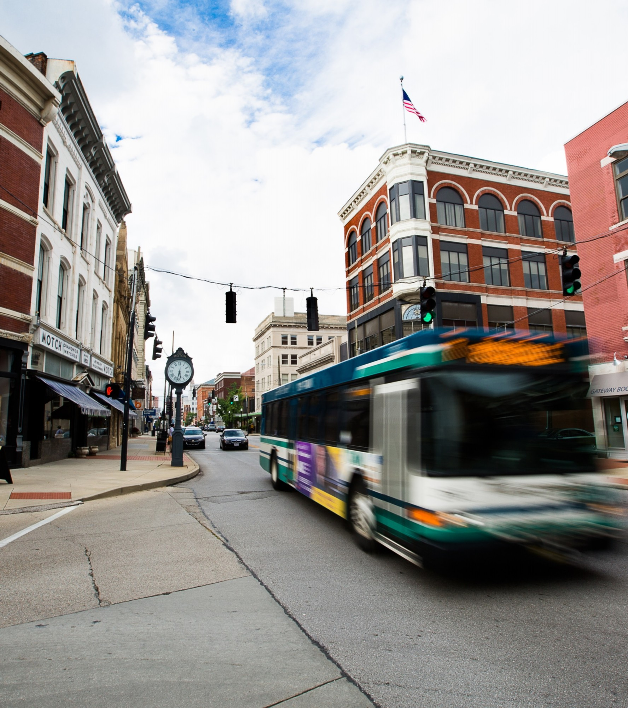

Because Strong Businesses are our Mission
Our Mission is to promote and support the development of strong businesses and a vibrant economy in the Northern Kentucky region, through leadership and advocacy, resulting in a better quality of life for all.

Slide 3
Strategic Imperatives – Always front and center
Growing, attracting, and retaining world class talent
Building an inclusive business community
Uniting the region to advocate for an improved economy

Slide 4
Because We Support Our Members
All employees at your company are members
You can serve on our committees, participate in our leadership programs, sponsor events and use our facility
You are now part of a vibrant, supportive, well-informed network of people dedicated to your success

Slide 5
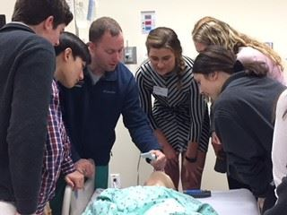
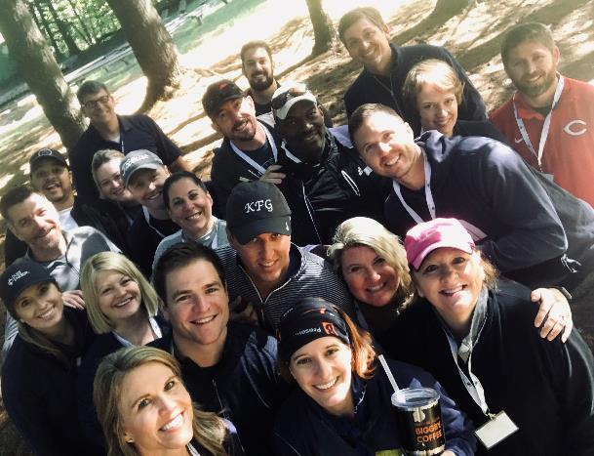

Leadership
Regional Youth Leadership
RYL
Leadership Northern Kentucky
LNK

Slide 6

Encounter NKY

Slide 7

Northern KY Young Professionals

Slide 8
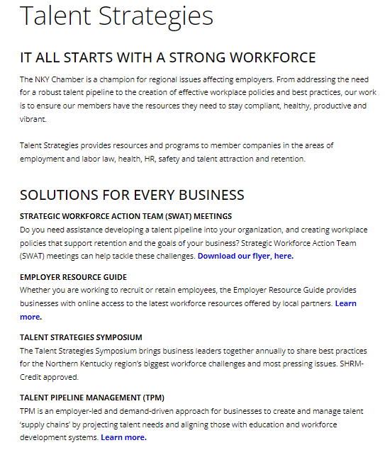
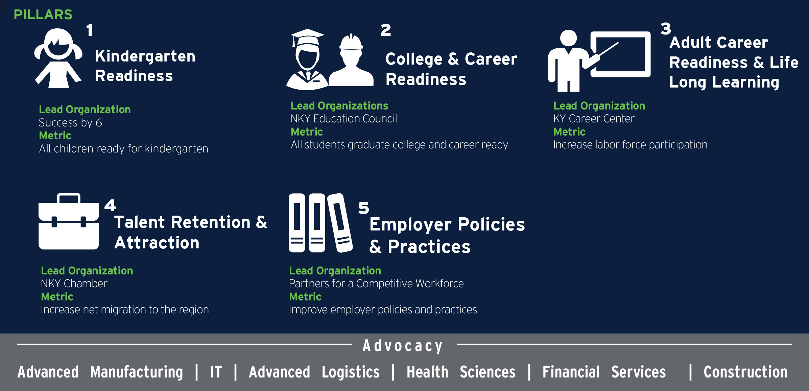
Workforce
GROW NKY
Talent Strategies

Slide 9
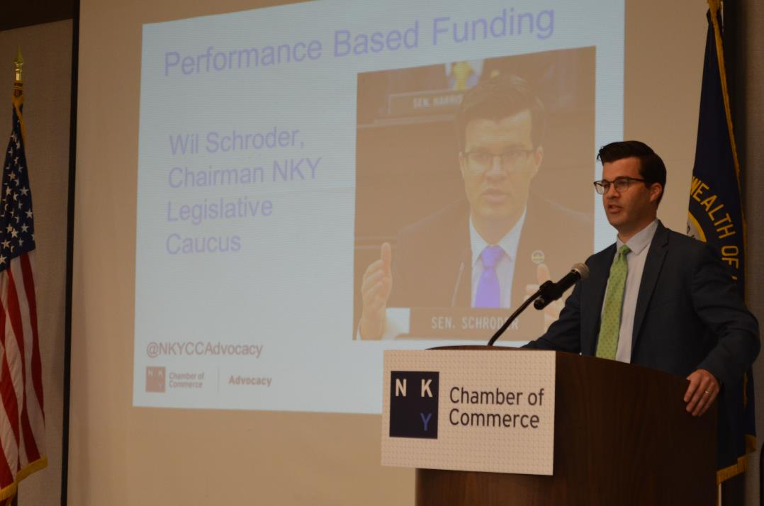
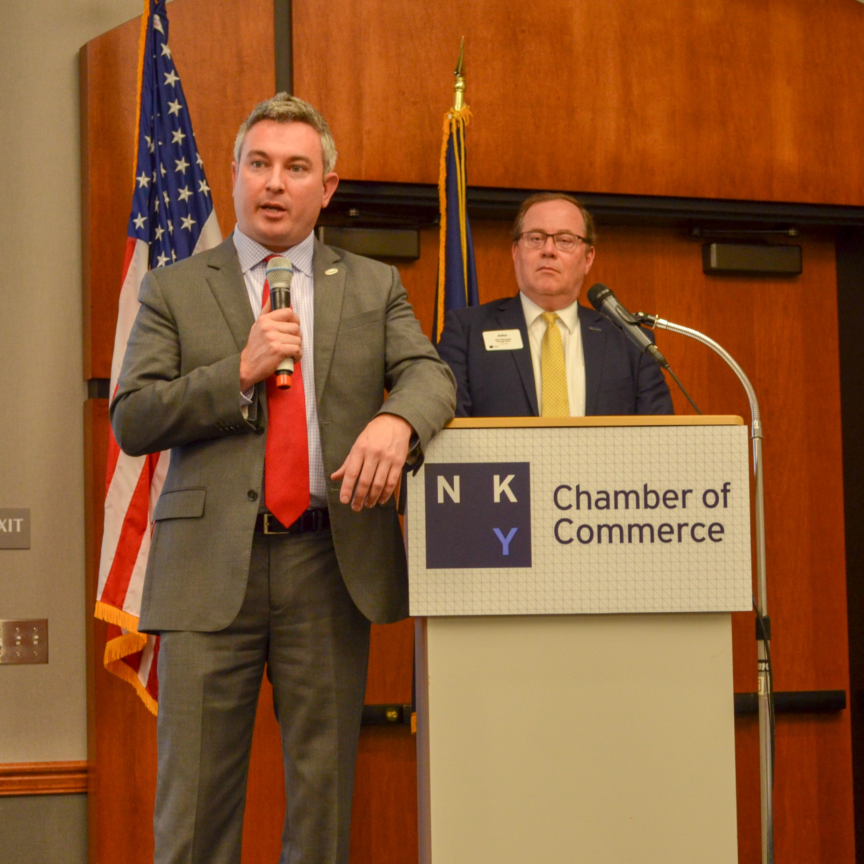
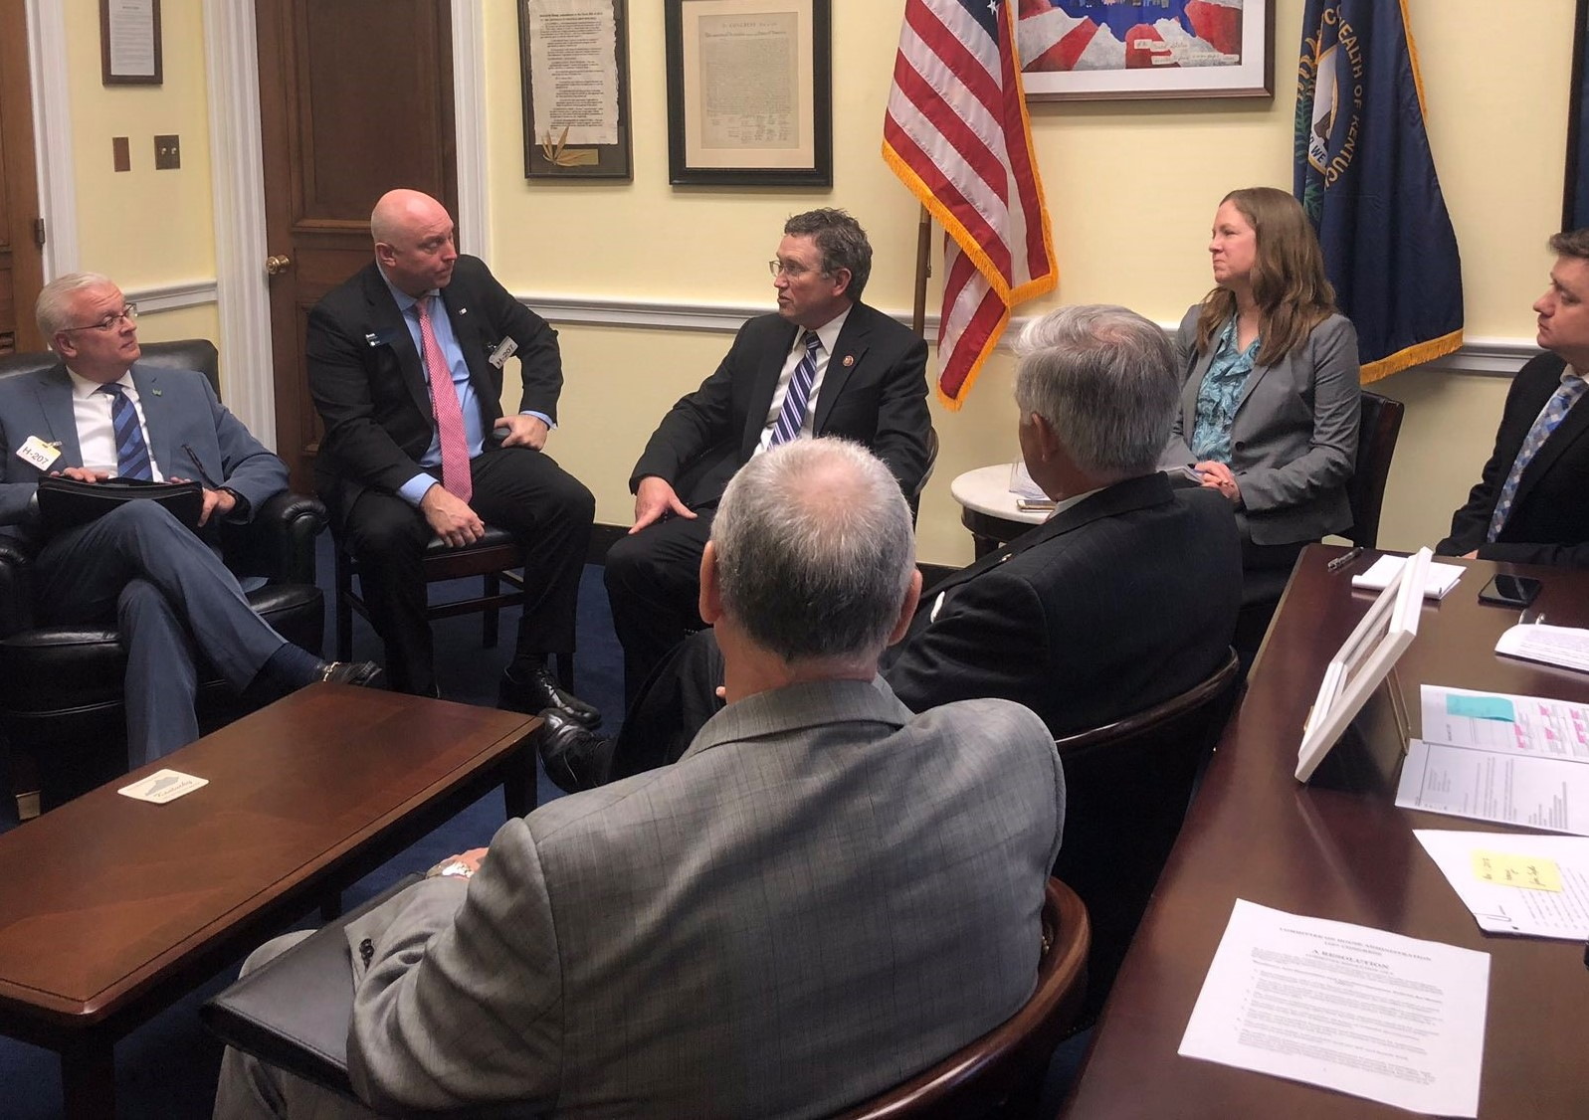
Advocacy
Access to Elected Officials
Legislative Appreciation Breakfast
Government Forums

Slide 10
Because We Connect Members to Outstanding Programs and Events

Slide 11
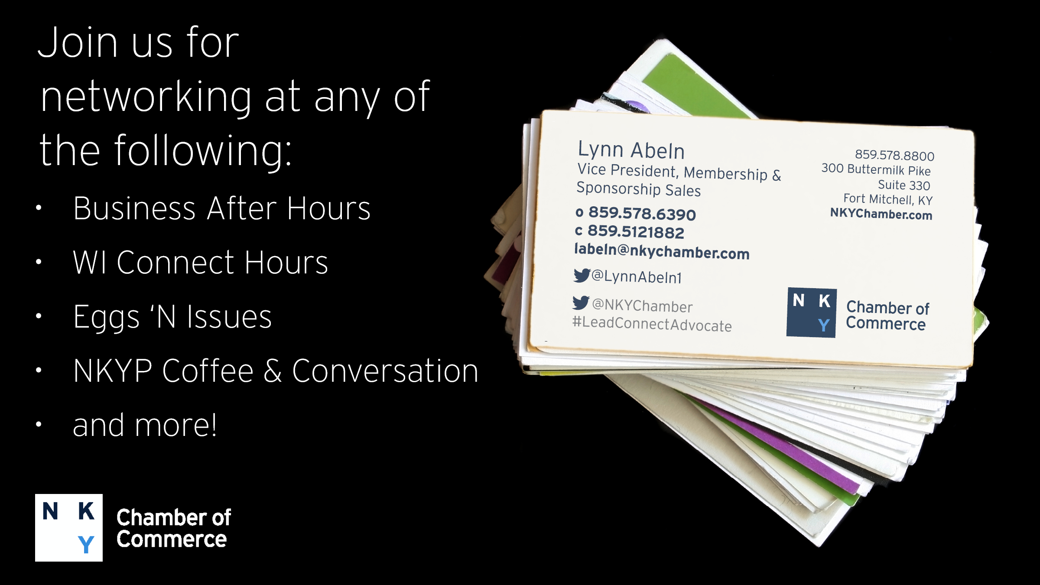


Slide 12
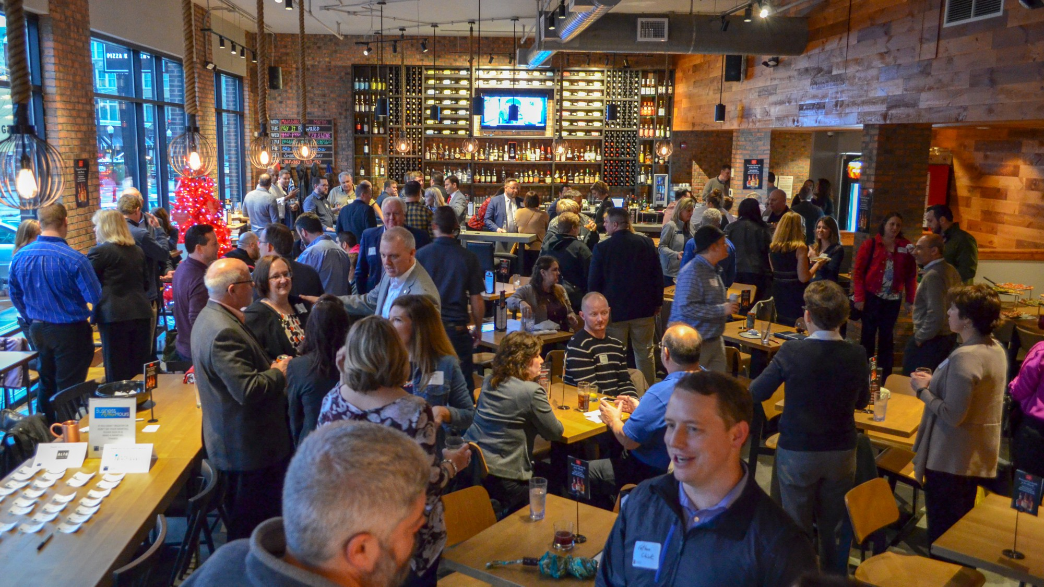
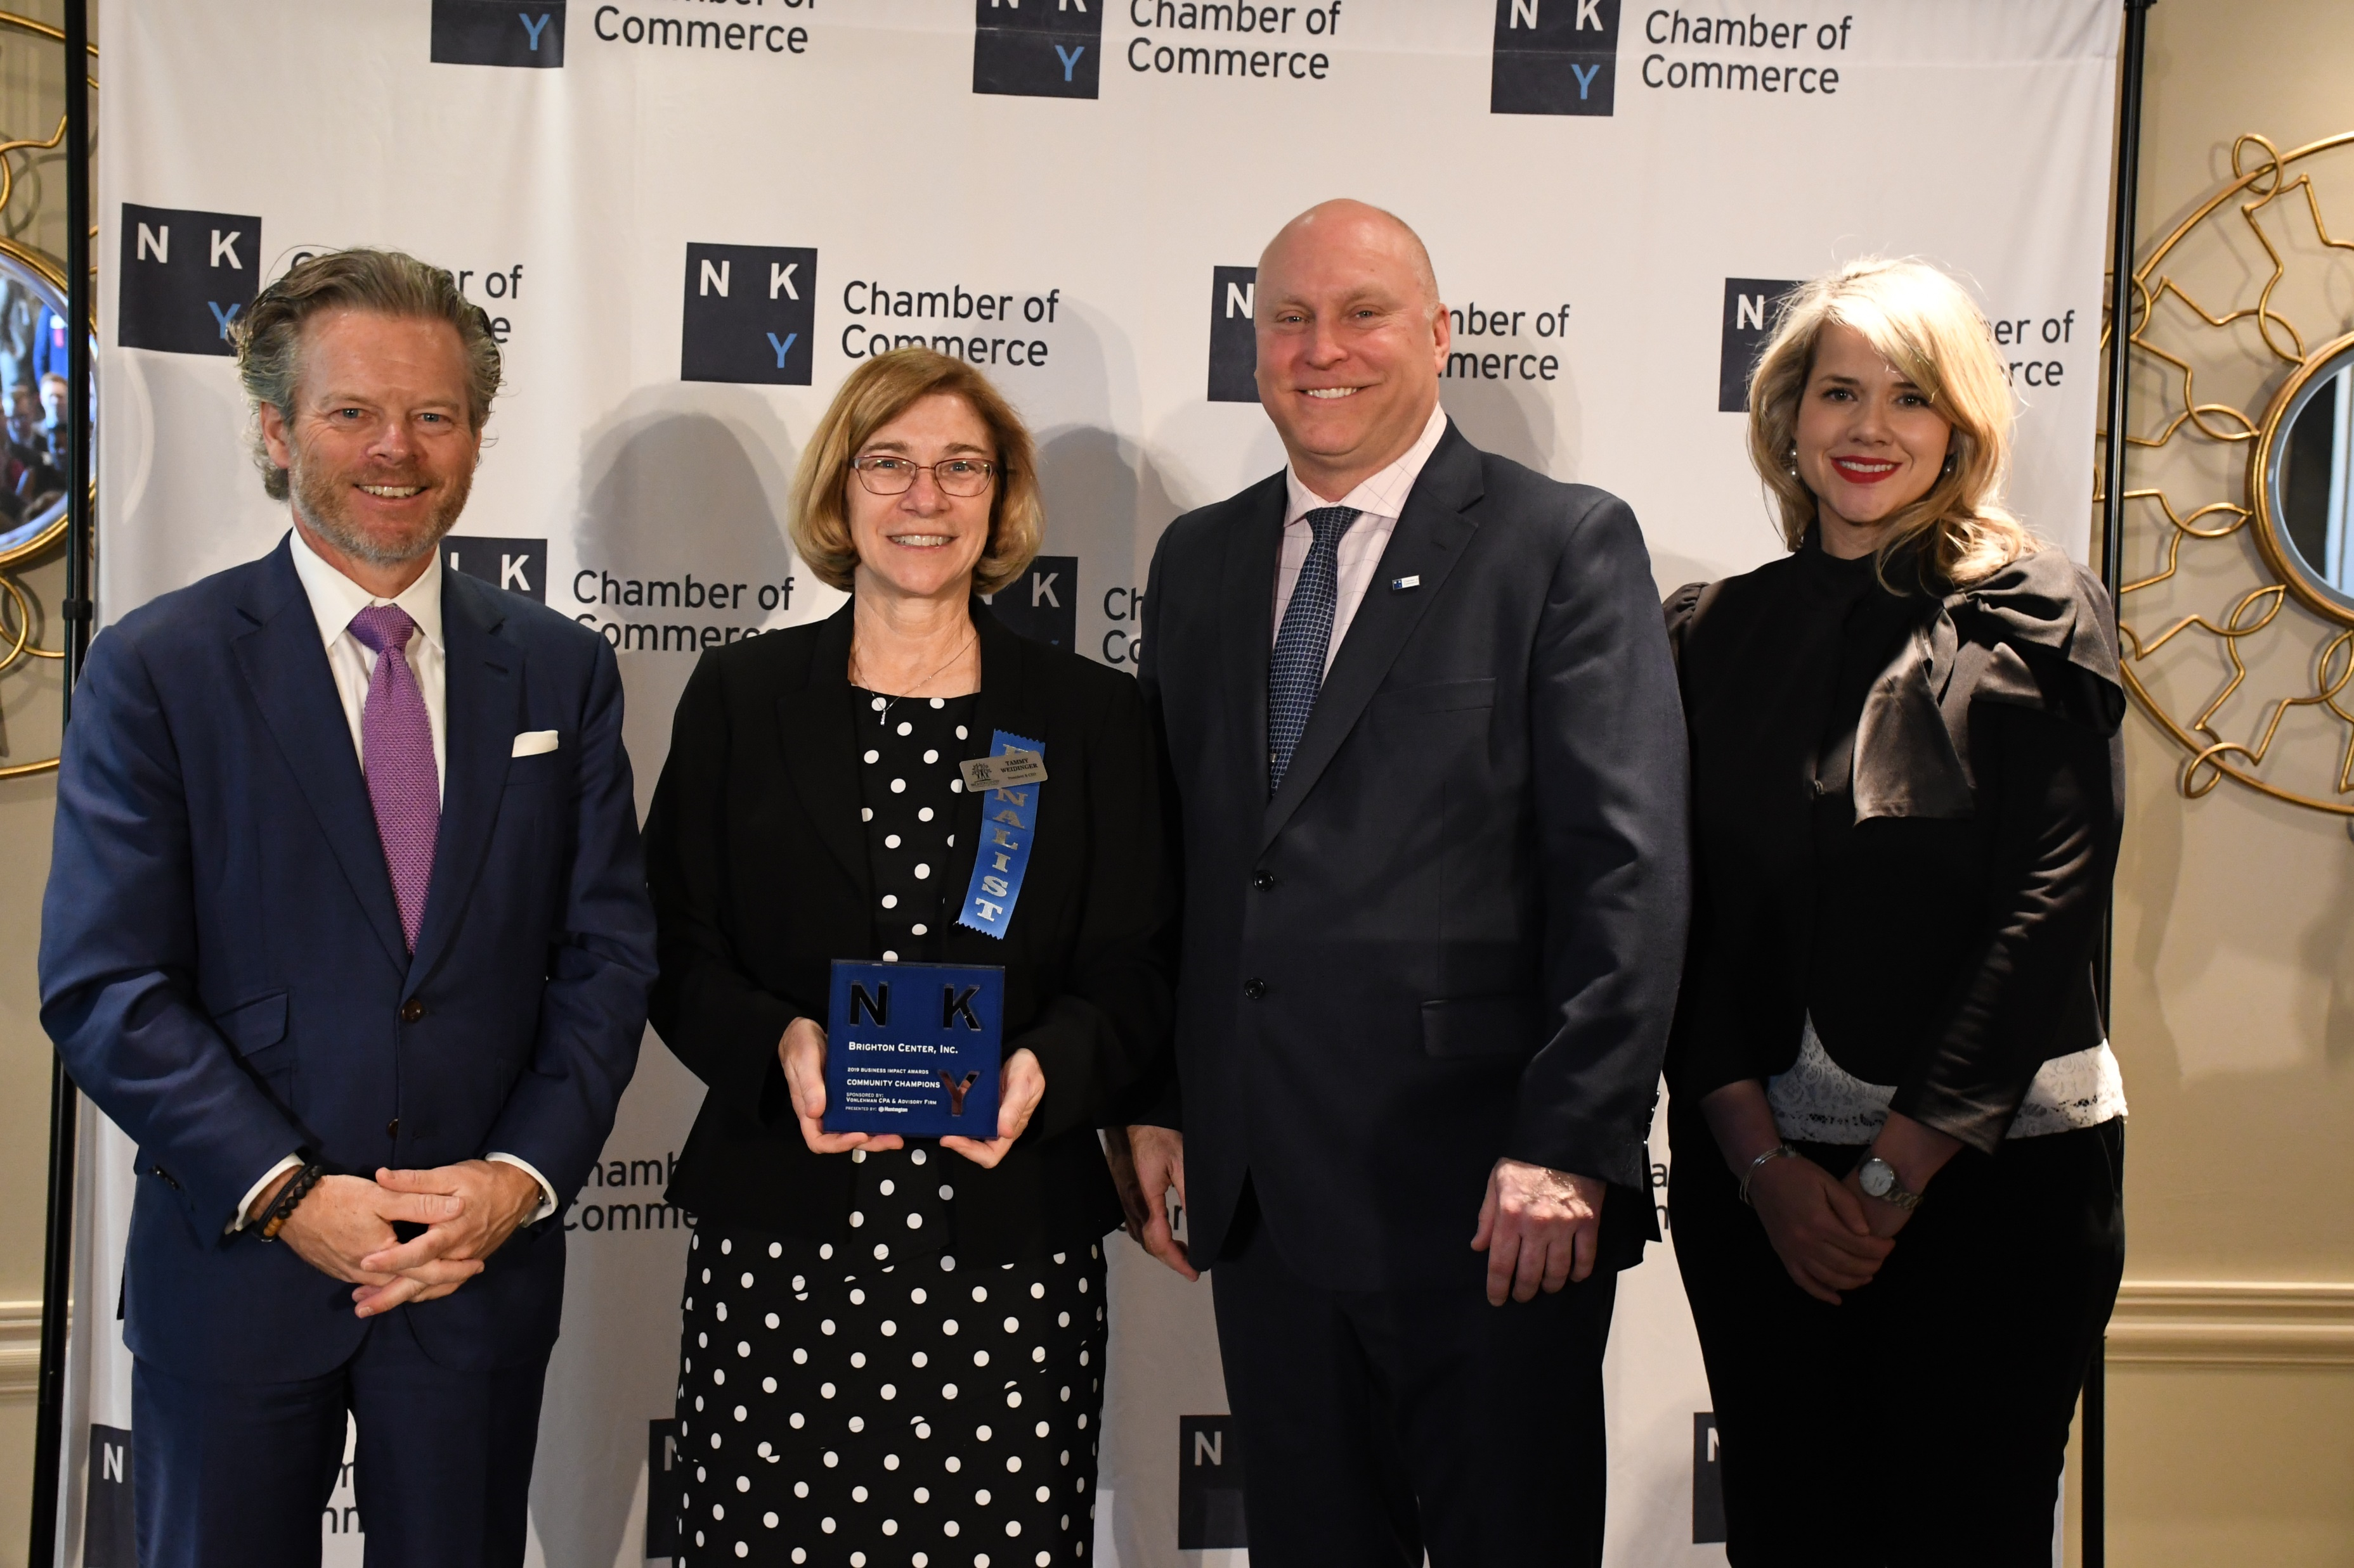
Business After Hours
Business Impact Awards

Slide 13
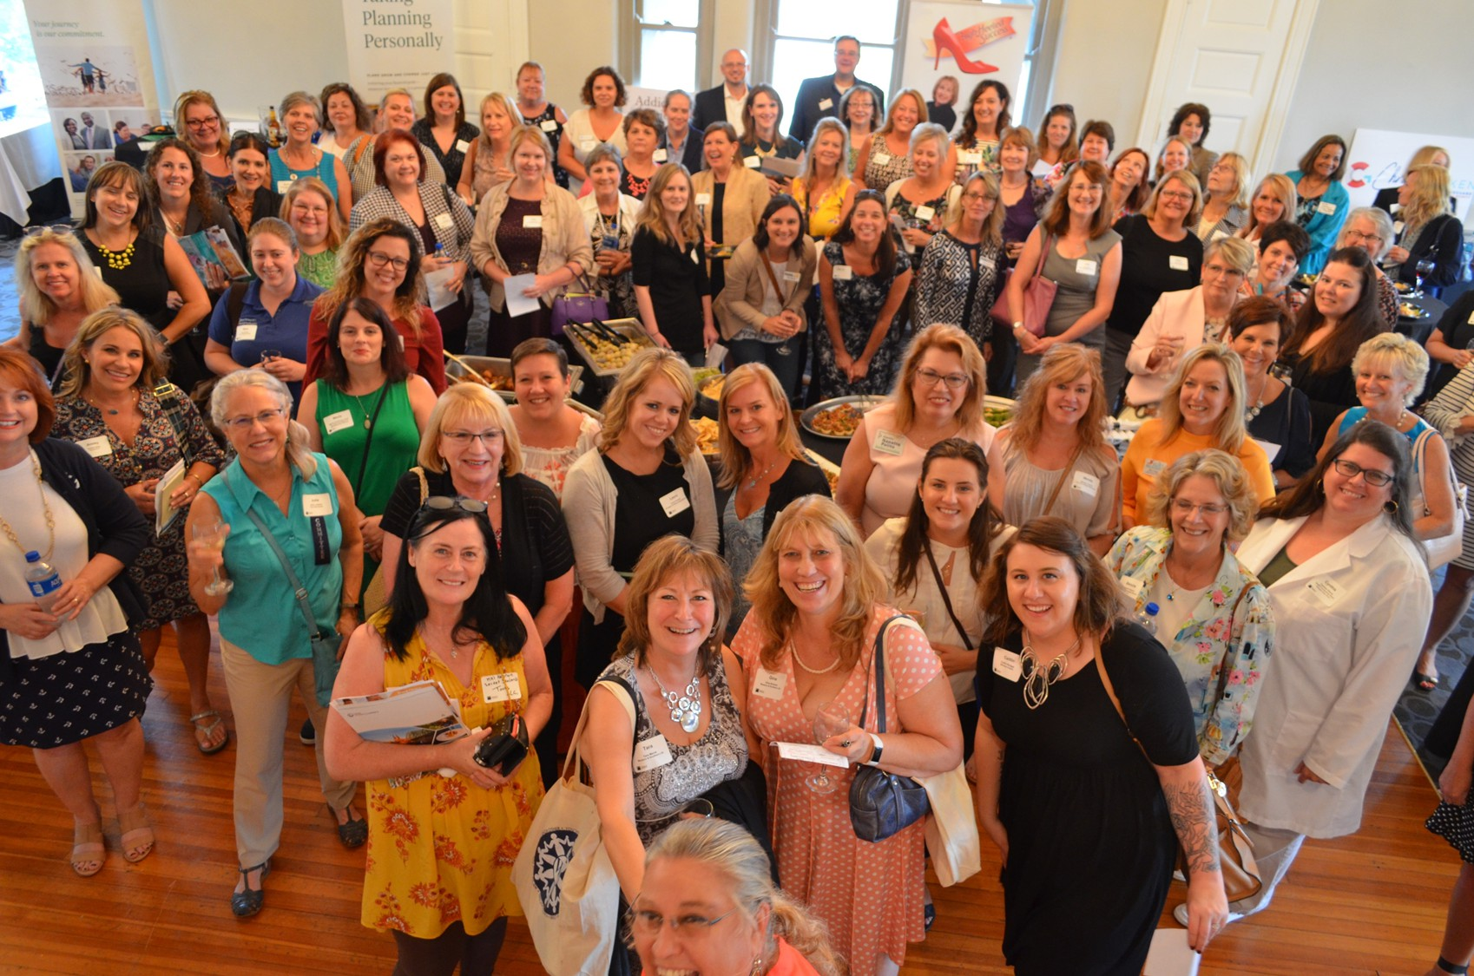

Women’s Initiative
Grow. Connect. Achieve.
  Events:
  Annual Breakfast
  Outstanding Women of NKY
  Professional Series – Fall and Spring
  Regional Summit – Women’s Conference
  CONNECT Hour
  Programs:
  Peer-to-Peer Roundtables
  Grow Mentoring Program

Slide 14
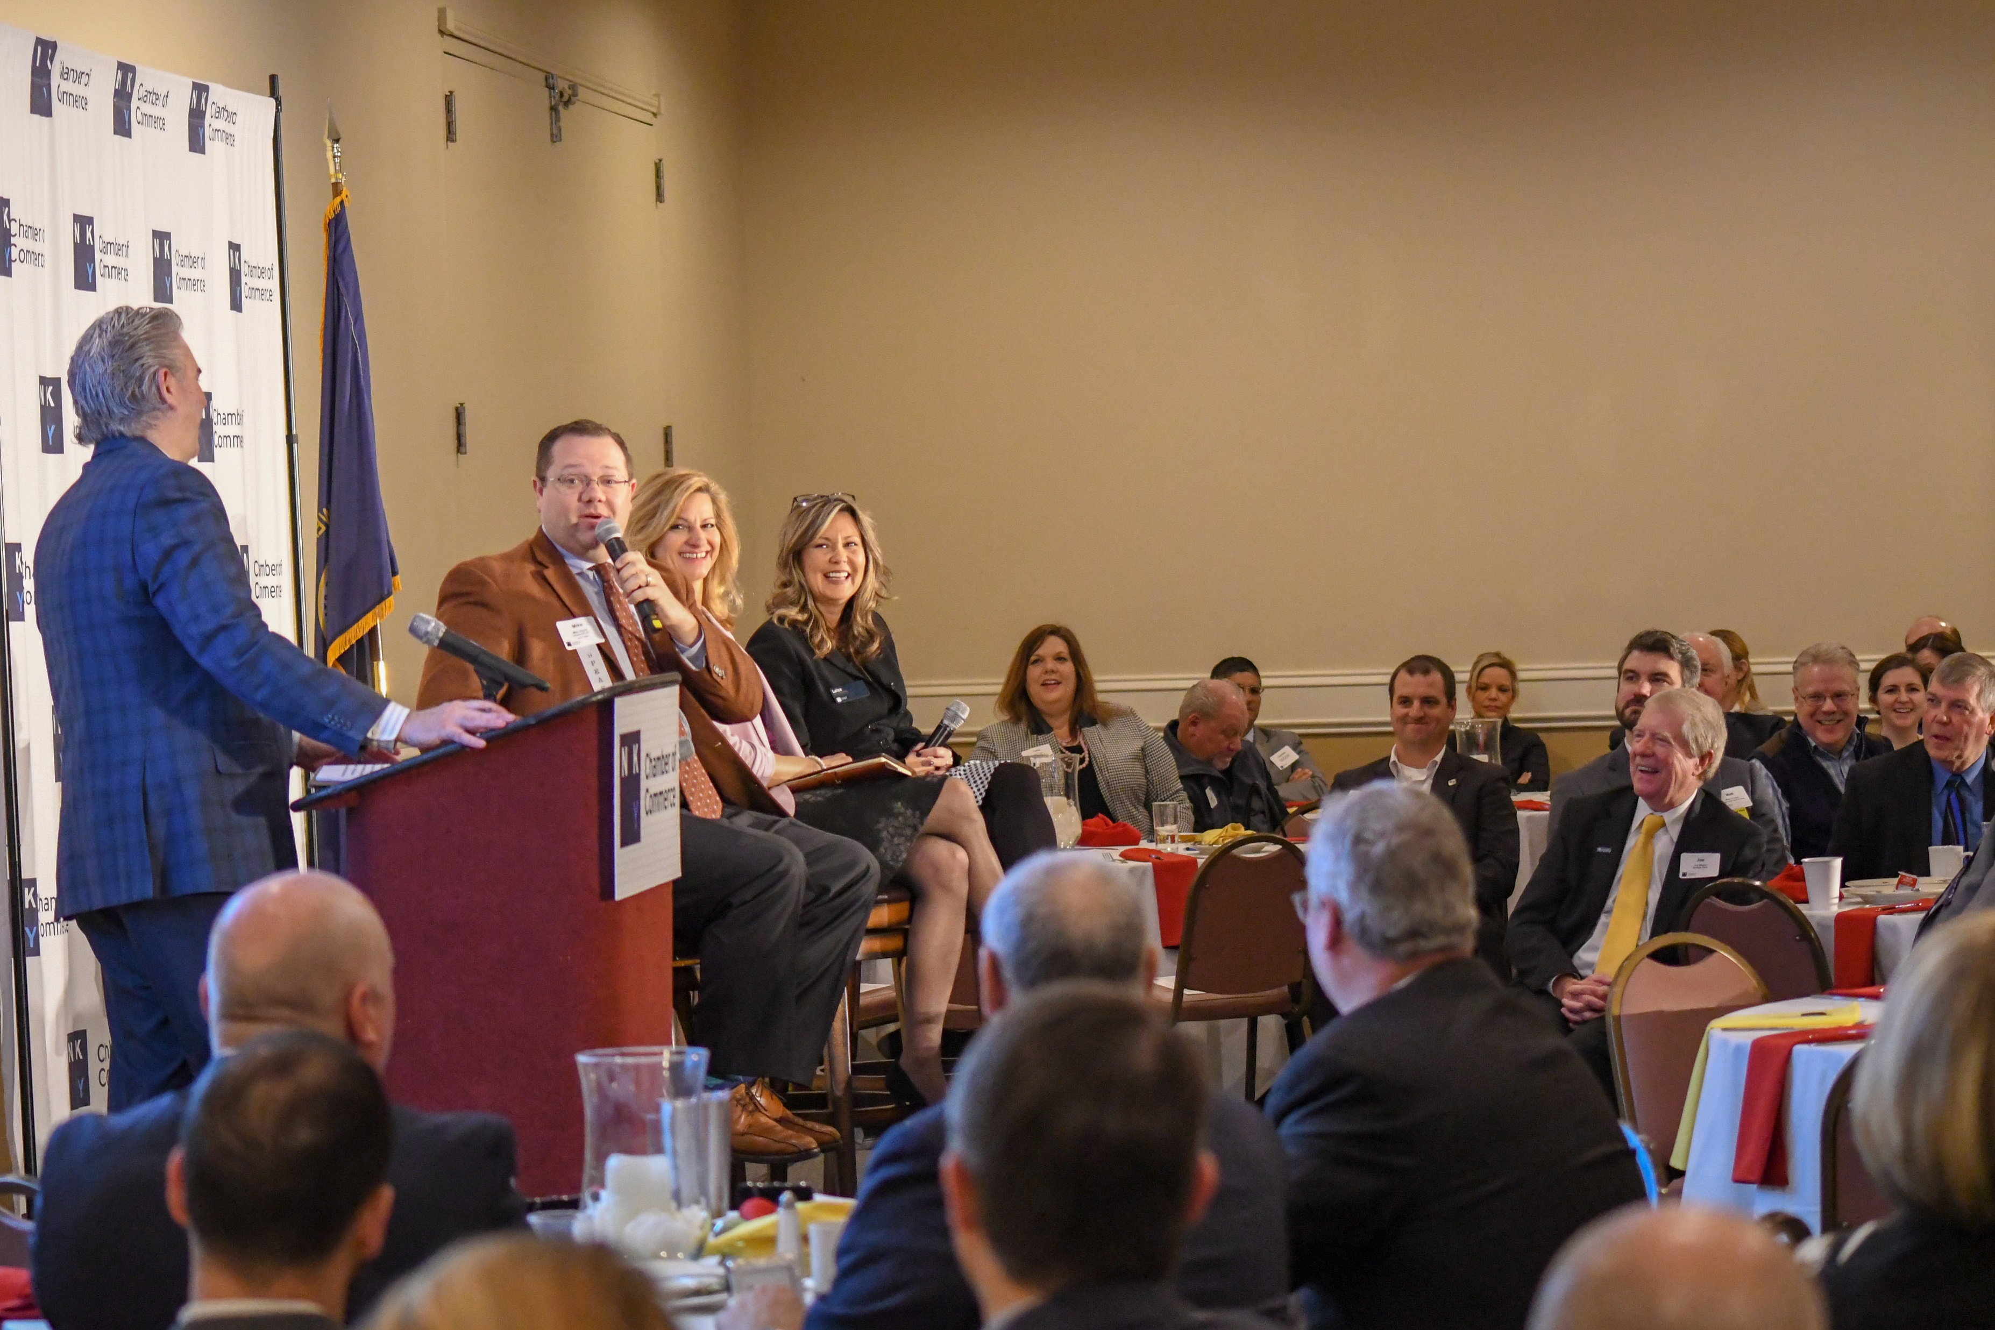
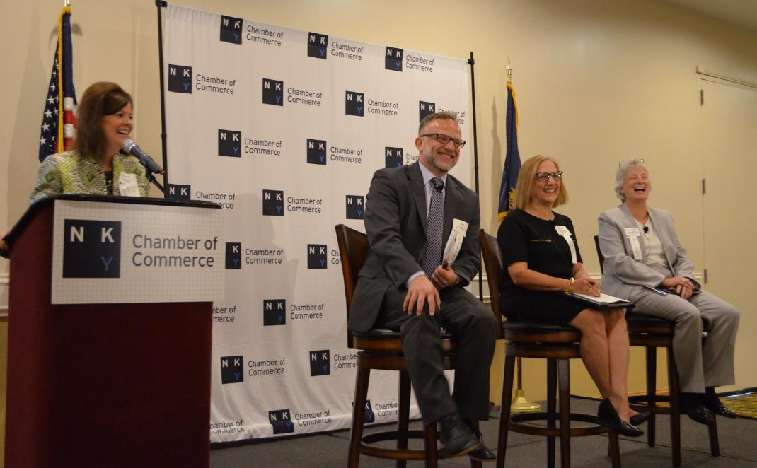
Eggs ‘N Issues

Slide 15
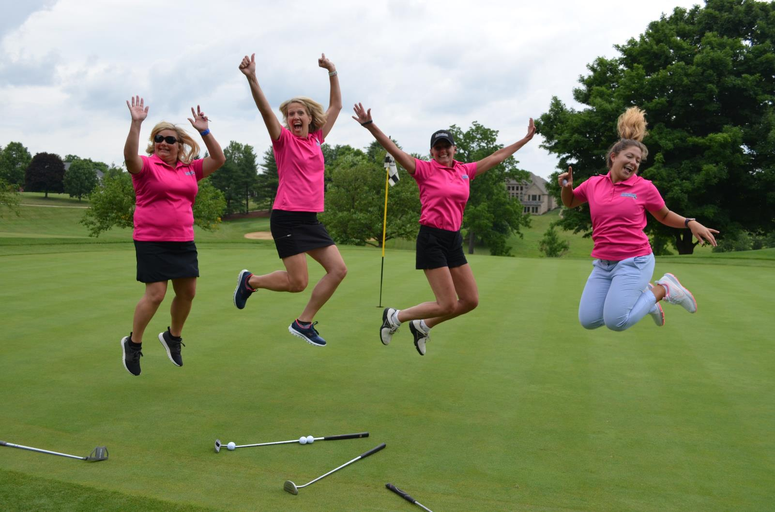
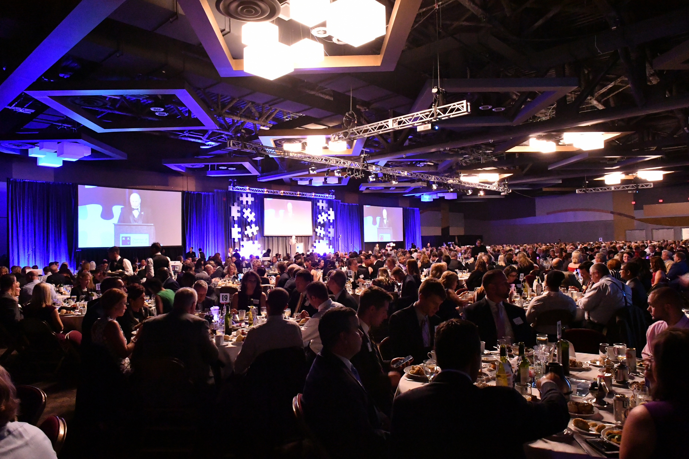
Golf Outing
Annual Dinner

Slide 16
















Because Your Membership Can Save You Money

Slide 17
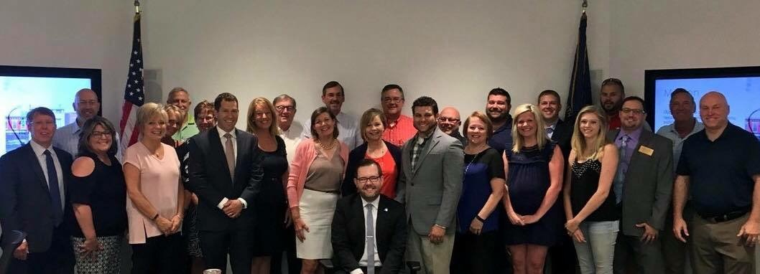
Because Engagement will bring success
  Ways to engage:
    Be an Ambassador
    Serve on a committee
    Attend Events
    Participate in leadership opportunities
    Sponsor events
    Contribute to Business Journal
    Advertise in Business Journal and website
    Participate in Member of the Day and weekly
    Podcast

Slide 18
Thank you!

