Slide 1
Northern Kentucky Accountability Group
Kenton County Public Library (Erlanger Branch)
April 24, 2024

Slide 2
Largest workforce resource for job seekers and employers
Collaborative Team of local partnering organizations
Driven by local business leaders / the NKY Workforce Investment Board

Slide 3
Workforce Innovation and Opportunity Act (WIOA)
WIOA is landmark legislation that is designed to strengthen and improve our nation's public workforce system and help get Americans, including youth and those with significant barriers to employment, into high-quality jobs and careers and help employers hire and retain skilled workers.
American Job Centers were established under the Workforce Investment Act and reauthorized in the Workforce Innovation and Opportunity Act (WIOA) of 2014.
American Job Centers are designed to provide a full range of assistance to job seekers and employers under one roof.

Slide 4
Kentucky Career Center – Did you know?
Team of Experts
Not an employer of record
Collaborative partnership of government, non-profit, and educational entities
“More Than”
There is much more to KCC than just the “Unemployment Office”
Priority of Service
Special programming is available to veterans, and they receive expedited connection to services

Slide 5
Kentucky Career Center: Current Partners

Slide 6
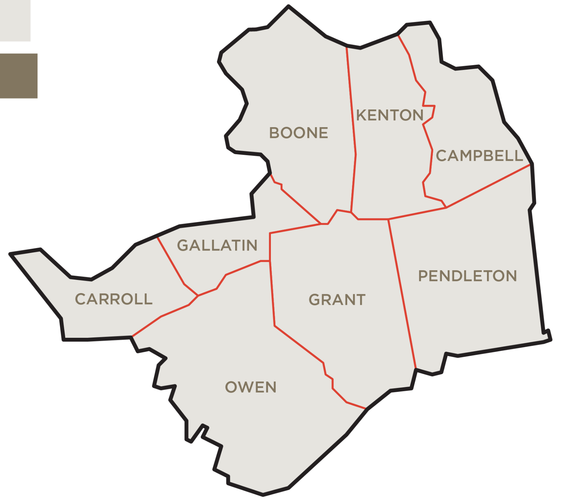
Kentucky Career Center Locations
Kentucky Career Center Library Access Points

Slide 7
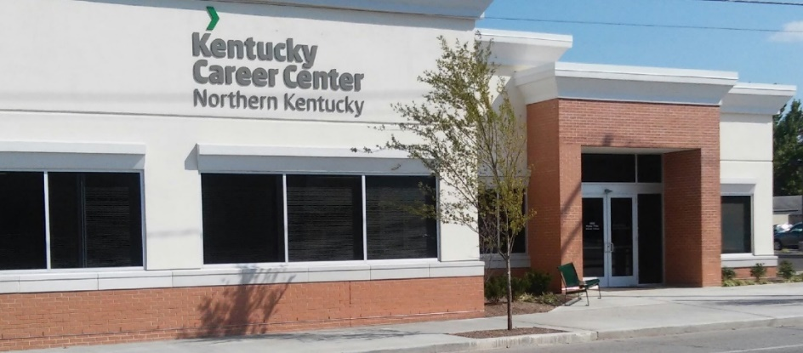
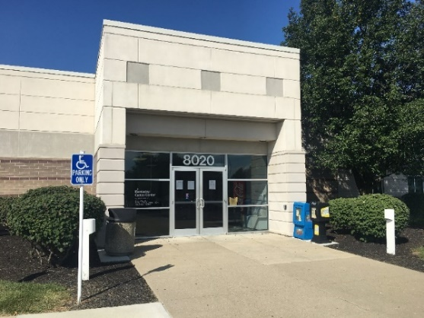
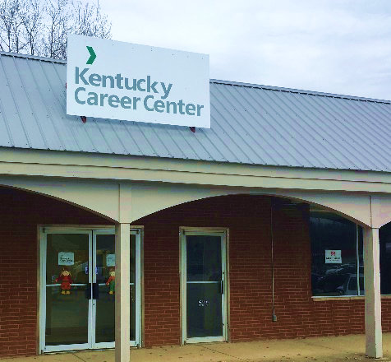
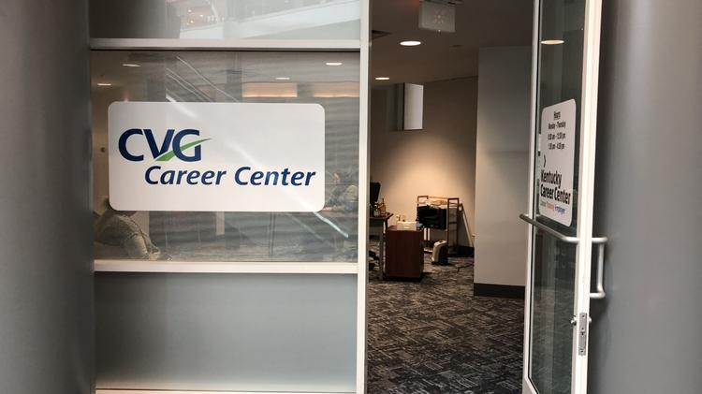
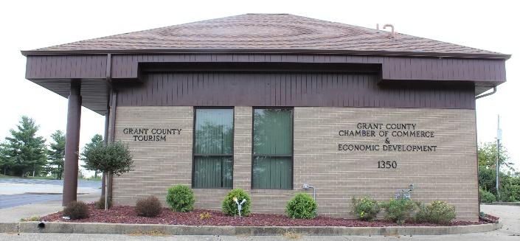
Current KCC Locations
Covington: 1324 Madison Avenue, Covington, KY, 41011
Florence: 8020 Veterans Memorial Drive, Florence, KY, 41042
Williamstown: 1350 N. Main St., Williamstown, KY 41097
Carrollton: 1209 Highland Ave. Suite S, Carrollton, KY, 41008
CVG Airport Career Center: 3087 Terminal Drive, Hebron, KY 41048
Kenton County Public Library: 401 Kenton Lands Rd, Erlanger, KY 41018
Owen County Public Library: 1370 Hwy 22 East, Owenton, KY 40359
Pendleton County Public Library: 801 Robbins Avenue, Falmouth, KY 41040

Slide 8
Overview: KCC Direct Workforce Services
Talent Development Services
Individualized Career Coaching by a Talent Development Specialist
Career exploration & labor market consultation, resume development, interview coaching, etc.
Job Search Assistance
Direct connections to local job openings
Skill-building workshops and credential attainment
Job Search Success workshop, Microsoft Office classes, Kentucky Essential Skills Certification, Mock Interviewing, etc.
Funding for Career Training (for eligible individuals) made possible by WIOA
Contact: careercoach@brightoncenter.com

Slide 9
Let’s Talk Training: WIOA Eligibility
WIOA will provide up to $7,000 for training for careers in high-demand industry sectors for eligible individuals.
Business/IT
Construction
Healthcare
Manufacturing
Transportation & Logistics

Slide 10
WIOA Eligibility at a Glance
Adults
Unemployed or under-employed
Dislocated Workers
Lost job through no fault of their own
Exhausted Unemployment Insurance within the last 6 months
Youth (age 18-24)
Focus on “out-of-school” youth
Significant barriers to employment (parenting, justice-involved, foster youth, etc.)
Training
Must meet one of the above criteria
Not hold a certification or degree in an in-demand field already
Training provider must be on the KY Eligible Training Provider List

Slide 11
More than resumes and job applications
Brighton Center
Support for the in-between. Access supports for basic needs, financial coaching, home loss prevention services, debt-free job training, addiction recovery... and so much more. 48 programs in total.
Northern Kentucky Community Action Commission
Support for food insecurity, health care enrollment, affordable housing, etc.
EC Learn
Works to eliminate the workforce barrier of lack of childcare
Office of Vocational Rehabilitation
Supports individuals with disabilities to enter and excel in the workplace

Slide 12
More than resumes and job applications
TANK
Rider education
Assessments for RAMP service
Veteran Services
Support veterans with navigating the civilian workforce to obtain high-quality employment. The team works with veterans and employers to find the best match for both parties.
Federal Bonding
A federal fidelity bond is an insurance policy (up to $25,000) that protects employers against loss of money or property resulting from an employee’s act of dishonesty (Theft, Forgery, Larceny, Embezzlement).
To protect employers against employee dishonesty
To help job seekers market themselves to employers

Slide 13
Overview: KCC Direct Workforce Services
Business Services
Access to team of Business Service Representatives
Coordinate job fairs, hiring events, job postings, applicant interviews
Employer use of facility for trainings, meetings, etc.
Create employee trainings
Direct connection to job seekers
Rapid Response coordination
Labor market data consultation
SWAT meeting
Connections to resources such as federal bonding, tax credits, etc.
Contact: kccbst@brightoncenter.com

Slide 15
Stay in touch!
Lauren Allhands
Director of Kentucky Career Center Operations
Brighton Center, Inc.
lallhands@brightoncenter.com | 502-764-2722
@kcc_nky
@NorthernKentuckyCareerCenter
@KentuckyCareerCenterNKY
@NKYCareerCenter

