Slide 1
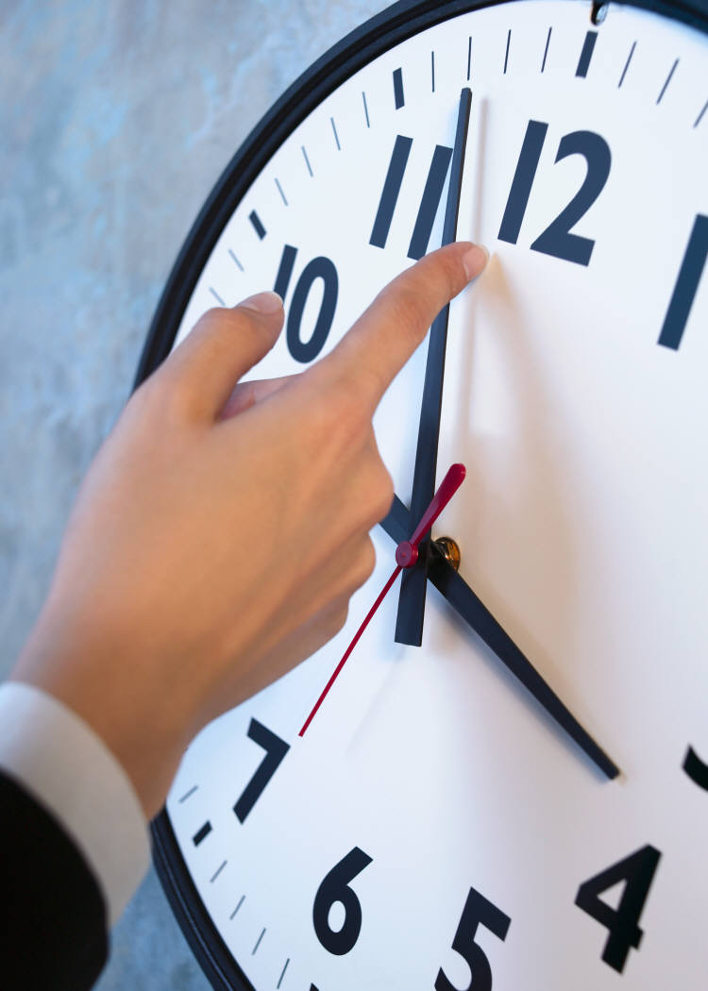
Rod Lukey
Time Management
Notes:
Mention what I am leaving behind
My story

Slide 2

What We Will Cover
Leadership
Life Fitness
GTD System
Procrastination
Distractions
Clutter
TM Tips
Next Steps

Slide 3

Learning and Timing
When the student is ready the teacher will appear
When the student is truly ready the teacher will disappear

Slide 4
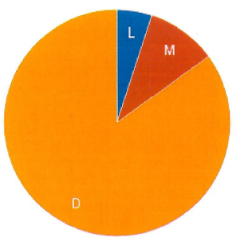
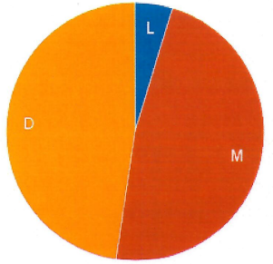
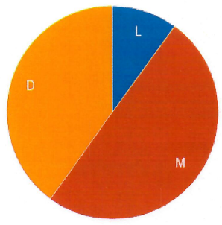
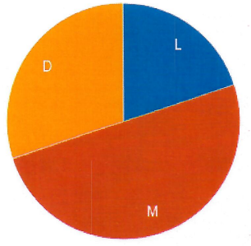
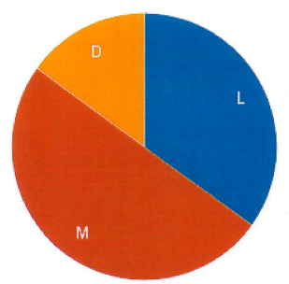
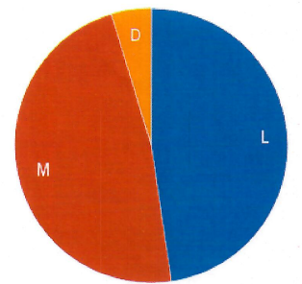
Lead Manage Do

Slide 5

Lead Manage Do
You’re not the boss of me. Don’t tell me what to do

Slide 6
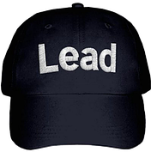
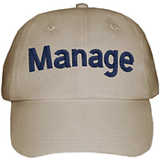
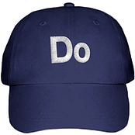
Lead Manage Do
Lead (plan, motivate, reflect, set goals, visionary, future-oriented, mission, direction)
Manage (schedule, prioritize, evaluate, adjust, motivate, delegate, monitor, structure, process-oriented, achieve goals)
Do (execute)

Slide 7
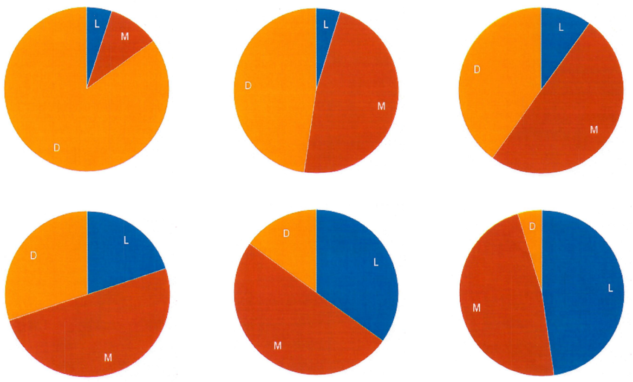
Lead Manage Do
Where are we and where do we want to be?

Slide 8

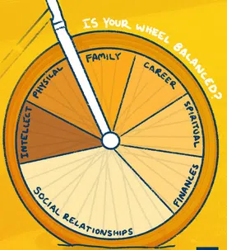
Lead
Family
Career
Spiritual
Finances
Social Relationships
Intellect
Physical

Slide 9
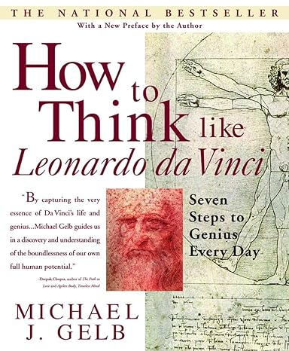
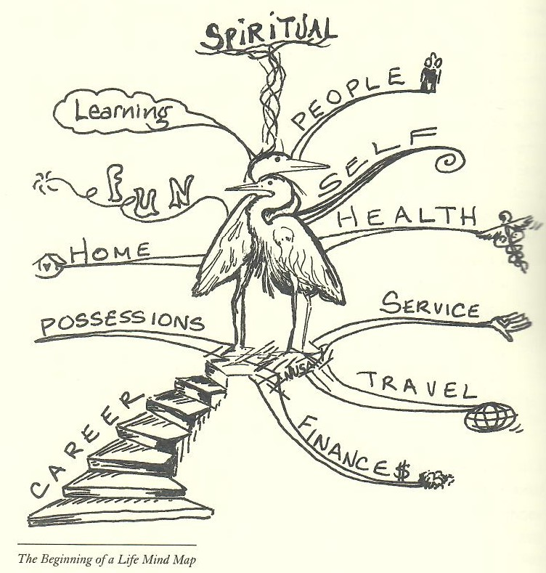
Lead

Slide 10
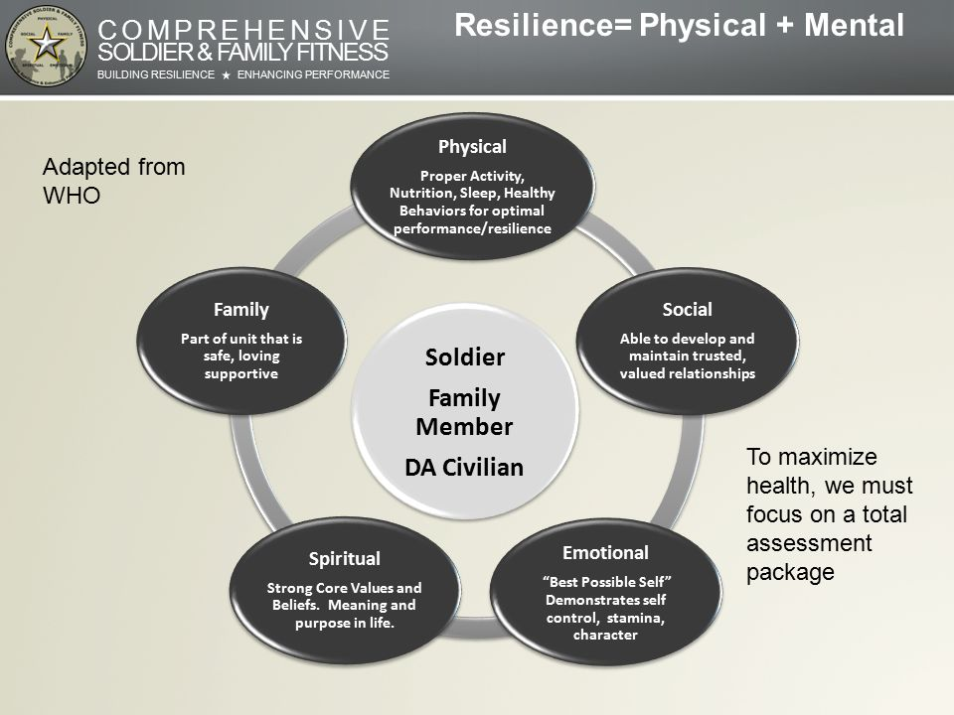

Lead

Slide 11

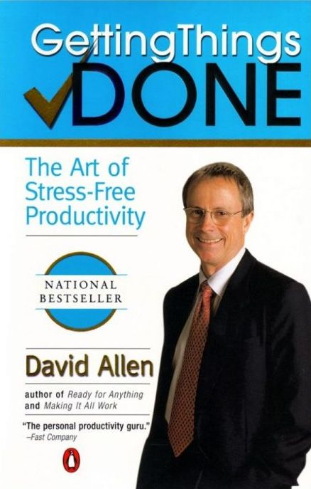
Getting Things Done®
Horizon 5: Purpose and Principles
If you are not spending enough time with your family, your health, your spiritual life, etc., you will still have “incompletes” to deal with, make decisions about, and have projects and actions about, to get completely clear.
GTD and Getting Things Done are registered trademarks of the David Allen Company

Slide 12

Lead
systems are better for making progress than goals
systems are the processes that lead to desired results, while goals are the results themselves
You do not rise to the level of your goals, you fall to the level of your systems

Slide 13
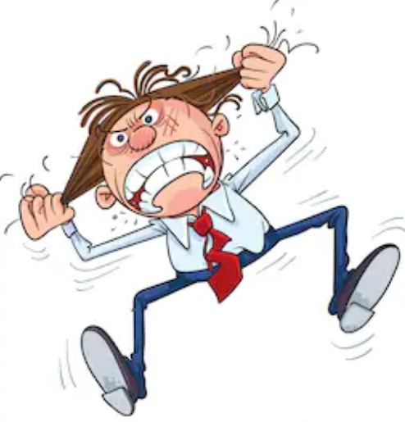
My Introduction to GTD
I felt like I had too much work and I did not feel in control.
I knew there is got to be a better way to get things done.
I Googled “getting things done”

Slide 14
Getting Things Done®
get more done with less stress
feel in control with less anxiety
tap into your creativity
make decisions with greater confidence
GTD and Getting Things Done are registered trademarks of the David Allen Company

Slide 15
Time Management Defined
Time management refers to the development of processes and tools that increase efficiency and productivity.
TheBalance.com
GTD focuses on managing your “actions” rather than your time.

Slide 16
The Mind
not good at prioritizing things stuck in RAM
thinks everything should be done immediately
sees broken commitments as personal failure
SOLUTION: get things out of our head, put them in a trusted place (inbox/collection bin)

Slide 17
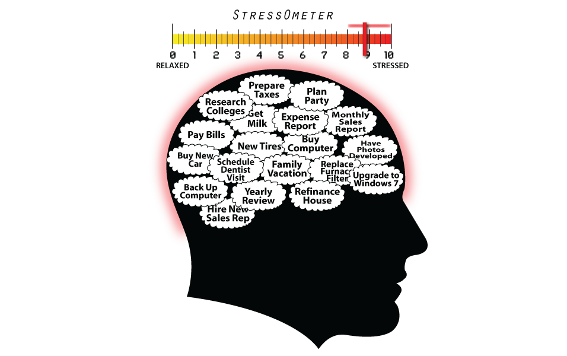
Stress!!!

Slide 18
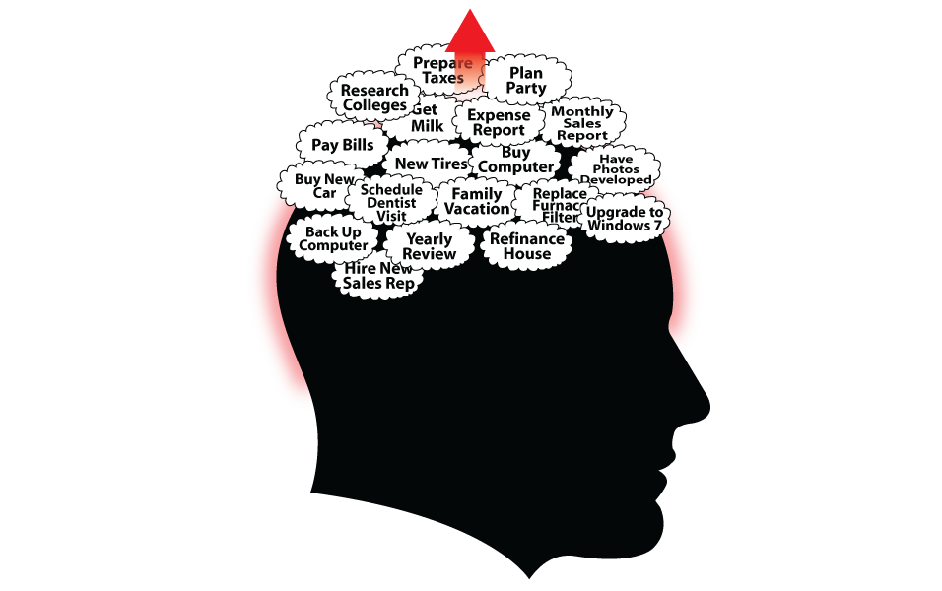
Stress!!!

Slide 19
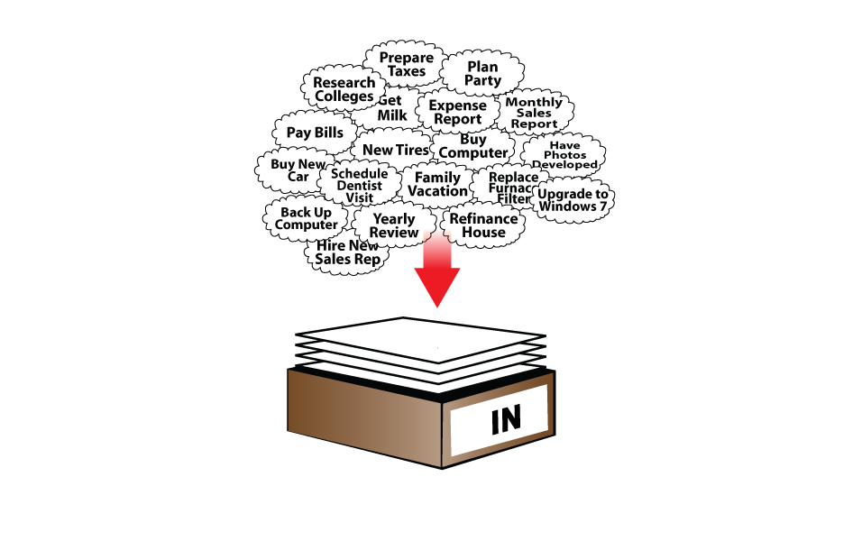
Out of Mind
Collection Bin

Slide 20
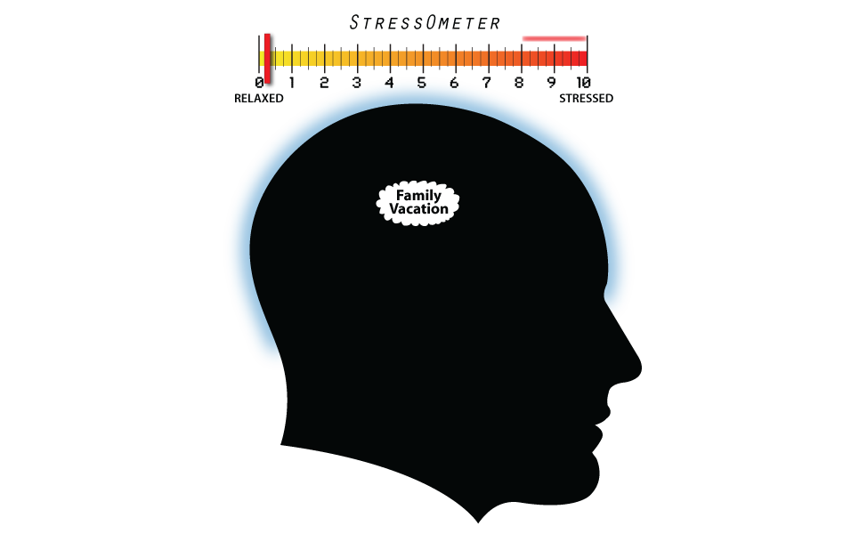
No Stress

Slide 21

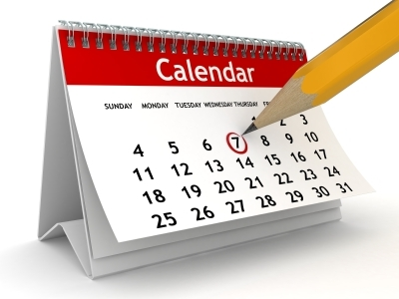
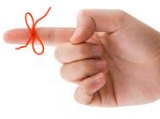

GTD Tools
Trash
Projects
To Do List
Calendar
Tickler
Parking Lot
(someday maybe)
Reference (A-Z)
GTD and Getting Things Done are registered trademarks of the David Allen Company

Slide 22
Getting Things Done®
GTD - 5 Easy Steps
Collect
Process
Organize
Review
Do
GTD and Getting Things Done are registered trademarks of the David Allen Company

Slide 23







Collect – GTD Step 1 (get it out of your head)
Stuff
capture it
GTD and Getting Things Done are registered trademarks of the David Allen Company

Slide 24
Process – GTD Step 2
What is it? - Is it actionable?
Processing is “not” doing – stay focused
Processing helps you clear your inbox and build your To Do list
Follow the basic steps when processing your stuff:
one item at a time
never back in the inbox
take from the top – don’t cherry pick from the middle
try to finish (clear the inbox)
GTD and Getting Things Done are registered trademarks of the David Allen Company

Slide 25
Organize - GTD Step 3
Incubate
File
Pitch
Not Actionable
Parking Lot
(Someday Maybe)
Reference
Trash
Do It Now
Delegate
Defer
Actionable
Two Minutes
or Less
To Do
Calendar
Tickler
Projects
GTD and Getting Things Done are registered trademarks of the David Allen Company

Slide 26
Review - GTD Step 4 (building to do list)
Calendar
Tickler
Parking Lot
(someday maybe)
Projects
GTD and Getting Things Done are registered trademarks of the David Allen Company

Slide 27
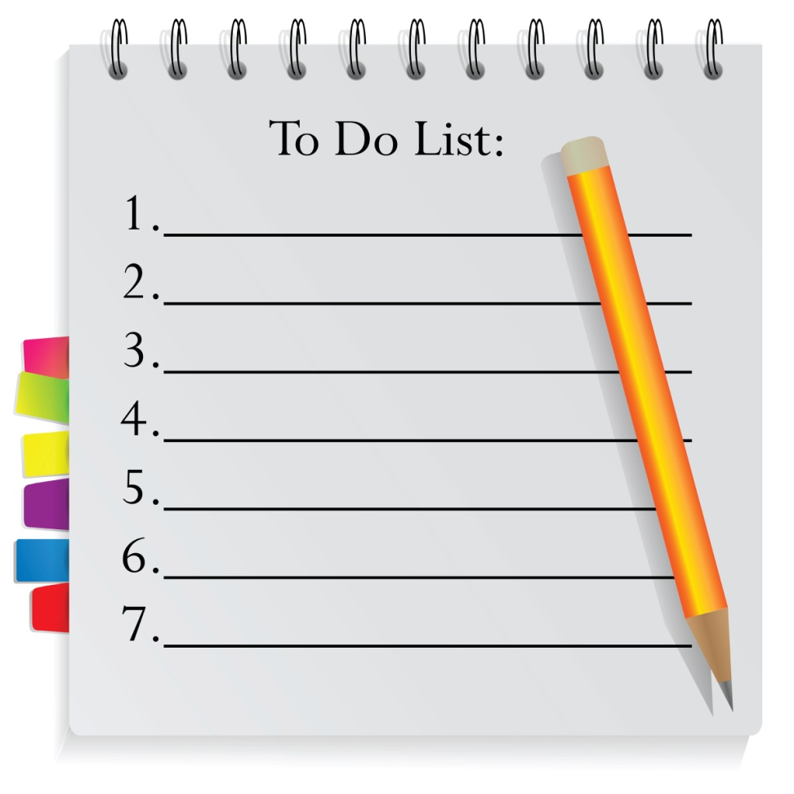
Do - GTD Step 5
Review morning routine
Set up my GTD system
Read my GTD book chapter 1
GTD and Getting Things Done are registered trademarks of the David Allen Company

Slide 28
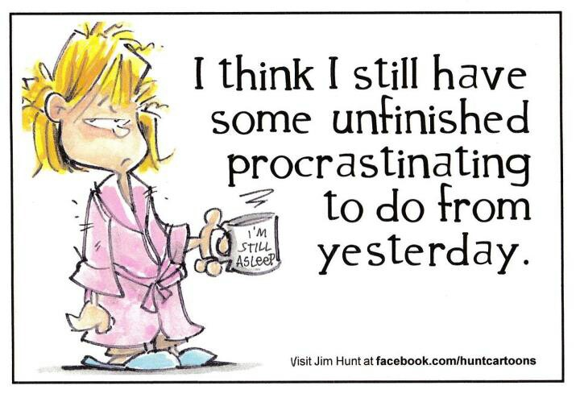
Procrastination

Slide 29
Why do we Procrastinate?
The most creative and intelligent people are some of the best procrastinators
Procrastinators create images of negative events that might happen in the future (too hard, too long, too expensive…)
Procrastinators imagine things not being done perfectly and visualize the negative consequences
Get into the habit of dumbing things down by focusing on and starting on the very next action
Countdown - 5, 4, 3, 2, 1

Slide 30
Distractions
  “A study by the University of California, Irvine found that it takes an average of 23 minutes to get yourself back on track after being interrupted.”
  Dealing with Distractions
    quit looking for distractions and push yourself to refocus sooner
    avoid the major contributors (e.g. cell phones, clutter, TV, etc.)
    use the Pomodoro Method

Slide 31
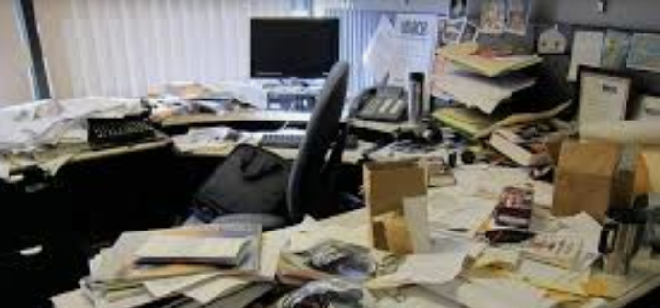
Clutter
bombards our mind with constant stimuli
draws our mind away from what we should focus on
signals our brains that our work is not complete

Slide 32
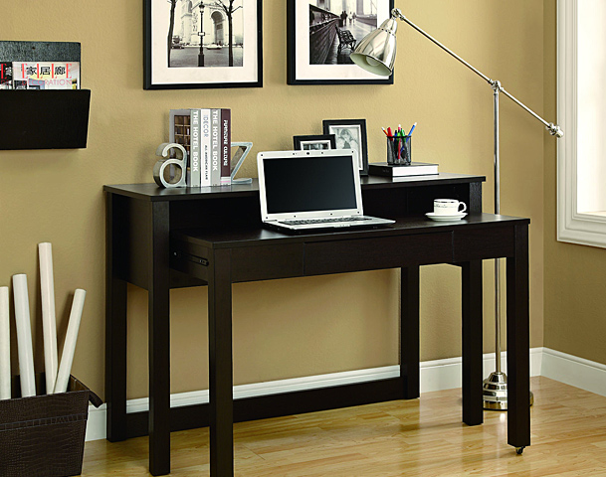
Cockpit of Control
I like this place
I want to be here
It makes me feel in control
I feel productive
I am happy with my tools

Slide 33
Tips 1 of 2
Get it out of your head and put it in a trusted place
Put a reminder in front of the door
Reduce clutter – clutter causes stress
Create a daily routine
Schedule it – become a master of your calendar
Make it easy (e.g. buy extra stuff)
Don’t make it perfect upfront
Stop saying “remind me to” or “I need to remember to” – capture it and put it in a trusted place or “do it now”

Slide 34
Tips 2 of 2
Try to finish your To Do list each day
Use your phone as a capture tool (e.g. “hey Siri create a note” “hey Siri add a reminder”)
Go to a different location (e.g. library)
Use an inbox (collection bin)
For an energy boost complete something easy
If you can’t keep a commitment renegotiate it
Look at projects from a higher level
Share your system with someone else – don’t push it on them – everyone does it differently

Slide 35
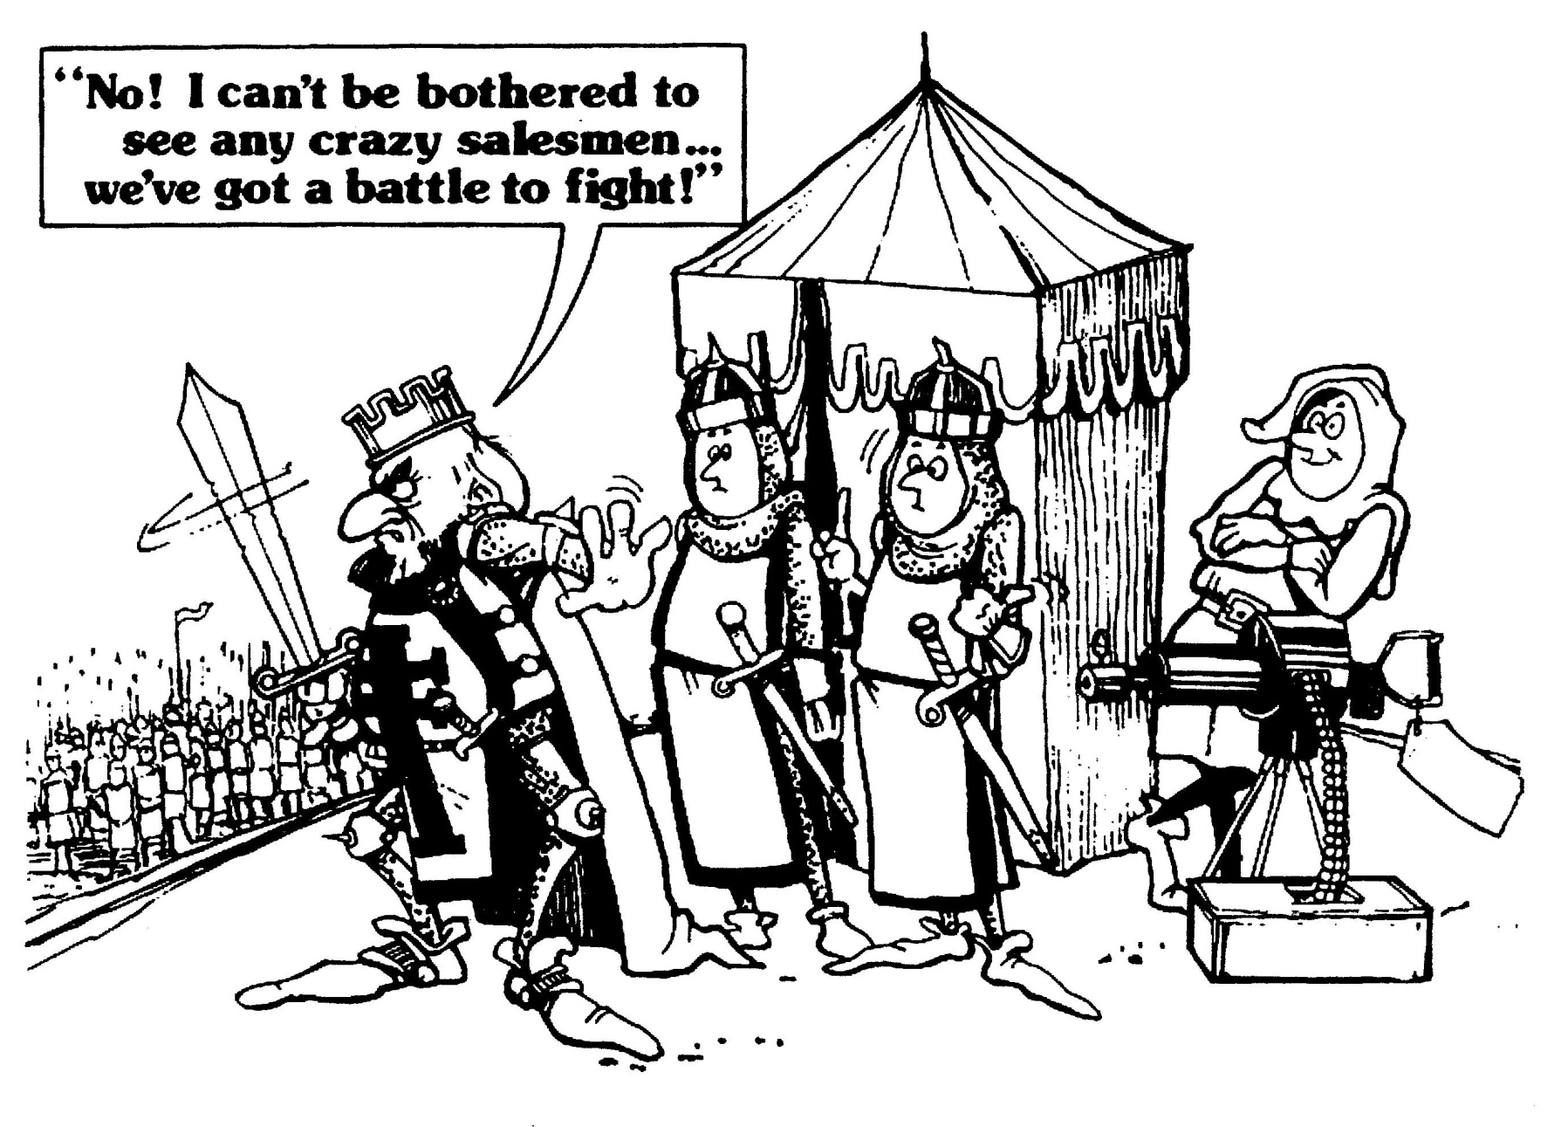
Stick With It – It is Worth It
GTD

Slide 36
Next Steps
Are we at the right level of leadership
Are we at the right level of Life Fitness
Are we ready to commit to a time management system
Note: Life Fitness components can feed your time management system (i.e. action management)

Slide 37

More Efficient – Less Stress

Slide 38
The End
Please clap now!

