Slide 1
Behavioral Health Services and Journey Recovery Center
Presented by: Lisa Arrasmith, Psychiatric Nurse Practitioner
Clinical Director of Behavioral Health and Addiction Medicine

Slide 2
SEP Behavioral Health
Practice Leaders: Jennifer Sampang PMHNP-C, Brent Plummer PMHNP-C, Dr.Tom Davis PhD.
Director of Operations: Sara Mullins Clinical Director of Operations: Lisa Arrasmith PMNNP-C
Practice Managers: Lori Cochran, Sheri Tyler, Jennifer Fulwood
Psychiatrist- 13
Psychiatric Nurse Practitioners – 18
Physician Assistants – 4
SUN Doctors/NPs– 4/4
Psychologists – 6
Licensed Clinical Social Workers – 7
Licensed Professional Clinical Counselor- 1
Licensed Professional Clinical Counselor-Supervisor-2
“Ish”
Total Prescribers:40
Total Therapist: 16

Slide 3
Top 10 Diagnoses - Adult
1) Generalized anxiety disorder
2) Unspecified mood (affective) disorder
3) Major depressive disorder, recurrent severe w/out psychotic features
4) Major depressive disorder, recurrent, moderate
5) Post-traumatic stress disorder, unspecified
6) Anxiety disorder, unspecified
7) Attention-deficit hyperactivity disorder, combined type
8) Panic disorder (episodic paroxysmal anxiety)
9) Insomnia, unspecified
10) Suicidal ideations
Notes:
Pulled by Sara Mullins for 8/2022-7/2023

Slide 4
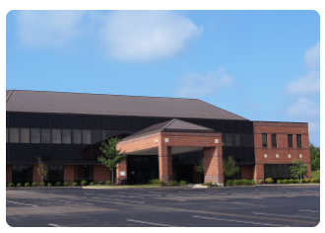
SEP Behavioral Health
Services
Offices
Adult Therapy/Testing
Child & Adolescent Therapy/Testing
Adult Medication Management/ TMS
Child/Adolescent Medication Management
SUN Inpatient Psych/ Medical
SEHC Psych Consultation
Nursing Home Psych Medication Management/Consult
Acute Psychiatric Intervention Clinic
Thomas More University Counseling Services
Main Hub - Crestview
Primary Care Practices
Behavioral Health located within 11 sites.

Slide 5
SEP Journey Recovery Center
Practice Leaders: Teresa Koeller-Brueggemann, MD; Mina Kalfas, MD
Director of Operations: Sara Mullins Clinical Director of Operations: Lisa Arrasmith PMNNP-C
Practice Manager: Stacey Tolle
Program Manager: Alivia Eggleston
Therapeutic Services Manager: Julie Williams
Total Prescribers: 9
Total Therapist: 11
Psychiatrist- 1
Psychiatric Nurse Practitioners – 1
Doctors/NPs– 7
Licensed Clinical Social Workers – 3
Licensed Cinical Social Worker-Supervisor- 1
Licensed Professional Clinical Counselor- 3
Licensed Marriage & Family Counselor- 2
Clinical Social Workers- 2

Slide 6
Top 10 Diagnoses- JRC
1) Other long term (current) drug therapy
2) Opioid dependence, uncomplicated (HCC)
3) Unspecified mood (affective) disorder (HCC)
4) Generalized anxiety disorder
5) Nicotine dependence, cigarettes, uncomplicated
6) Essential (primary) hypertension
7) Anxiety disorder, unspecified
8) Alcohol dependence, uncomplicated (HCC)
9) Encounter for therapeutic drug level monitoring
10) Other psychoactive substance abuse, uncomplicated (HCC)
Notes:
Pulled by Sara Mullins for 8/2022-7/2023

Slide 7
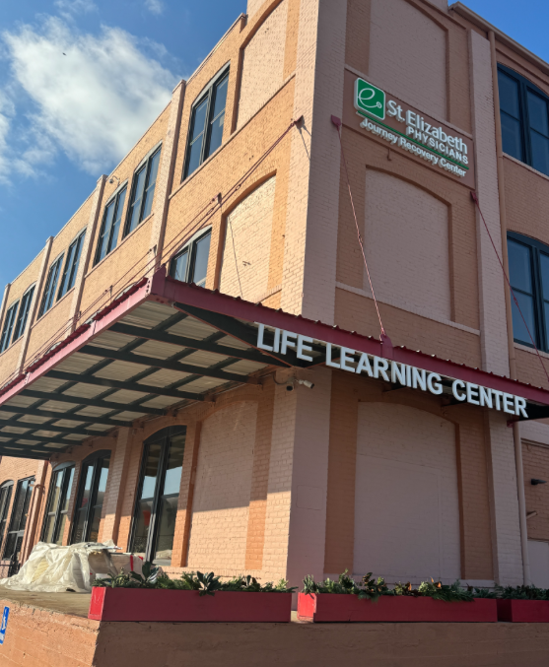
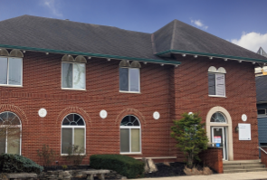
SEP journey recovery center
Services
Offices
Medication Assisted Treatment (MAT)
Intensive Outpatient Treatment (IOP)
Individual Therapy
Group Therapy
MAT Groups
Targeted Case Management
Peer Support Specialists
Psychiatry/Behavioral Health
Baby Steps Program
Main Hub - Covington
Alternate Location-
Aurora, IN

Slide 8
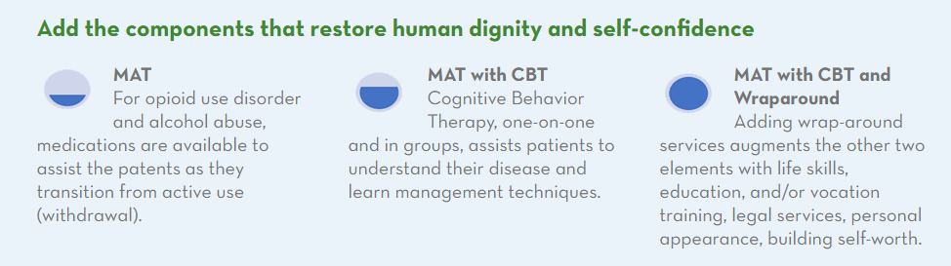
Focus on all aspects of recovery
Focus on All Aspects of Recovery
Gold Standard of Treatment
JRC is designed to assist individuals out of substance use disorder and onto a pathway to wellness. JRC staff have provided services to an average of 1,500 individuals per year, accounting for nearly 33,000 office visits. Therapeutically, our goal is facilitating independence, short-term and long-term recovery support, and the rebuilding of lives and families.
Patient Centered Approach
JRC provides a continuum of patient-centered care to meet the socioeconomic and biopsychosocial needs of the individuals we serve using a multi-faceted approach

Slide 9
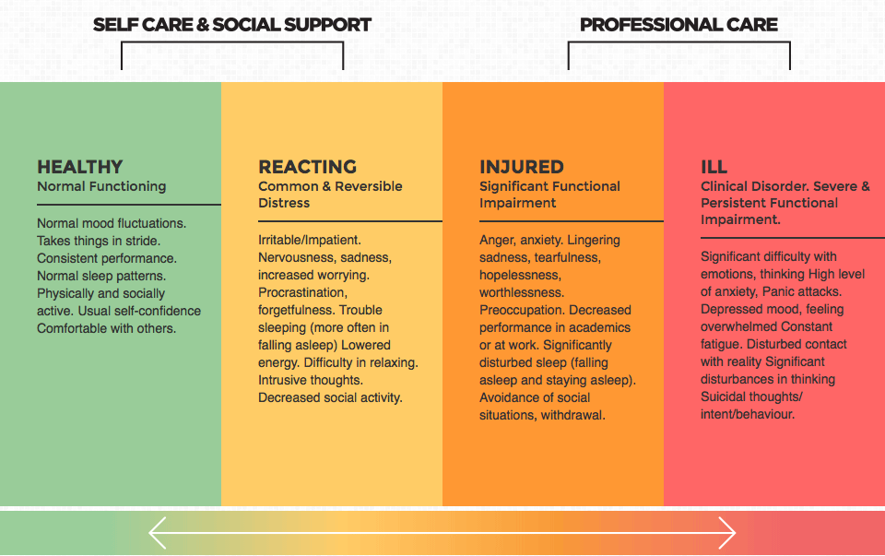
Vision: Gift access and time to help
Education for the community on intervening sooner and where to take patients in different phases.
Source: https://mental-health-matters.org/about-mental-health/attitudes-to-mh-issues/the-mental-health-continuum/

Slide 10
Different Levels of care and resources:
Access and Triage for Psychiatry and Mental Health
Who ya’ gonna call?
- These patients need Stabilization and Safety Rapid/Immediately now in 24 hrs or less:
Thoughts of harming self or others, Behavior that is life threatening or destructible, actively psychotic, safety risk with medica manic/impulsive/unpredictable, safety risk with medications or medication withdrawal severe: GO TO SUN
    - If patient is medically unstable or concern for medical instability that medical clearance at the ER is necessary. Once stable can transfer to SUN...
    These patients need Higher level of care but not full Inpatient within the week-2 weeks:
    Difficulty keeping up with daily functions, family/work and social interactions now problems because of symptoms and impairments. Close medication adjustments or observations by provider 1-2 x a week. Group therapy in Intensive Outpatient or Partial Hospitalization programs at SUN and CHNK
    These patients need help with Outpatient Psych/Mental health resources within 1-4 months.
    Depressed mood, panic attacks, bipolar disorder, OCD, ADHD, Stress/anxiety, Adjustment disorder, difficulty sleeping. Patients are mostly stable on meds or initiating med management for psych/mental health needs.
    These patients may have minor issues of mental health that are in need of better health and support to live healthy lifestyle- Self management.
    Patients with need for coaching on living healthy lifestyle- smoking cessation, stress management, adjustment to life transitions/phases. Care Management Team could provide Brief Intervention Therapy for these patients and Resource Coordination.
SUN Behavioral Kentucky- 859-484-8700
Intake evaluations, Intensive Outpatient, Partial Hospitalization, Inpatient.
911/ ER- emergency psych consults at all SEHC locations or If patient is medically unstable or concern for medical instability that medical clearance at the ER is necessary. Once stable can transfer to SUN...
Call #988- Crisis and Suicide Hotline by Northkey
Care Management Team in Primary Care-embedded at each SEP PCP office.
NURSE NOW HELPLINE 888-4STE-NOW
SEP On Demand Video Visits- VIDEO VISITS ON DEMAND
SCHEDULE A VIDEO VISIT WITH MYCHART
SEP BH outpatient- Call 859-301-5901 option 1
Community Partners- Health Point, Childrens,CHNK, Northkey, DCCH, Viewpoint, MEBS, NAMI, Mental Health America, Alzheimer's Association, Ellie Mental Health, Hope Behavioral Health, Lifestance, L & C Psychological

Slide 11
Different Levels of care and resources:
Access to other levels of care for Addiction Medicine
Who ya’ gonna call?
- These patients need Stabilization and Safety Rapid/Immediately now in 24 hrs or less:
Patients who are unable to stop use of drugs/alcohol or are going through withdrawal will be referred to detox before continuing outpatient care with Journey Recovery Center
Thoughts of harming self or others, Behavior that is life threatening or destructible, actively psychotic, safety risk with medica manic/impulsive/unpredictable, safety risk with medications or medication withdrawal severe: GO TO SUN
    - If patient is medically unstable or concern for medical instability that medical clearance at the ER is necessary. Once stable can transfer to SUN...
    These patients need Higher level of care :
    Difficulty maintaining sobriety, attending meetings, attending appointments (therapy, group therapy, intensive outpatient treatment, medical appointments), have positive urine drug screens, unable to maintain employment or housing
    These patients may have minor issues of mental health that are in need of better health and support to live healthy lifestyle- Self management.
    Patients in need of resources/assistance with housing, employement, vision, dental work, budgeting, and so much more can receive Targeted Case Management Services. Patients who need recovery coaching can speak to one of our Peer Support Specialists for guidance and support.
SUN Behavioral Kentucky- 859-484-8700
Intake evaluations, Intensive Outpatient, Partial Hospitalization, Inpatient.
911/ ER- emergency psych consults at all SEHC locations or If patient is medically unstable or concern for medical instability that medical clearance at the ER is necessary. Once stable can transfer to SUN...
The Ridge- 859-269-2325
Dual diagnosis, provides detox services
Beckett Springs- 513-942-9500
Provides detox- accepts Private insurance; Medicare/Tricare
Northern Kentucky Helpline (859-415-9280)
Residential Treatment Center (RTC) 859-491-4435
Recovery Works- 606-498-4174
Provides detox and residential services with MAT
SEP On Demand Video Visits- VIDEO VISITS ON DEMAND
SCHEDULE A VIDEO VISIT WITH MYCHART
SEP BH outpatient- Call 859-301-5901 option 1
Community Partners- Life Learning Center, The Brighton Center, Kentucky Career Center

Slide 12
Who knows where to go or who to call?
Northern Kentucky resources:
St. Elizabeth Physicians Resources:
-For SEP BH outpatient- Call 859-301-5901 option 1
-NURSE NOW HELPLINE
888-4STE-NOW
Don’t Wait and Worry!
-Video Visits- VIDEO VISITS ON DEMAND
SCHEDULE A VIDEO VISIT WITH MYCHART
-Journey Recovery Center- Covington Suite 300
20 West 18th Street
Covington, KY 41011-3329
(859) 757-0717
-SUN Behavioral Kentucky- 859-484-8700
Intake evaluations, Intensive Outpatient, Partial Hospitalization, Inpatient.
Call #988- Crisis and Suicide Hotline by Northkey- mobile crisis options!
ER- emergency psych consults at all SEHC locations-medical clearance and then triaged to SUN if needed.
-Community Partners- Health Point, Childrens,CHNK, Northkey, DCCH, Viewpoint, MEBS, NAMI, Mental Health America, Alzheimer's Association, Ellie Mental Health, Hope Behavioral Health, Lifestance, L & C Psychological
St. Elizabeth Physicians

Slide 13
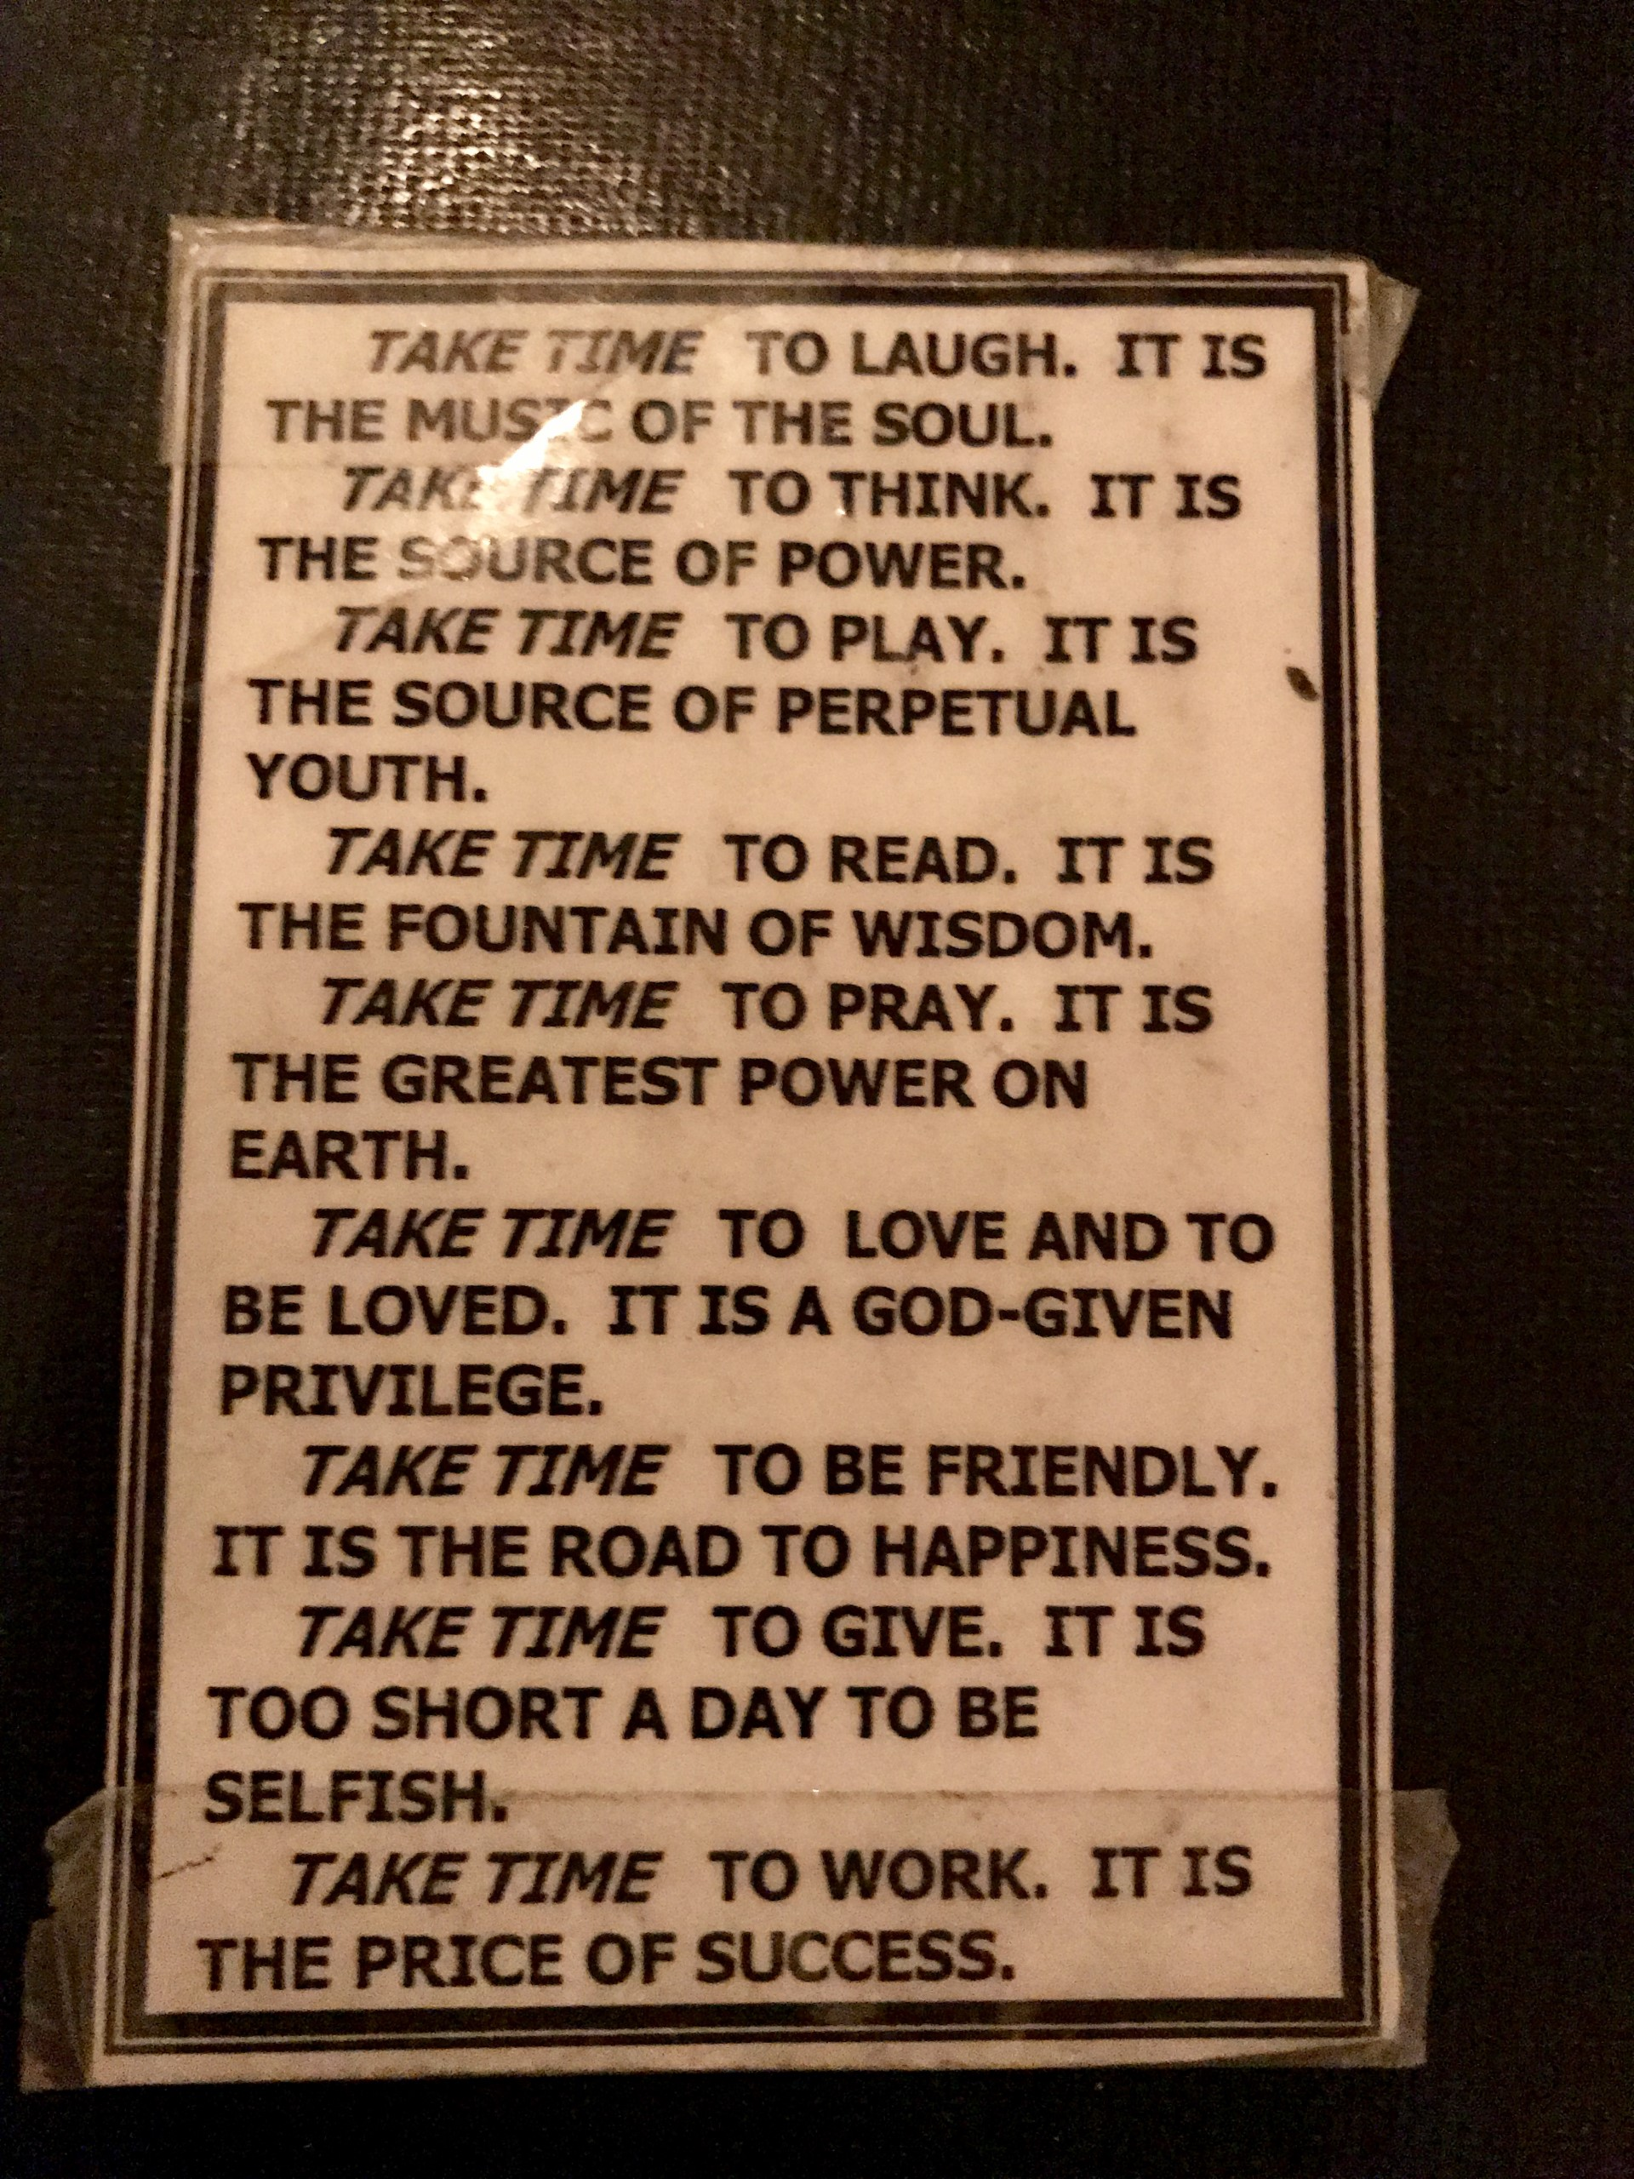
Reflection on Time
Time is a blessing and a curse…..
Take TIME to Laugh. It is the music of the soul.
Take TIME to Think. It is the source of power.
Take TIME to Play. IT is the source of perpetual youth.
Take TIME to Read. It is the fountain of wisdom.
Take TIME to Pray. It is the greatest power on Earth.
Take TIME to Love and to be Loved. It is a GOD-GIVEN privilege.
Take TIME to be Friendly. It is the road to happiness.
Take TIME to Give. It is too short a day to be selfish.
Take TIME to Work. It is the price of success.

