Slide 1

Emotional Intelligence at Work
Dr. Sandra Spataro
Notes:
Script notes: https://docs.google.com/document/d/154bL_4kSrkkMxCFI5ST8UV6tCci6PtbL2RkiIw3uuuo/edit

Slide 2


Imagine a typical day…
When do you feel like this?
Notes:
Before we jump into content… start with a reflection. Imagine a typical day for you… picture yourself walking in the door in the morning, going to your classroom, getting prepped for the day, students rolling in… imagine all of the ups and downs of your day.
When do you feel like this… swimming against the current, the day feels hard, you’re stressed, tired, anxious, irritated, water splashing in your face, not able to move as fast as you want… (examples)
When do you feel like this… Swimming with the current - When we’re in the flow, fully engaged and present, at our best in terms of performance, our emotions are working with us (examples)
Write in the textbox right now what your day is looking like so far. Write first if it feels like this, second if it feels more like this….

Slide 3
How the “current of emotions” shapes our day
Swimming Against the Current
Swimming With the Current
Stressed out; burned out
Difficulty relating to colleagues
Problems communicating effectively
Problems focusing
Emotional distress
Dissatisfied with work
More attuned to colleagues
Better able to handle stress
Less burnout
Better relationships with colleagues
Receive more support from upper management
Greater work satisfaction
(Yale Center for Emotional Intelligence)
Notes:
What’s the difference? It’s the circumstances, yes. But it’s also a lot about how we respond to the circumstances. Specifically, how we manage our emotions….

Slide 4
What determines if you are swimming “against” the current or “with” the current?

Slide 5

Emotions as Currents
  20,000 waves of emotions per day
  warning: emotions are highly contagious!
  we ignore them or notice them
  we suppress or manage them

Slide 6
“The rules for work are changing. We are being judged in new ways. Not just by how smart we are, but by how we handle ourselves and each other.”
- Daniel Goleman, Working with Emotional Intelligence

Slide 7
Emotional Intelligence is a differentiator among leaders.
Everyone hearing this talk is a leader.
Notes:
“In a study of 300 top-level executives from 15 global companies, 85-90% of leadership success was linked to social and emotional intelligence.”
Competency Assessment Methods: History and State of the Art, Lyle Spencer, 1997
“In a study of 100 leaders from family firms – with revenues ranging from under $25M to over $500M – emotional and social intelligence explained ⅔ of the variance in leadership effectiveness.”
Miller, 2015
“Research in over 200 organizations worldwide attributes ⅓ of the difference between top performers and average performers to technical and cognitive ability, and ⅔ to emotional competence.”
Goleman, 1998
High EI business people report higher sales results, more profitable account management, and profit growth.
“At L’Oreal, sales professional with high EI scores sold $91,370 more than their lower-scoring peers.”
Spencer & Spencer, 1993
“The ability of financial services leaders to recruit new financial advisors – a key driver of sales revenue – was attributed to their emotional and social intelligence (.33, p<.01)”
Boyatzis, Good, Massa, 2012
“High scoring consulting partners delivered $1.2 million more profit from their accounts than their peers.”
Boyatzis, 1999
“In a study of the competencies that best predict profitability in a European firm, four emotional and social intelligence competencies predicted 17% of the variance in profit growth.”
Ryan, Spencer, Bernhard, 2012
“In studies of the competencies demonstrated by managers, 11 of the 12 EI competencies differentiated high potential managers and those who had already been identified for promotion.”
Ryan, Emmerling, Spencer, 2009
“In a multinational study of 515 senior executives, EI scores were high in 74% of successful hires, but only high in 24% of failed hires.”
Egon Zehnder International
“In most complex jobs a top performer is 127% more productive than an average performer.”
Hunter, Schmidt & Judiesch, 1990

Slide 8
People with high EI...
Strive to meet or exceed high standards.
Show empathy and insight in their relationships.
Adapt to change and help to make change happen.
Resolve conflict, lead others and co-operate.
Maintain their effectiveness under stress.
Influence, coach and develop others.
Look for ways to overcome obstacles.
Bring out the best in themselves and others.
(Korn Ferry)

Slide 9
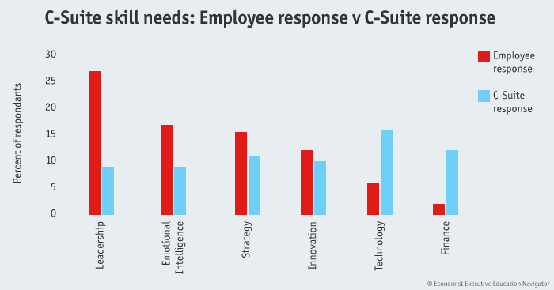
Who needs EI?
Ask employees…
Notes:
In a recent survey by The Economist Executive Education Navigator of more than 4,000 professionals, a sharp divergence emerged between skills that C-Suite executives think they need and those that their employees want them to prioritise. In fact, answers from the two groups were nearly inverse.
In the survey, which was conducted on Economist.com, C-Suite executives most frequently cited technology and finance as the two areas where they sought to improve. Yet when lower-ranking employees were asked what skills they wished their top executives would hone, leadership and emotional intelligence were the most popular answers.

Slide 10
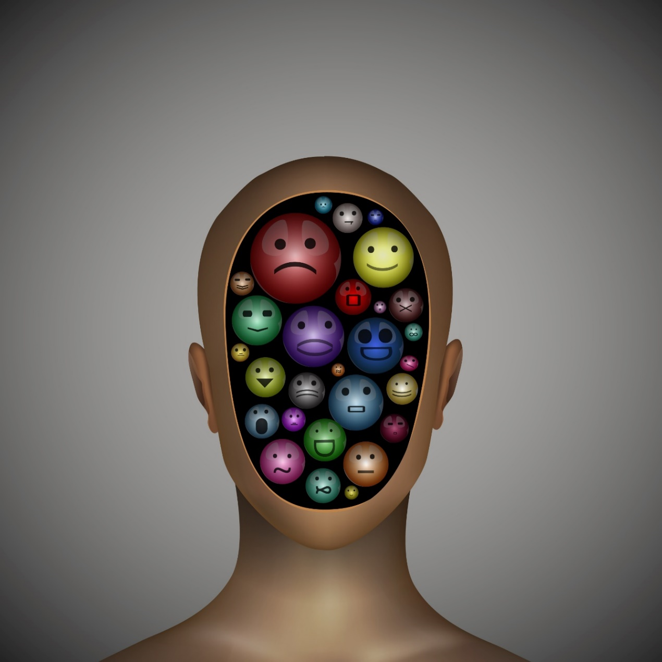
So….
WHAT IS EI?

Slide 11
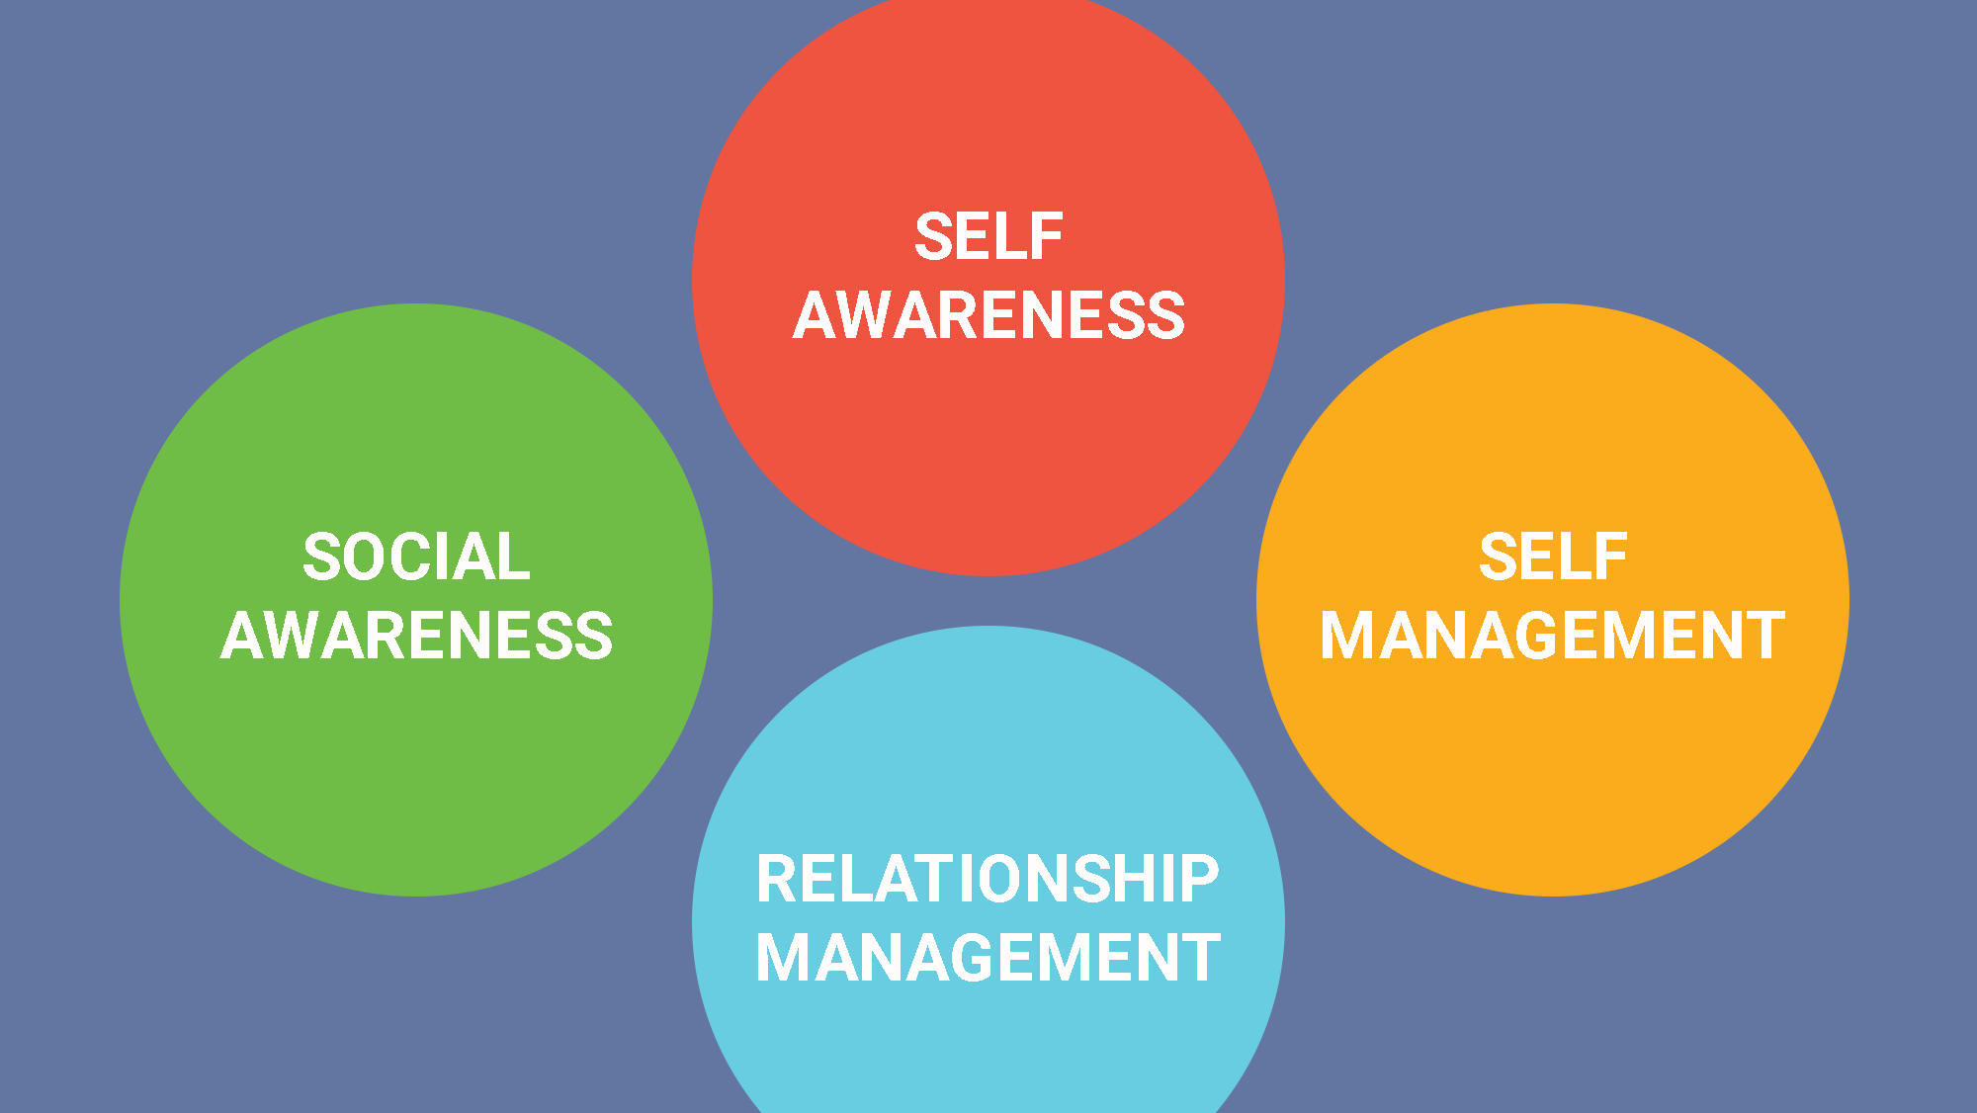
Goleman, Emotional Intelligence

Slide 12
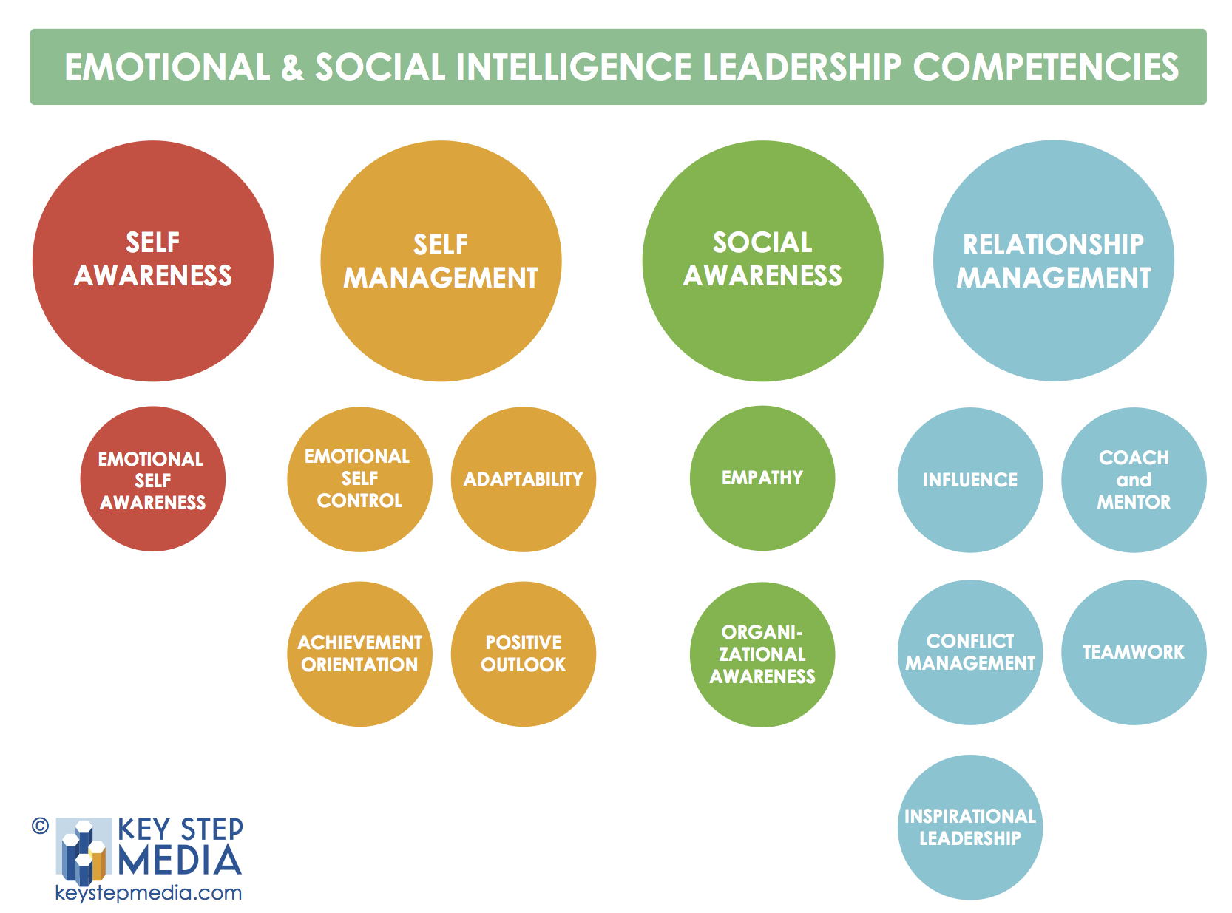
Emotional & Social Intelligence
Perceiving and understanding your own emotions
Managing your own emotions
Perceiving and understanding others’ emotions
Managing other people’s emotions
EI Competence

Slide 13
Self-awareness: the heart of emotional intelligence
What are you feeling right now?
Self-Awareness
Notes:
Emotional self-awareness
Recognizing how your emotions affect your performance.
Knowing your own inner resources, abilities, and limits.
Honesty in your positive and negative biases, and your own strengths and weaknesses.
Being open to feedback.
Having a sense of humor about yourself.

Slide 14
Acceptance
Admiration
Adoration
Affection
Afraid
Agitation
Agony
Aggressive
Alarm
Alarmed
Alienation
Amazement
Ambivalence
Amusement
Anger
Anguish
Annoyed
Anticipating
Anxious
Apathy
Apprehension
Arrogant
Assertive
Astonished
Attentiveness
Attraction
Aversion
Awe
Baffled
Bewildered
Bitter
Bitter sweetness
Bliss
Bored
Brazen
Brooding
Calm
Carefree
Careless
Caring
Charity
Cheeky
Cheerfulness
Claustrophobic
Coercive
Comfortable
Confident
Confusion
Contempt
Content
Courage
Cowardly
Cruelty
Curiosity
Cynicism
Dazed
Dejection
Delighted
Demoralized
Depressed
Desire
Despair
Determined
Disappointment
Disbelief
Discombobulated
Discomfort
Discontentment
Disgruntled
Disgust
Disheartened
​Dislike
Dismay
Disoriented
Dispirited
Displeasure
Distraction
Distress
Disturbed
Dominant
Doubt
Dread
Driven
Dumbstruck
Eagerness
Ecstasy
Elation
Embarrassment
Empathy
Enchanted
Enjoyment
Enlightened
Ennui
Enthusiasm
Envy
Epiphany
Euphoria
Exasperated
Excitement
Expectancy
Fascination
Fear
Flakey
Focused
Fondness
Friendliness
Fright
Frustrated
Fury
Glee
Gloomy
Glumness
Gratitude
Greed
Grief
Grouchiness
Grumpiness
Guilt
Happiness
Hate
Hatred
Helpless
Homesickness
Hope
Hopeless
Horrified
Hospitable
Humiliation
Humility
Hurt
Hysteria
Idleness
Impatient
Indifference
Indignant
Infatuation
Infuriated
Insecurity
Insightful
Insulted
Interest
Intrigued
Irritated
Isolated
Jealousy
Joviality
Joy
Jubilation
Kind
Lazy
Liking
Loathing
Lonely
Longing
Loopy
​Love
Lust
Mad
Melancholy
Miserable
Miserliness
Mixed up
Modesty
Moody
Mortified
Mystified
Nasty
Nauseated
Negative
Neglect
Nervous
Nostalgic
Numb
Obstinate
Offended
Optimistic
Outrage
Overwhelmed
Panicked
Paranoid
Passion
Patience
Pensiveness
Perplexed
Persevering
Pessimism
Pity
Pleased
Pleasure
Politeness
Positive
Possessive
Powerless
Pride
Puzzled
Rage​
Rash
Rattled
Regret
Rejected
Relaxed
Relieved
Reluctant
Remorse
Resentment
Resignation
Restlessness
Revulsion
Ruthless
Sadness
Satisfaction
Scared
Schadenfreude
Scorn
Self-caring
Self-compassionate
Self-confident
Self-conscious
Self-critical
Self-loathing
Self-motivated
Self-pity
Self-respecting
Self-understanding
Sentimentality
Serenity
Shame
Shameless
Shocked
Smug
​Sorrow
Spite
Stressed
Strong
Stubborn
Stuck
Submissive
Suffering
Sullenness
Surprise
Suspense
Suspicious
Sympathy
Tenderness
Tension
Terror
Thankfulness
Thrilled
Tired
Tolerance
​Torment
Triumphant
Troubled
Trust
Uncertainty
Undermined
Uneasiness
Unhappy
Unnerved
Unsettled
Unsure
Upset
Vengeful
Vicious
​Vigilance
Vulnerable
Weak
Woe
Worried
Worthy
Wrath
EMOTIONS
Self-Awareness

Slide 15
INSPIRATION
Self-Awareness
Passionate
Determined
Joyful
Engaged
Optimistic
Bored
Content/Calm
Lonely/Sad
Cautious
Overwhelmed
Frustrated
BURNOUT

Slide 16
Self-management: the fire and the brakes
.
Self-Management
How can you use and express your emotions appropriately – and for your benefit?
Notes:
Emotional self-control
Keeping disruptive emotions and impulses in check.
Adaptability
Flexibility in handling change.
Achievement orientation
Striving to meet or exceed a standard of excellence.
Positive outlook
Persistence in pursuing goals despite obstacles and setbacks

Slide 17
Managing emotions requires…
Self-Management
Noticing when your emotions are working against you,
Knowing what emotions would better serve you in that moment, and
Using strategies to swiftly shift your emotions.

Slide 18
Managing the Amygdala Hijack
&
Increasing positive/decreasing negative emotions

Slide 19

That moment… when you cannot believe what you just heard or saw…
when you are completely stunned/
halted/shocked/ angered/ disappointed…

Slide 20
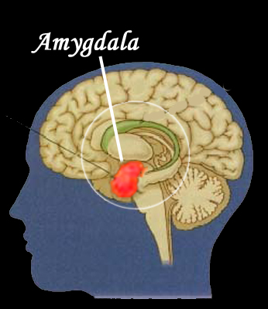
The Amygdala Hijack
Self-Management
Happens in response to extreme stress.
The amygdala (emotion center) hijacks control over the frontal lobes (logic center).
You can’t think clearly, make rational decisions, or control your emotions.
Notes:
Lead: Allison
Time: 2 min
Content: Neuroscientist Joseph LeDoux suggests that we process things emotionally first, long before they ever reach our rational mind. His work ultimately informed well-known author and psychologist Daniel Goleman who would later call these overwhelming experiences “amygdala hijacking.”
Essentially, your emotions take over your brain and any rational response you might make. The brain’s amygdala, which runs our fight, flight or freeze response, jumps into action without giving you a chance to mull things over. Your poor neocortex — home of impulse control — doesn’t stand a chance.
When your amygdala takes over, you get grabbed by something – and your reactions from this place of the brain are impulsive, lack empathy… language locks down… become less effective at solving problems…As leaders, becoming more aware of our triggers and when we are acting from this grabbed place can be extremely helpful as we can choose to shift our emotions before reacting
Amygdala
The amygdala is a collection of cells near the base of the brain. There are two, one in each hemisphere or side of the brain. This is where emotions are given meaning, remembered, and attached to associations and responses to them (emotional memories).
The amygdala is considered to be part of the brain’s limbic system. It’s key to how you process strong emotions like fear and pleasure.
Fight or flight
Early humans were exposed to the constant threat of being killed or injured by wild animals or other tribes. To improve the chances of survival, the fight- or-flight response evolved. It’s an automatic response to physical danger that allows you to react quickly without thinking.
When you feel threatened and afraid, the amygdala automatically activates the fight-or-flight response by sending out signals to release stress hormones that prepare your body to fight or run away.
This response is triggered by emotions like fear, anxiety, aggression, and anger.
Frontal lobes
The frontal lobes are the two large areas at the front of your brain. They’re part of the cerebral cortex, which is a newer, rational, and more advanced brain system. This is where thinking, reasoning, decision-making, and planning happen.
The frontal lobes allow you to process and think about your emotions. You can then manage these emotions and determine a logical response. Unlike the automatic response of the amygdala, the response to fear from your frontal lobes is consciously controlled by you.
When you sense danger is present, your amygdala wants to automatically activate the fight-or-flight response immediately. However, at the same time, your frontal lobes are processing the information to determine if danger really is present and the most logical response to it.
When the threat is mild or moderate, the frontal lobes override the amygdala, and you respond in the most rational, appropriate way. However, when the threat is strong, the amygdala acts quickly. It may overpower the frontal lobes, automatically triggering the fight-or-flight response.
The fight-or-flight response was appropriate for early humans because of threats of physical harm. Today, there are far fewer physical threats, but there are a lot of psychological threats caused by the pressures and stresses of modern life.
When stress makes you feel strong anger, aggression, or fear, the fight-or-flight response is activated. It often results in a sudden, illogical, and irrational overreaction to the situation. You may even regret your reaction later.
A psychologist named Daniel Goleman called this overreaction to stress “amygdala hijack” in his 1995 book, “Emotional Intelligence: Why It Can Matter More Than IQ.”
It happens when a situation causes your amygdala to hijack control of your response to stress. The amygdala disables the frontal lobes and activates the fight-or-flight response.
Without the frontal lobes, you can’t think clearly, make rational decisions, or control your responses. Control has been “hijacked” by the amygdala.

Slide 21
Managing Hijacks - Discussion
(pair share)
Self-Management
When were you last hijacked by your emotions?
What was the impact on you/team/others?
How did you manage your emotions well?
What could you have done differently?
Please be prepared to share your insights.
Notes:
Lead: Allison
Time: 10 min
We’re going to start off with a quick warm up to get you thinking about how emotions impact you day-to-day – self and other…
Take 3 minutes to complete the worksheet
Break into pairs, and discuss (4 min); group share (3 min) – as groups share strategies, write them up on the board.

Slide 22
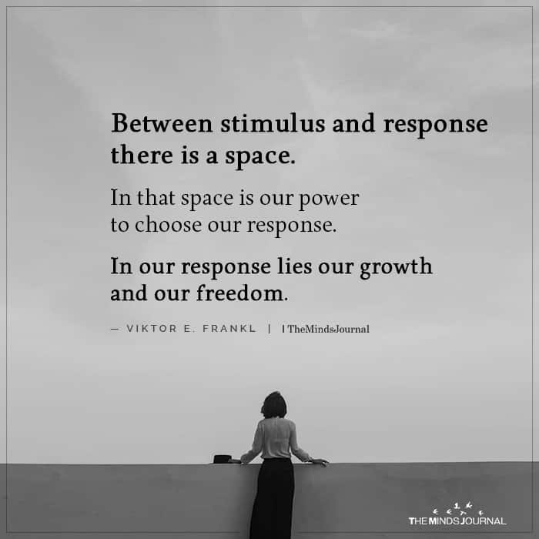
We choose our response to amygdala hijacks.
Self-Management

Slide 23
managing the hijack: create more space
emotional | cognitive | physical

Slide 24
Creating space to recover from a hijack
Self-Management
Step away
Breathe
Change mindsets
Use reset rituals (movement, body postures)
Listen to music
Seek social support or advice
Prime positive emotions

Slide 25

Increasing Positive & Decreasing Negative Emotions
Self-Management

Slide 26
Important note
Self-Management
Remember that all emotions, even negative ones, can be adaptive and helpful. For example, moderate anxiety supports performance in high stress situations more than no anxiety). Anger, when warranted and expressed appropriately, can motivate action in yourself or others. In situations that require critical thinking, positive emotions can be distracting. The key is to know how positive/negative emotions work, when they are most effective for you and others, and how to generate them when needed.

Slide 27
Positive emotions at work
Self-Management
“Positive emotions are consistently associated with better performance, quality, and customer service—this holds true across roles and industries and at various organizational levels.”
HBR, “Manage your emotional culture,” 2016

Slide 28
How do you decrease negative emotions?
Use the hijack coping methods…reset energy and emotions by creating space.
“Stop, drop, and give me 5” (things you are grateful for in this moment)
Go down and up 3 flights of stairs: on the way down, think of three negative emotions you are letting go of; and on the way up, think of 3 positive emotions you are generating.
When faced with a conflict, practice your growth mindset, using your creativity and curiosity to understand – what happened here? What can I learn from this?
Self-Management

Slide 29
Generating Positive Emotions Discussion
Self-Management
What brings you joy?
What are you grateful for right now?
How do you remind yourself of sources of positivity in all aspects of your life?
What is your “feel good” theme song/playlist?
.
Notes:
Lead: Allison
Time: 10 min
We’re going to start off with a quick warm up to get you thinking about how emotions impact you day-to-day – self and other…
Take 3 minutes to complete the worksheet
Break into pairs, and discuss (4 min); group share (3 min) – as groups share strategies, write them up on the board.

Slide 30

Positive emotion go-to’s: generate gratitude express appreciation find your play-list
Self-Management

Slide 31
Social awareness: tuning in
What are others feeling right now?
Social Awareness
Notes:
Emotional awareness
Reading a person’s or group’s emotional state and the related dynamics
Empathy
Sensing others’ feelings and perspectives.
Taking an active interest in their concerns.

Slide 32
What emotions do you see expressed in the workplace?
53%
19%
ANGER
JOY
(S. Barsade)
Notes:
Content:
Ask the question first – what emotions do you see in the workplace? See if they come up with examples of anger, etc..
Then ask, what emotion do you think the study shows comes up the most/least in the workplace? Animate in both columns.
Debrief – Does this surprise you? Why/why not? What emotions do you want to see (culture)?
Define: display rules…what are the display rules in your organizations?

Slide 33

Social Awareness
Empathy →
emotional intelligence
Notes:
Some researchers talk about empathy as being an outcome of EI… I think it can also be a foundational pre-cursor... In other words, the more we practice being empathetic, the more our EI skills will increase.
So the tool we will share with you today focuses exclusively on empathy, helping you develop it and express it.
Empathy is foundational to EI. And, on its own, it has been shown to have business impact. According to a recent HBR article and the 2015 Global Empathy Index ratings: “there is a direct link between empathy and commercial success.”
In this study, the most empathetic companies, as measured by internal culture, social media, company ethics, and CEO performance, generated the most value and revenue growth. In fact, according to a recent Forbes article, empathy moves business forward: “Although the concept of empathy might contradict the modern concept of a traditional workplace—competitive, cutthroat, and with employees climbing over each other to reach the top…the reality is that for business leaders to experience success, they need to not just see or hear the activity around them, but also relate to the people they serve.”

Slide 34
Empathy has always been critical. It is taking on new meaning now.
Social Awareness
Forbes, Empathy is the Most Important Leadership Skill According to Research (2021)

Slide 35
Empathy drives positive work outcomes
Social Awareness
Comparing those who report having an empathetic leader to those who do not:
Innovation (61% with empathetic leaders v. 13%)
Engagement (76% v. 32%)
Retention (~60% of women said less likely to leave)
Inclusivity (50% v. 17%)
Work-life (86% v. 60%)
Forbes, “Empathy is the most Important Leadership…..,” (2021)

Slide 36
What is empathy?
Social Awareness
How do you define it?
Where would it be most useful to you?

Slide 37
The Empathy Exercise
Draw a T shape on the top half of a piece of paper. Put an “F” on the top of the left side and an “N” on the right.
Write down what the other person said that you didn't like hearing.
On the left side of the T-shape, under the "F“ column, write down how you're feeling when you think about that quote.
On the right side, under the "N" column, write down what you are (or were) needing and not getting the moment you heard the words.
F N
Social Awareness
Notes:
Think of a recent difficult conversation, one that had some conflict in it, that didn’t generate positive emotions.

Slide 38
FEELINGS

Slide 39
NEEDS

Slide 40
The Empathy Exercise, cont’d
Draw a second "T" shape on the bottom half of the paper with an "F" on the left side and an "N" on the right, just like the one above it
On the left side, under the "F" column, write down what you imagine the other person was feeling when you heard what they said
On the right side, under the "N" column, write down what you imagine the other person was needing and not getting in the moment you heard their words.
F N
Social Awareness

Slide 41
FEELINGS

Slide 42
NEEDS

Slide 43
Social Awareness
Empathy
How does tuning into another’s emotions change your perception/ feelings of the discussion?
emotional intelligence
Notes:
Some researchers talk about empathy as being an outcome of EI… I think it can also be a foundational pre-cursor... In other words, the more we practice being empathetic, the more our EI skills will increase.
So the tool we will share with you today focuses exclusively on empathy, helping you develop it and express it.
Empathy is foundational to EI. And, on its own, it has been shown to have business impact. According to a recent HBR article and the 2015 Global Empathy Index ratings: “there is a direct link between empathy and commercial success.”
In this study, the most empathetic companies, as measured by internal culture, social media, company ethics, and CEO performance, generated the most value and revenue growth. In fact, according to a recent Forbes article, empathy moves business forward: “Although the concept of empathy might contradict the modern concept of a traditional workplace—competitive, cutthroat, and with employees climbing over each other to reach the top…the reality is that for business leaders to experience success, they need to not just see or hear the activity around them, but also relate to the people they serve.”

Slide 44
To think about:
Who would benefit from more empathy from you?
How will you make that happen?
For Reflection
Social Awareness

Slide 45
Relationship management: making a difference
How can you affect others’ emotions for good?
Relationship Management
Notes:
Influence
Having positive impact on others.
Inspirational leadership
Inspiring and guiding individuals and groups.
Coach and mentor
Taking an active interest in others’ development needs and bolstering their abilities.
Conflict management
Negotiating and resolving conflict.
Teamwork
Working with others toward a shared goal.

Slide 46
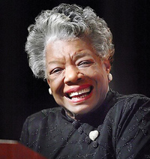
“I've learned that people will forget what you said, people will forget what you did, but people will never forget how you made them feel.”
- Maya Angelou
Relationship Management
Notes:
JEN
Debrief: Notice that there are very clear differences in the methods these leaders used to inspire you…
Research shows that our emotions are inextricably linked to our thoughts and our behaviors - how we feel impacts how we think and what we are able to do, and well we are able to inspire and lead others

Slide 47

What can you do TODAY to make someone feel good?
Relationship Management

Slide 48

Summary
    Emotional intelligence makes a difference.
    Awareness is the first step.
    Actively manage your emotions to increase your effectiveness – AND your resilience.
    Start with self, knowing emotions are contagious
Notes:
Any questions?

Slide 49

At this point, you might be thinking:
Hm…. This EI is pretty good stuff.
- Where can I get some?
- How can I help my employees get more of this?
Notes:
JEN
Debrief: Notice that there are very clear differences in the methods these leaders used to inspire you…
Research shows that our emotions are inextricably linked to our thoughts and our behaviors - how we feel impacts how we think and what we are able to do, and well we are able to inspire and lead others

Slide 50

Master of Business Leadership and Innovation

Slide 51
Outcomes for participants
Newfound mastery of leadership skills – of self, other individuals, teams, and orgs
Command of an innovation mindset
Comfort with general business knowledge (accounting, finance, project mgt)
Cross-cultural perspective from international travel
Notes:
Master leadership skills in emotional and social intelligence and leading personal and organizational change from other aspiring leaders in a variety of backgrounds.
Adopt an innovation/entrepreneurial mindset toward leadership to embrace innovation and change and drive renewal from within your organization.
Gain foundational business knowledge of finance, accounting, entrepreneurship and innovation that will help you add value to any organization.
Discover how to serve key stakeholders while maintaining socially responsible business practices

Slide 52


Slide 53
Leadership
Leading Teams
Creating High Performing Organizations
Global Leadership
Organizational Consultation
Strategy Development
Public Engagement
Managing Change
Driving Innovation
Research methods
Accounting, Finance, Project Management
Program Content

Slide 54
Admission Requirements
Online Application and Fee
Current Resume
Official Transcripts - Undergraduate GPA of 2.5 or higher
3+ years of professional leadership experience
Full time employment
Personal Leadership Growth Essay
2 letters of recommendation, 1 of which must be from your direct administrator
Admission Interview

Slide 55
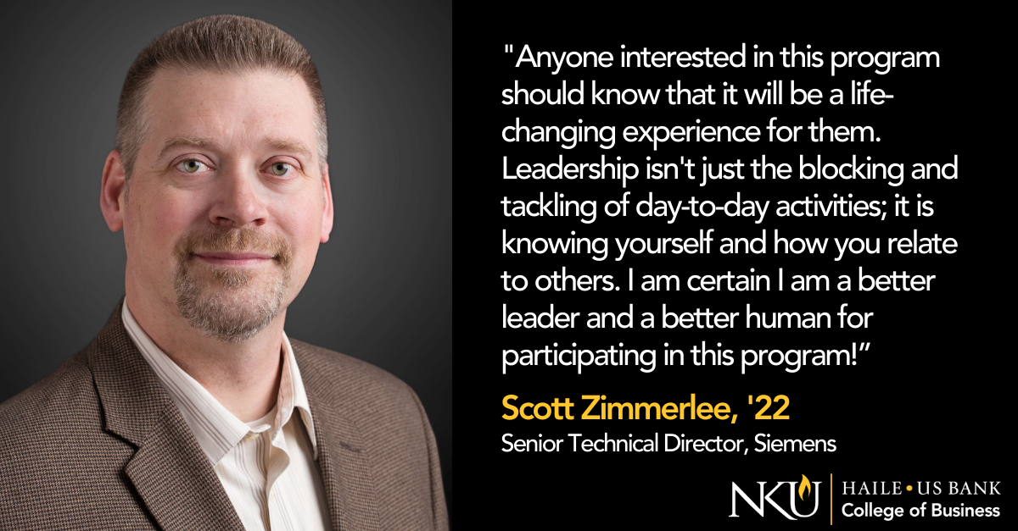
Notes:
We would be grateful to you to send any interested parties to us. Kari is putting the information in the chat. Also the url and our emails.

Slide 56



Thank you!
spataros1@nku.edu
nku.edu/mbli
Sandra Spataro
Happy to answer questions! Also very happy to connect further.

