Slide 1



The Keys to Getting Hired From the HR Manager’s Perspective
Carl Allison, MSOB, SHRM-SCP, HCS
Chief Human Resources Officer
Notes:
Welcome, thank you, Natalie! Welcome those in the room and online! Thank you all for showing up on such a beautiful morning. Ask me anything throughout the presentation at any time, and more importantly share your experiences with us so we can learn from each other. Folks online I think the easiest way to do this is through the chat. To start I want to share that I have used outplacement services – very valuable! At Clark Schaefer we offer outplacement to folks, and I have been involved in executive roundtables, etc. I also worked for the second largest Library systems in the United States – The Cincinnati and Hamilton County Public Library. NONE of those provide the level and quality of services you have here at the NKYAG! None. Period. Hats off to you and your staff Natalie, let’s show our appreciation for all their efforts!

Slide 2
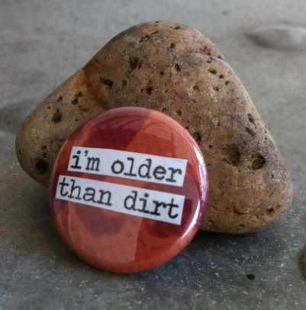
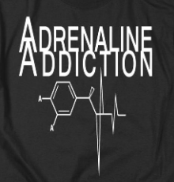

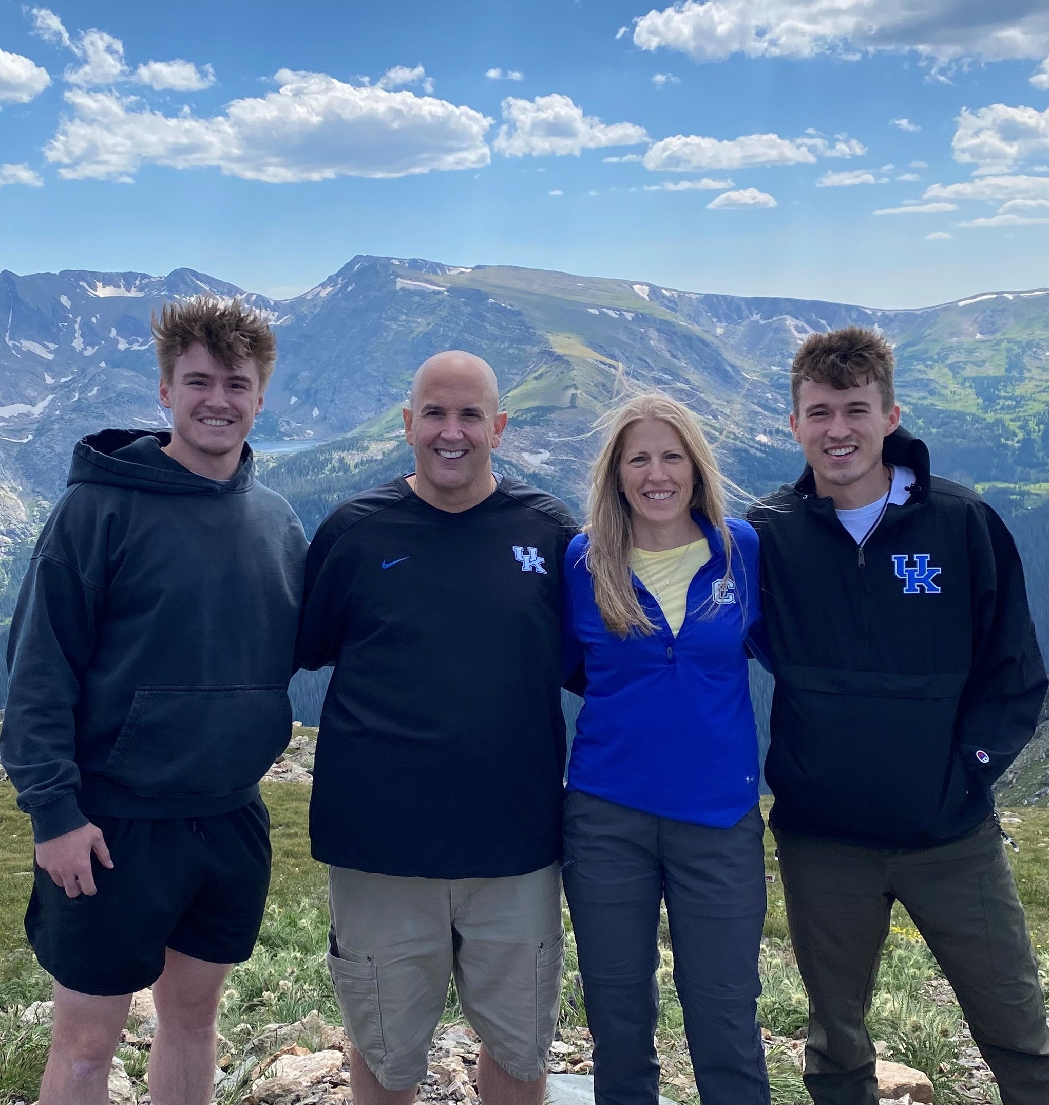
INTRODUCTION
More than 35 years of experience. Started my HR career doing high-volume recruiting for a staffing agency. I have been responsible for hiring tens of thousands of employees.
Experience in seven (7) different industries: Manufacturing, Financial Services, Healthcare, Education, Consulting, Libraries, & Professional Services.
It truly is an honor to be here with you today! I am very familiar/friends with many speakers at NKYAG.
I am blessed by an amazing family and to be Carol Allison’s husband for more than 30 years!
Notes:
Some of the NKYAG speakers who I connections with are: Patricia Borne, Angie Taylor, Nancy Spivey, Laura Canter, Mike Sipple, Sammie Kelly, Robin Throckmorton, Dave Hatter, and one of my all-time favorite human beings, Matt Marvin.
Some other items: I have a masters in Organizational Behavior, an Undergrad in Management, four certifications (SHRM-SCP, HCS, CoachU, DiSC). I am a certified coach. I did not grow up here, I grew up in WVA – anyone else from “Almost Heaven” in the room? A plug for the library we saw Ted Vigil here not long ago in this room where he performed a John Denver tribute and it was a fabulous show!

Slide 3

What We Will Be Discussing
What Are HR Folks Always Nervous About
What The HR Folks Are Waiting For You To Tell Them During An Interview
Best Practices For Communicating During The Interview Process, and
Best Practices for Getting Hired from an HR Manager’s Perspective
Notes:
We’re going to have some fun today as these topics will build on each other as we learn more about what we, as HR Managers/Directors/Recruiters expect from you, and more precisely, what I think are some hidden secrets that will help you in your journey.
Anyone here work in HR?

Slide 4

4
Notes:
OK, y’all ready to roll? I used to teach PPT skills more than 20 years ago and one of the “must not do” items is to never start a presentation with a graph. So, to start I would like to start the discussion with a graph

Slide 5
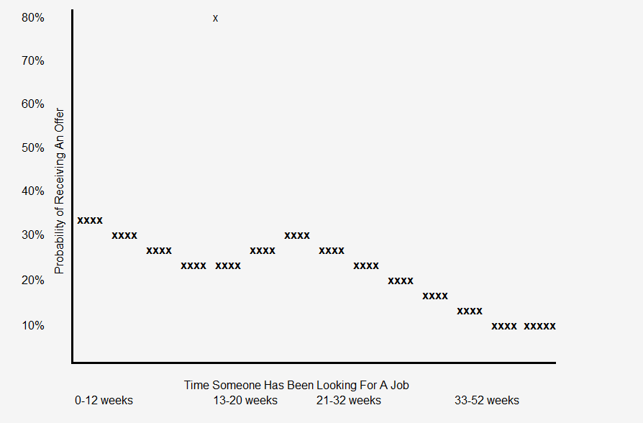
X
X
X
X
X
X
X
5
Notes:
Now this is a nice graph. We have information on both axis and we have some data points that form some sort of trend line. What most people do is to study those

Slide 6

X
X
X
X
X
X
X
6

Slide 7
Let’s Chat
What Would You Say HR Folks Are MOST Nervous About?

Slide 8
What Are HR Folks Nervous About
Please Share Your Insights…
Unsure: Not Being Confident In Our Own Decision-Making Abilities (we’re human).
The Unknown: Not Really Knowing What To Expect From A Candidate. For Example, Responding To A Candidate Who Offers A “Real Whopper Of A Response” To A Question We Ask.
Unprepared: Not Being Prepared Enough For The Interview. We Worry We’re Going To Miss Something…Sound Familiar? ☺
Making A Mistake: Hiring Someone Who Creates Disruption.

Slide 9
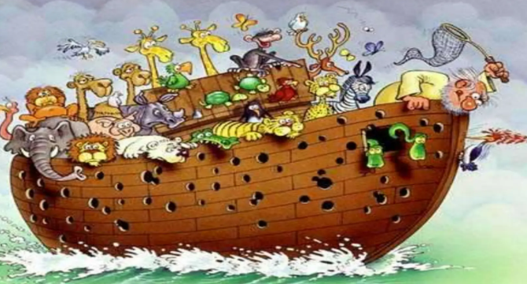
What Hiring Someone Who Creates Disruption Looks Like

Slide 10
Let’s Chat
What Do You Think HR Folks Are Waiting For You To Tell Them During An Interview?

Slide 11
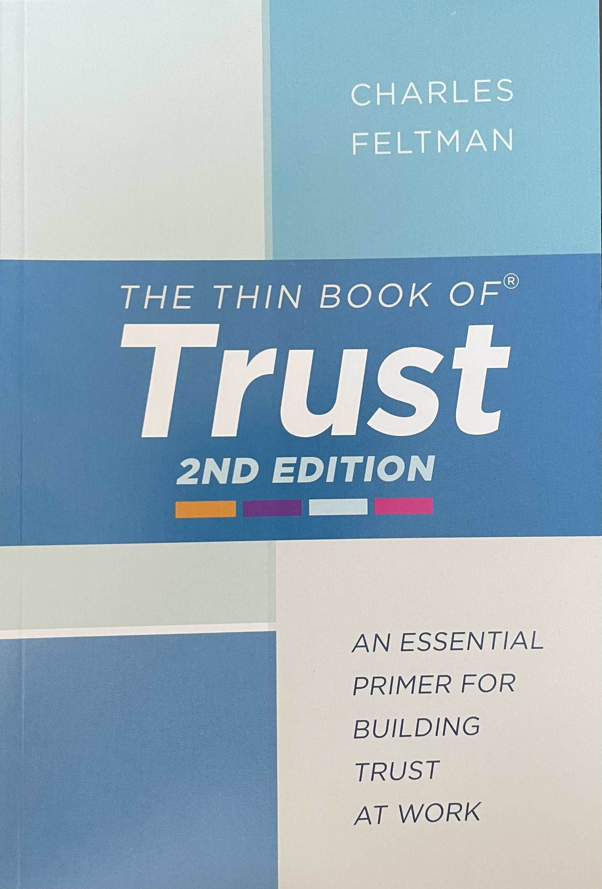
What Are HR Folks Waiting For You To “Tell” Them During An Interview?
Please Share Your Insights…
In Essence, That You Are Trustworthy

Slide 12
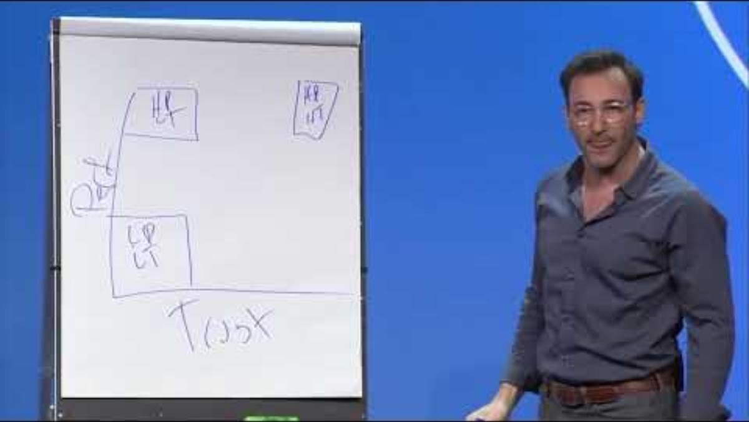
A Message About Trust From Simon Sinek

Slide 13
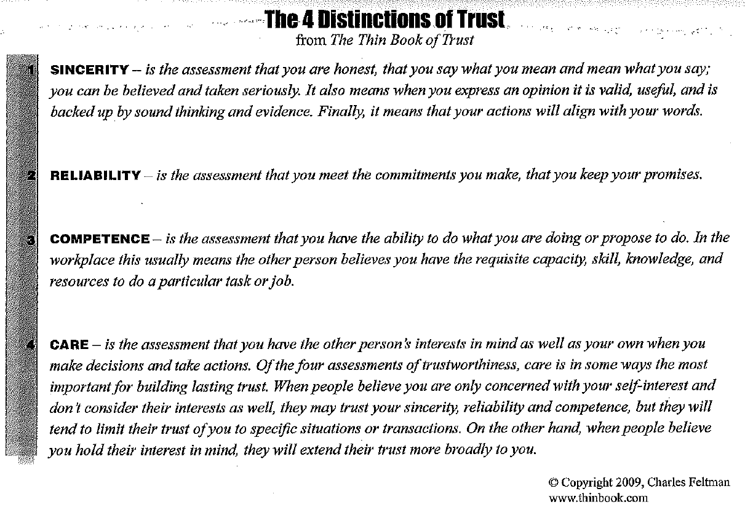
What Are HR Folks Waiting For You To “Tell” Them During An Interview?
Research suggests a tenth of a second is all it takes to start determining traits like trustworthiness.

Slide 14
What Are HR Folks Waiting For You To “Tell” Them During An Interview?
Sincerity is the assessment that you are honest, that you say what you mean and mean what you say; you can be believed and taken seriously. It also means when you express an opinion it is valid, useful, and is backed up by sound thinking and evidence. Finally, it means that your actions will align with your words.

Slide 15
What Are HR Folks Waiting For You To “Tell” Them During An Interview?
Reliability is the assessment that you meet the commitments you make, that you keep your promises.

Slide 16
What Are HR Folks Waiting For You To “Tell” Them During An Interview?
Competence is the assessment that you have the ability to do what you are doing or propose to do. In the workplace this usually means the other person believes you have the requisite capacity, skill, knowledge, and resources to do a particular task or job.

Slide 17
What Are HR Folks Waiting For You To “Tell” Them During An Interview?
Care is the assessment that you have the other person’s interests in mind as well as your own when you make decisions and take actions. Of the four assessments of trustworthiness, CARE is in some ways the most important for building lasting trust. When people believe you are only concerned with your self-interest and don’t consider their interests as well, they may trust your sincerity, reliability and competence, but they will tend to limit their trust of you to specific situations or transactions. On the other hand, when people believe you hold their interest in mind, they will extend their trust more broadly to you.
Another way to define CARE may be: Willing the good of another. Some would say this is also the definition for love. I would agree. I think they go hand-in-hand.
17

Slide 18
Let’s Chat
What Are 3 Best Practices For Communicating During The Interview Process

Slide 19
Best Practices For Communicating During The Interview Process
Please Share Your Insights…
HEAR ME
  HUMBLE
  ENGAGED
  ADAPTABLE
  RELATABLE
  MATURE
  ENERGETIC

Slide 20
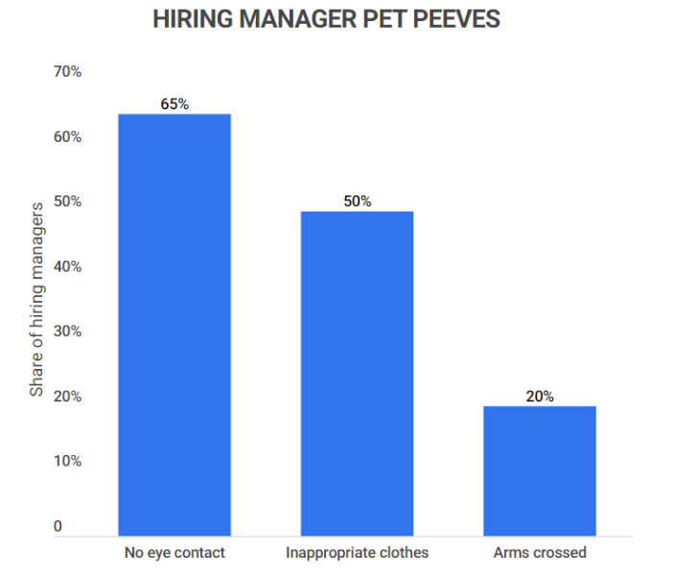
Data
TOP 3 Hiring Manager Pet Peeves
20

Slide 21

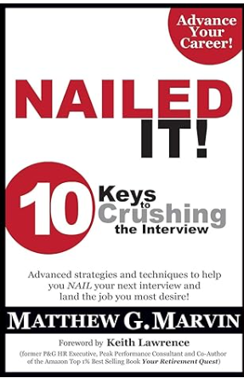

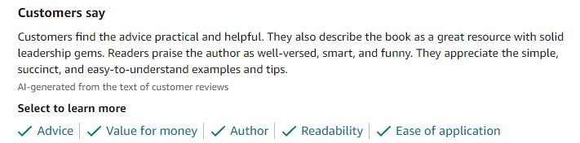
Best Practices For Communicating During The Interview Process
MY RECOMMENDED #1 RESOURCE!
Notes:
I met Matt when he and I were called by NKU to help them develop a leadership development program, and then led to me hiring Matt at the Greater Cincinnati/Hamilton County Public Library where Matt worked with me to create a leadership development program for the leadership team there. Matt’s book helped me nail my last two interviews which led me to my last two jobs. Matt also prepared our twins for interviewing for scholarships at University of KY and because of his work with our twins they received full rides at UK so we got a pay increase when our boys left high school

Slide 22
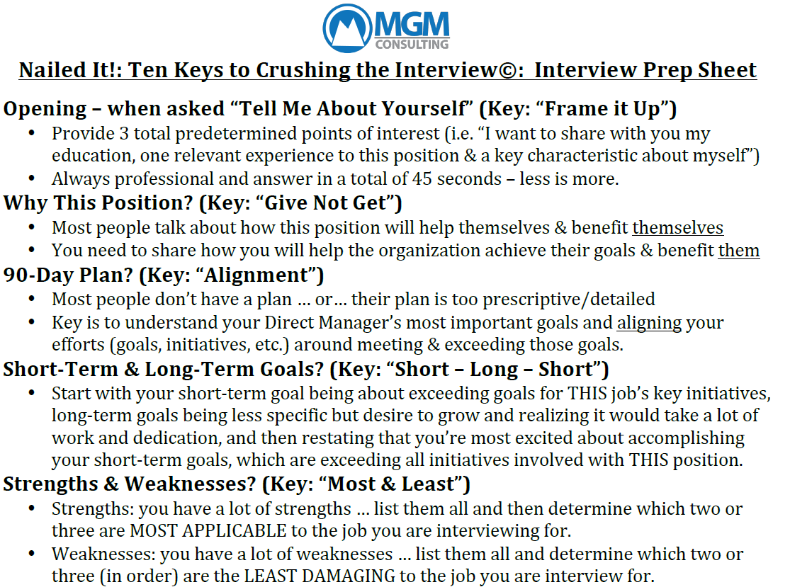
Nailed It “Commercial”

Slide 23
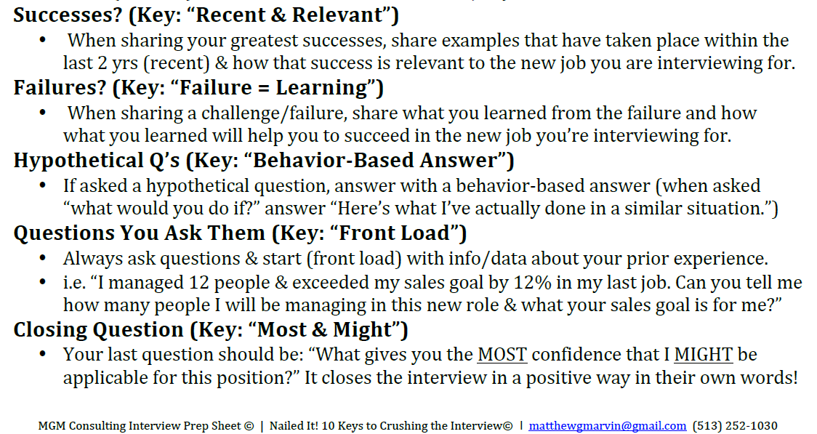
Nailed It “Commercial”

Slide 24
Nailed It “Commercial”
All the Key’s from Matt’s book help you demonstrate what’s most important: that you are trustworthy! The keys help you reassure the interviewer that:
You are competent to do the job
You are reliable
You learn from your mistakes
You are not in it for yourself
You will add value
You will not create a disruption, and most important
You care about what you do, how you do it, and those you do it with.

Slide 25
Let’s Chat
What Would You Say Are The TOP 3 Best Practices for Getting Hired from an HR Manager’s Perspective?

Slide 26

Best Practices for Getting Hired
Please Share Your Insights…
In two words:

Slide 27
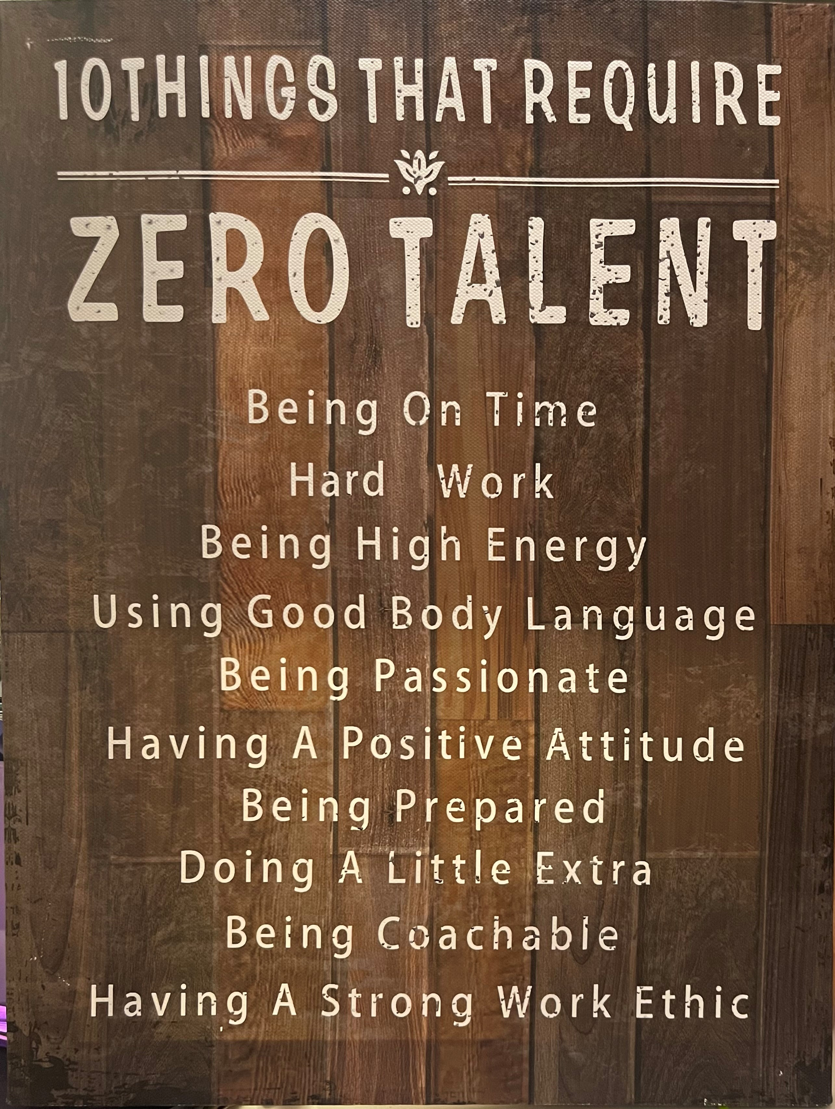
Best Practices for Getting Hired
My “Little Extra:” I provide each interviewer a folder – that’s one of the company’s colors – containing the following information:
My Resume
My Cover Letter
List of Successful Culture Change Projects, or other work product to demonstrate my level of competence
List of personal references
DiSC Results
StrengthsFinder Results
Standout Results
MBTI Results
Why this Information?
To Demonstrate I Am Trustworthy

Slide 28
Best Practices for Getting Hired According To AI
Best Practices for Getting Hired
Tailored Resume and Cover Letter: Customize your resume and cover letter for each job application. Highlight relevant experience and skills that match the job description.
Online Presence: Maintain a professional online presence, particularly on platforms like LinkedIn. We will find you ☺
Networking: Leverage your professional network. Attend industry events, participate in online forums, and connect with professionals in your field
Research the Company: Understand the company’s culture, values, and recent developments. This knowledge can help you tailor your responses during interviews and demonstrate your genuine interest.
Practice for the Interviews: Practice common interview questions and prepare specific examples that showcase your skills and achievements.
Follow-up: After interviews, send a thank-you email to express appreciation for the opportunity and reiterate your interest in the position.
Be Authentic: Authenticity can resonate well with hiring managers. Be yourself during interviews.
Create Meaningful Questions: Have insightful questions ready for the interviewer about the role, team dynamics, and company direction. This shows your engagement and interest in the position.

Slide 29
Interesting Stats
On average, 118 people apply for a single job.
83% of hiring managers prefer employed candidates.
77% of recruiters see typos or poor grammar as dealbreakers, and 35% feel the same about unprofessional email addresses.
47% of recruiters said they would reject a candidate who had little knowledge about the company where they’re applying.
27% of job seekers get a job offer after submitting up to 10 applications.
The average length of the job interview process in the United States is 23.8 days
An astonishing 40% of people lie on their resumes.
92% of companies use social media platforms to look up candidates.
You only have seven seconds to make a strong first impression.
71% of employers wouldn’t hire someone who doesn’t follow the appropriate dress code.
39% of the candidates leave a bad impression due to their overall confidence level, voice quality, or lack of a smile.
Referred candidates are five times more likely to be hired.
On average, 118 people apply for a single job.
83% of hiring managers prefer employed candidates.
77% of recruiters see typos or poor grammar as dealbreakers, and 35% feel the same about unprofessional email addresses.
47% of recruiters said they would reject a candidate who had little knowledge about the company where they’re applying.
27% of job seekers get a job offer after submitting up to 10 applications.
The average length of the job interview process in the United States is 23.8 days
An astonishing 40% of people lie on their resumes.
92% of companies use social media platforms to look up candidates.
You only have seven seconds to make a strong first impression.
71% of employers wouldn’t hire someone who doesn’t follow the appropriate dress code.
39% of the candidates leave a bad impression due to their overall confidence level, voice quality, or lack of a smile.
Referred candidates are five times more likely to be hired.
29

Slide 30
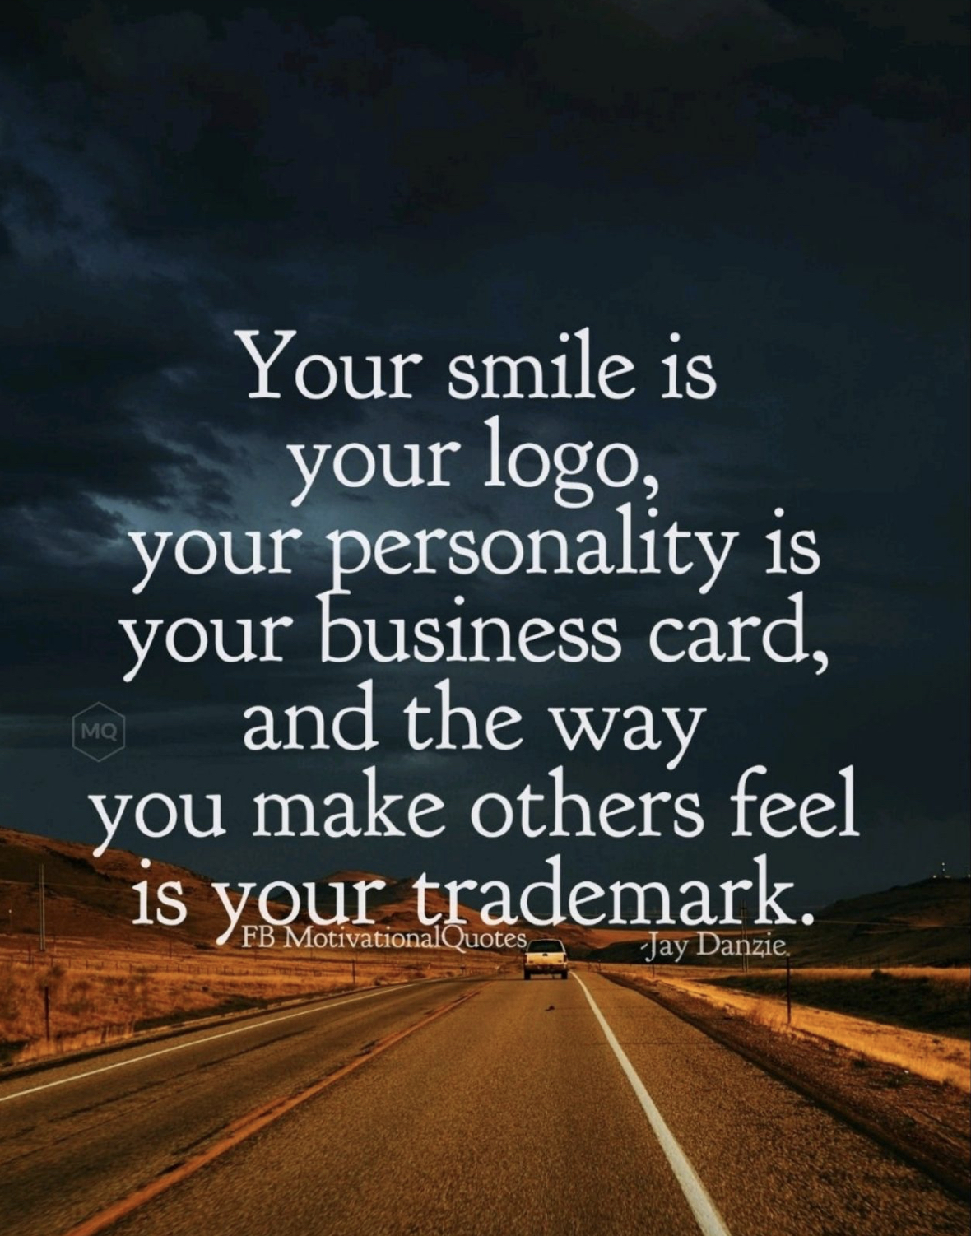
Data
30

Slide 31
In Closing
31

Slide 32
Always Remember…
This is YOUR story! You are creating a story, and like any good story ever written it includes three main elements:
    The Introduction / First Impression
    The Middle / How You Engage
    The End / How You Follow-Up
  However, before any writing takes place, a great author spends a considerable amount of time preparing for what they’re going to write by doing research, interviews, etc. Preparation is your key to a really good story!
You are not alone in this journey!

Slide 33
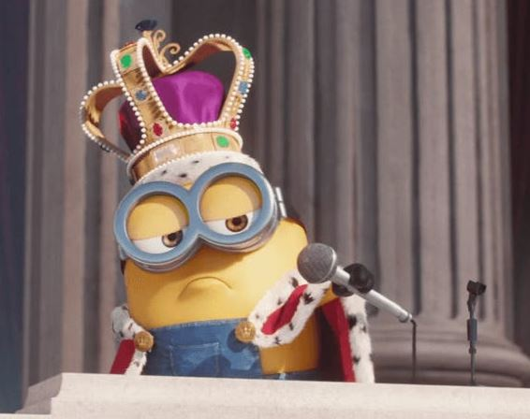
Well Known Fact
Results From Using NKYAG
33

Slide 34


What Questions Do You Have
34

Slide 35



