Slide 1


Networking Fundamentals
Presenter: John Rhoads

Slide 2
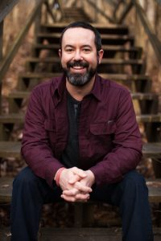


Rhoads Life Coaching, LLC
Finding Meaning and Purpose in Daily Life
One-On-One Coaching
Small Business and Team Workshops
Virtual Workshops
FREE Consultation
@RhoadsLifeCoaching
jrhoads.coach@gmail.com
John Rhoads, PCC
www.rhoadscoaching.com
Rhoads Life Coaching

Slide 3
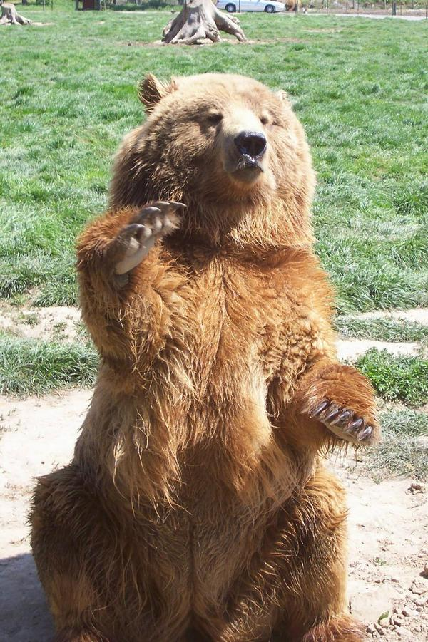
Introduction
How many miles were you born from here?
How do you plan to use networking?
What is the most difficult thing for you about networking?

Slide 4
Networking Fundamentals
What is networking?
Definition:
“Creating a group of acquaintances & associates & keeping it active through regular communication for mutual benefit. Networking is based on the question "How can I help?" and not with "What can I get?"
– Business Dictionary

Slide 5
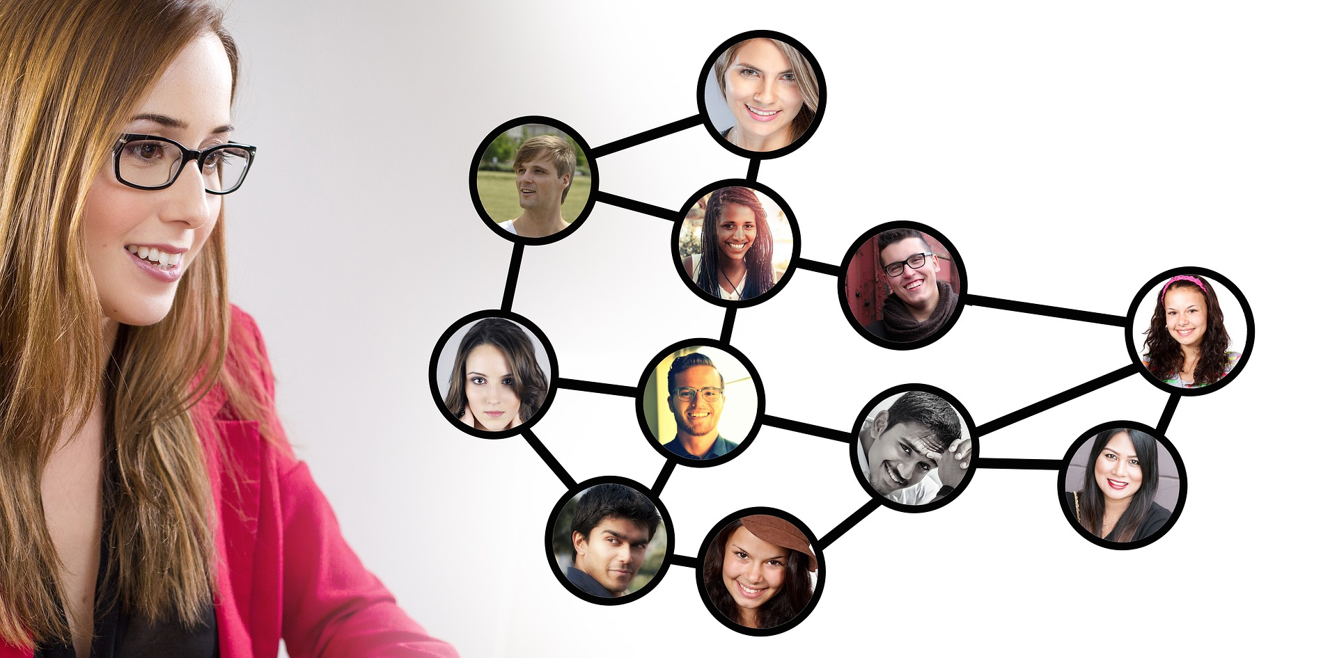
What are the elements that make up networking?
What is NOT included in networking?

Slide 6
Step-by-Step
Go Meet People
Ask People To Meet 1-on-1
Ask About Them
Ask What They Need In Terms of Meeting Other People
Come Up With Two Names To Offer To Introduce
Tell Them About You and What You Are Looking For
Ask If They Know Two People To Introduce To You
Make the Introductions From Your Network
Reach Out To The People They Offered
Repeat

Slide 7

What should I expect?
Where do I find networking opportunities?

Slide 8

What does an “up & running” network look like?
What prevents your network from being “up & running”?
What should I expect?
List 10 people you need
to ask to network

Slide 9

What data do I track?
What should I expect?
What are the tools to use?

Slide 10
Obstacles
What are the THREE biggest hurdles to networking for me?
(Write them down)
How am I going to address each of these three challenges?
(Write down the strategy)

Slide 11
What Are Characteristics of Being Introverted?
Extrovert
Neutral
Introvert

Slide 12
Best Practices and Self Care For Networking As An Introvert
What Gets In The Way Networking As An Introvert?
Why Is Networking As An Introvert Worth The Effort? (aka Why Do You Care?)

Slide 13
Next Steps
Write down for yourself three action items to complete.
Be specific:
What will you do? When will it be done? How will you celebrate?

Slide 14
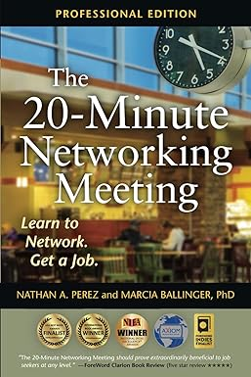

Great book to read!

Slide 15





Questions? Comments? Snide Remarks?
Visit the Library online for resources to help in your job search:
www.kentonlibrary.org/job-search-central
www.rhoadscoaching.thinkific.com
jrhoads.coach@gmail.com
www.kentonlibrary.org
859-962-4000
@RhoadsLifeCoaching
John Rhoads, PCC
Rhoads Life Coaching
Covington Branch
502 Scott Blvd.
Covington, KY 41011
Erlanger Branch
401 Kenton Lands Road
Erlanger, KY 41018
William E. Durr Branch
1992 Walton-Nicholson Road
Independence, KY 41051

