Slide 1
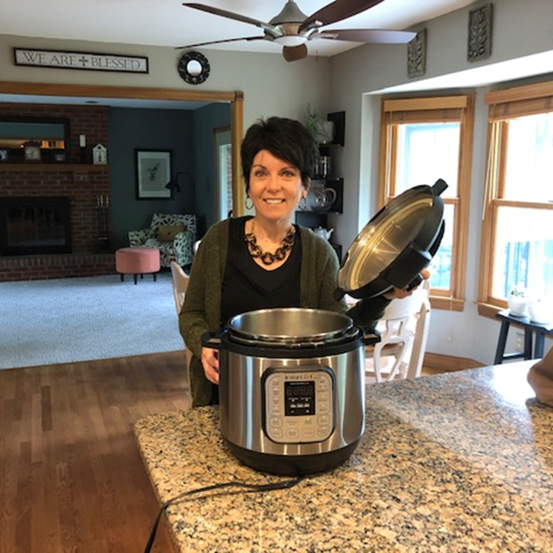
Teri VonHandorf, Ed.D.
Provost
Gateway Community and Technical College

Slide 2

Cooking and Conversation:
Lessons from The InstaPot

Slide 3

Create your own users’ manual

Slide 4
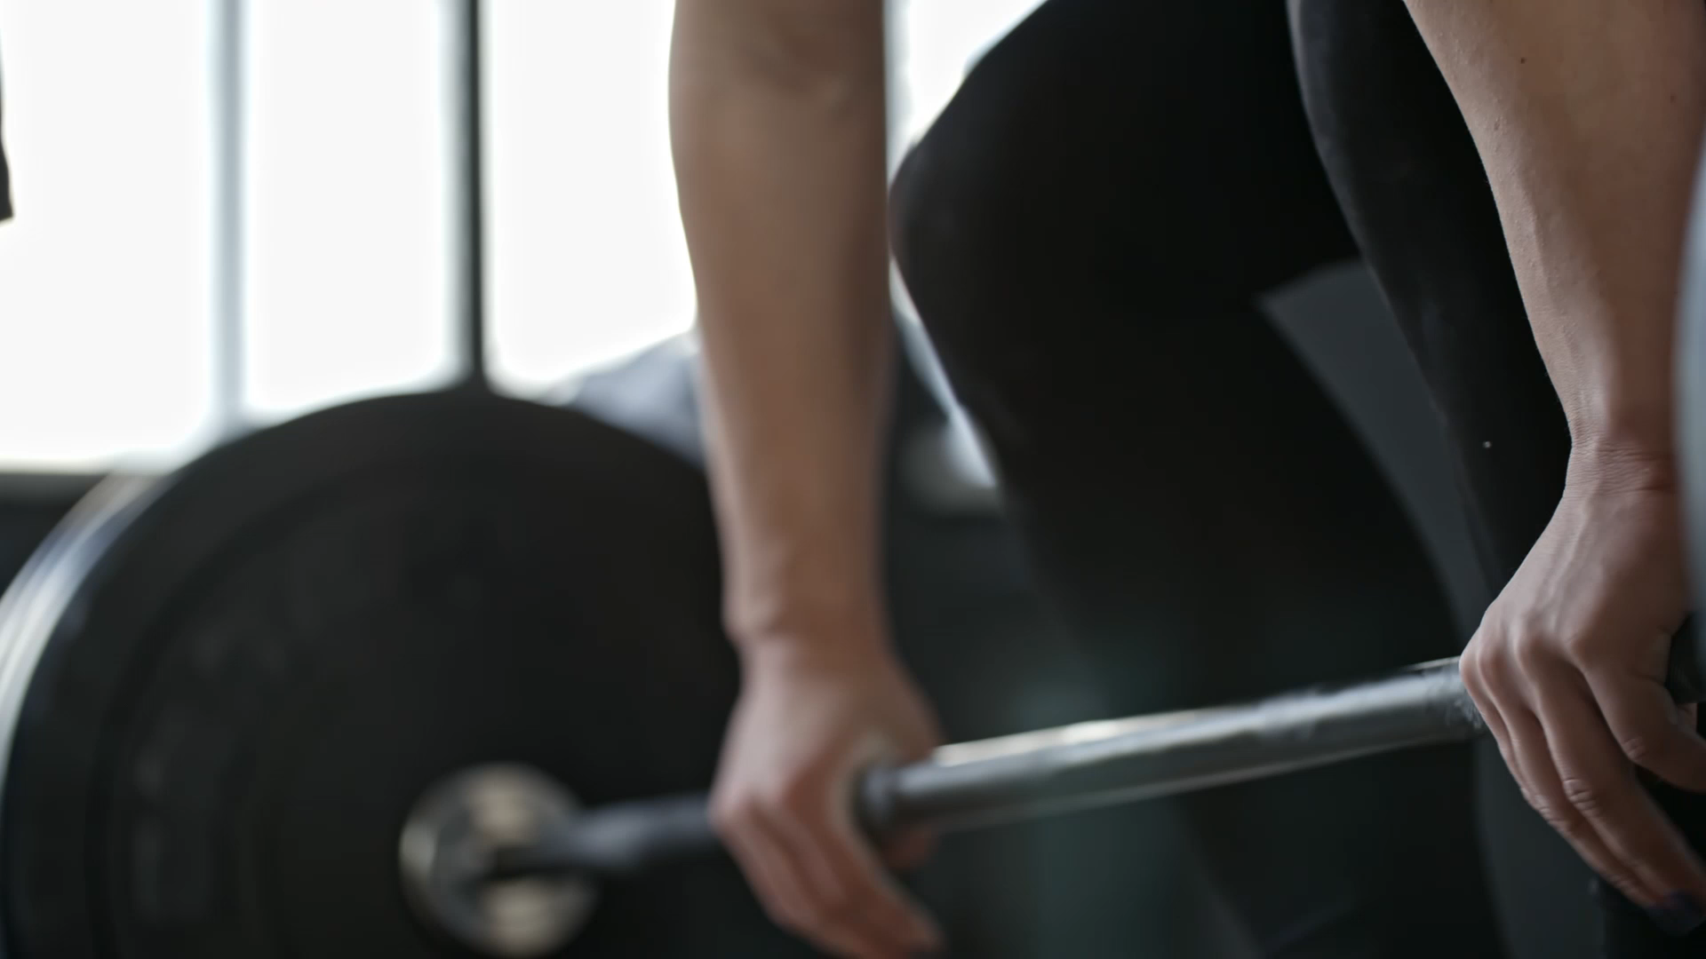
Play to your Strengths

Slide 5

CONFIDENCE COMES WITH EXPERIENCE

Slide 6

Plan (But be able to adapt)

Slide 7

Macro begins with Micro

Slide 8

Cognac Moment
(Reflective)

Slide 9

Be Impatient for Action but patient for outcomes

Slide 10

Feel it….
And move on.
This Photo by Unknown Author is licensed under CC BY-SA-NC

Slide 11

pressure builds great Individuals, teams and organizations

Slide 12

Every InstaPot Runs out of Steam

Slide 13

Focus only on what you can control

Slide 14
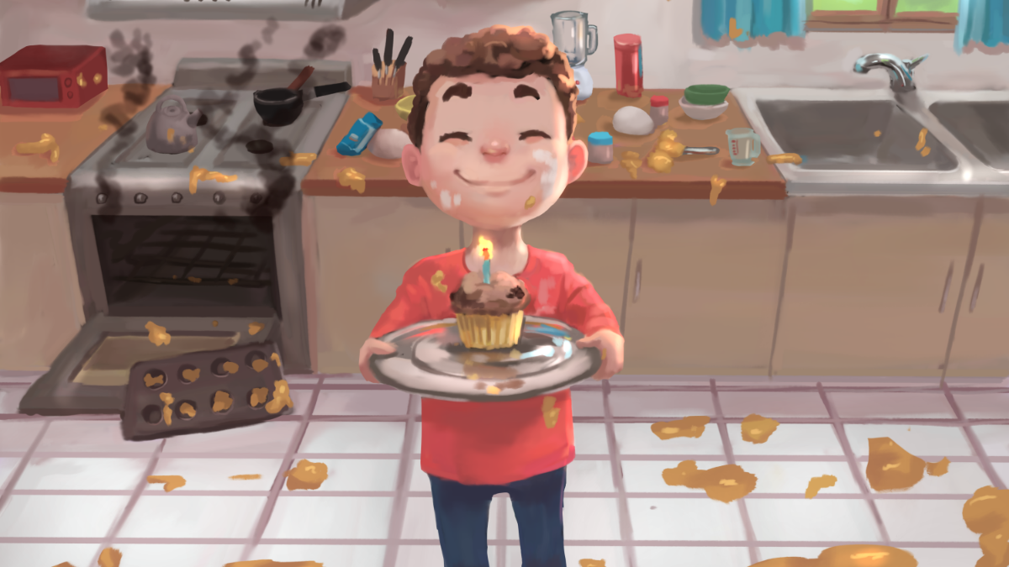
Embrace being capable, not perfect
his Photo by Unknown Author is licensed under CC BY-SA-NC​

Slide 15

Enjoy

