Slide 1
Making a Great Presentation
Bruce B. Rosenthal. MBA, PhD
Dean, College of Business.
Thomas More University

Slide 2
Most important elements of a presentation:
Why are you doing the presentation?
Information only: “Look at what I found!”
Tell them what to do
To whom are you doing the presentation?
Experts in the field?
Complete “lay-people”?

Slide 3
How to do it wrong…

Slide 4
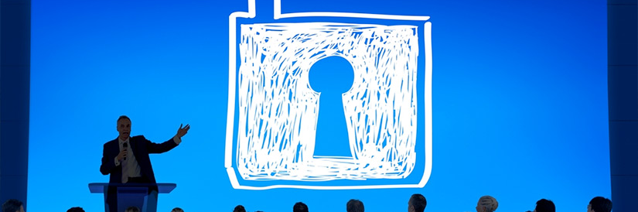
Three elements: the slides

Slide 5
The content

Slide 6
…and the speaker

Slide 7
How to do it wrong
First, let’s go over the slides…

Slide 9
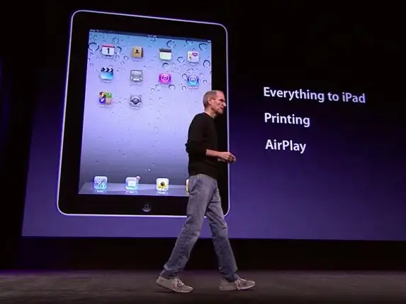
Slides
Write the minimum: “pick up points” – your job is to move the narrative forward
Use graphics, photos to make the narrative impactful

Slide 10
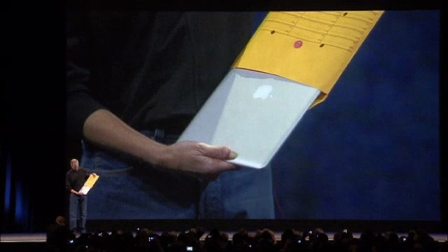
Impactful
“The world’s thinnest notebook”
“One thousand songs in your pocket”
“Vanquishing an ‘enemy’ – a frustrating situation or the competition”
MacBook Air in an inter-office envelope

Slide 11
How to do it wrong: The Content

Slide 12
How to do it wrong: The Content
There is no narrative: audience doesn’t know where they are at any particular moment in the presentation (Are we still on Point #1??)
Details are too confusing (Why are you telling me that??)
The content isn’t geared towards that particular audience: they already know it or have no clue
Information only vs strategic positioning?

Slide 13
Narrative

Slide 15
How to do it wrong (I’ll show you)

Slide 16
What to do right!

Slide 17
Slides, Content, Delivery
Fewer Slides; images; engaging
Know your audience; straightforward narrative; information or strategy?
Iceberg approach: 20 to 30% only

Slide 18
MORE what to do right!
If you are working as a team; practice by punching holes in your arguments; if not work with someone who knows the subject and the audience
Facts & figures MUST be correct! (Common sense!)_
Put numbers into context (“Deka!”)
PRACTICE PRACTICE PRACTICE!

Slide 19
Doing it right!
Speaking…

Slide 20
Speaking
5 seconds per person
Side to side
Read thru, then elaborate
Gestures!
Stand straight + posture
Hands…
Don’t turn your back on the audience
Every 10 or 15 minutes or so…

Slide 21
Reading from a busy slide

Slide 22
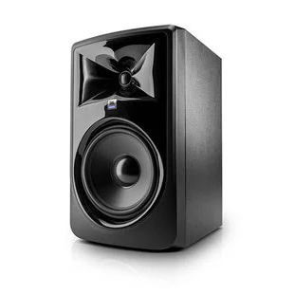
Good speakers!
Hit emotional points
Use imagery
Light humor
Are passionate!
Know what the audience is feeling

Slide 23
Q & A
Keep control! You don’t have to give a detailed answer simply because someone asked you!
“Look how smart I am!” vs serious question
Identify *when* you will take questions

Slide 24
Q & A continued
Do *not* let one person dominate the Q & A! “I would like to get someone else’s questions too, thank you!” “This lady/gentleman has their hand up too!” *SMILE*
“Yes sir” Yes ma’am”
You can guide the questions a bit: “Do you have any questions about my 4 point marketing plan?”

Slide 25
Q & A continued
Listen to the end of the question! The whole question…
01
Clarify and confirm: “If I understand you correctly, you would like me to explain (X); is that in relation to (Y)?”
02
Continue to involve all members of the audience. Use this as an opportunity to refine some of your points.
03

Slide 26
Q & A continued
Check to see if you have answered: “Does that answer your question?” (Chances are they will say “yes” even if it didn’t.)
“Thank you! That is a great question and goes back to my main point…”
Answer the question you wish you had been asked. BE CAREFUL WITH THIS!

Slide 27
How to do that…
Can you comment on the price of eggs in China?
“The price of eggs in New England =…”. X
“The price of eggs in China are related to the price of eggs in New England in this way…So the price of eggs in New England respond to X, Y, Z, as would the price of eggs in China” Towards your area of expertise
“I don’t really know much about the price of eggs in China but I do know how the worldwide market for eggs responds to price volatility…” Directly plugs in to your area of expertise BUT USES “CHINA” “EGGS”
“I really don’t know very much about China, that is not where my research or expertise lies” Avoids the question

Slide 28
More Q & A Strategies: Don’ts!
Don’t do another mini presentation
Don’t pass the buck: “I didn’t do that, Mary did!”
Don’t embarrass the questioner: “I already covered that!”
Do not give a defensive response; remain calm and in control

Slide 29
Some responses
“That’s an interesting idea, I hadn’t looked at that aspect. After the presentation is over I would love to chat with you about it further.”
“I know there are some experts in the audience; how would they respond?”
“That was not part of the focus for this research but it is a really interesting idea. Let’s discuss afterwards?”
“Thank you for your opinion – I know there are various schools of thought…”

Slide 30
Important response!
“I’m afraid I need to move on!”
“I do need to move on – perhaps we can talk more later…?”

Slide 31
Final Q & A Thoughts
Defend the *idea*, not yourself! Ignore personal jibes and steer the question(s) back to the idea, not your viewpoint or credentials!
You can raise some objections proactively if you know that some attendees are opposed to the idea: “May, I know you disagree with the new pricing strategy, but…”
Present the problem + solution objectively and be open to other ideas!

Slide 32
Have fun with it!

