Slide 1
The Big Scary
Declaring (and Achieving) Bold Goals

Slide 2
Today’s Agenda
Introduction
What is The Big Scary?
What is YOUR Big Scary?
SMART Goals (or Targets)
Tell everyone or no one?
Pivoting

Slide 3
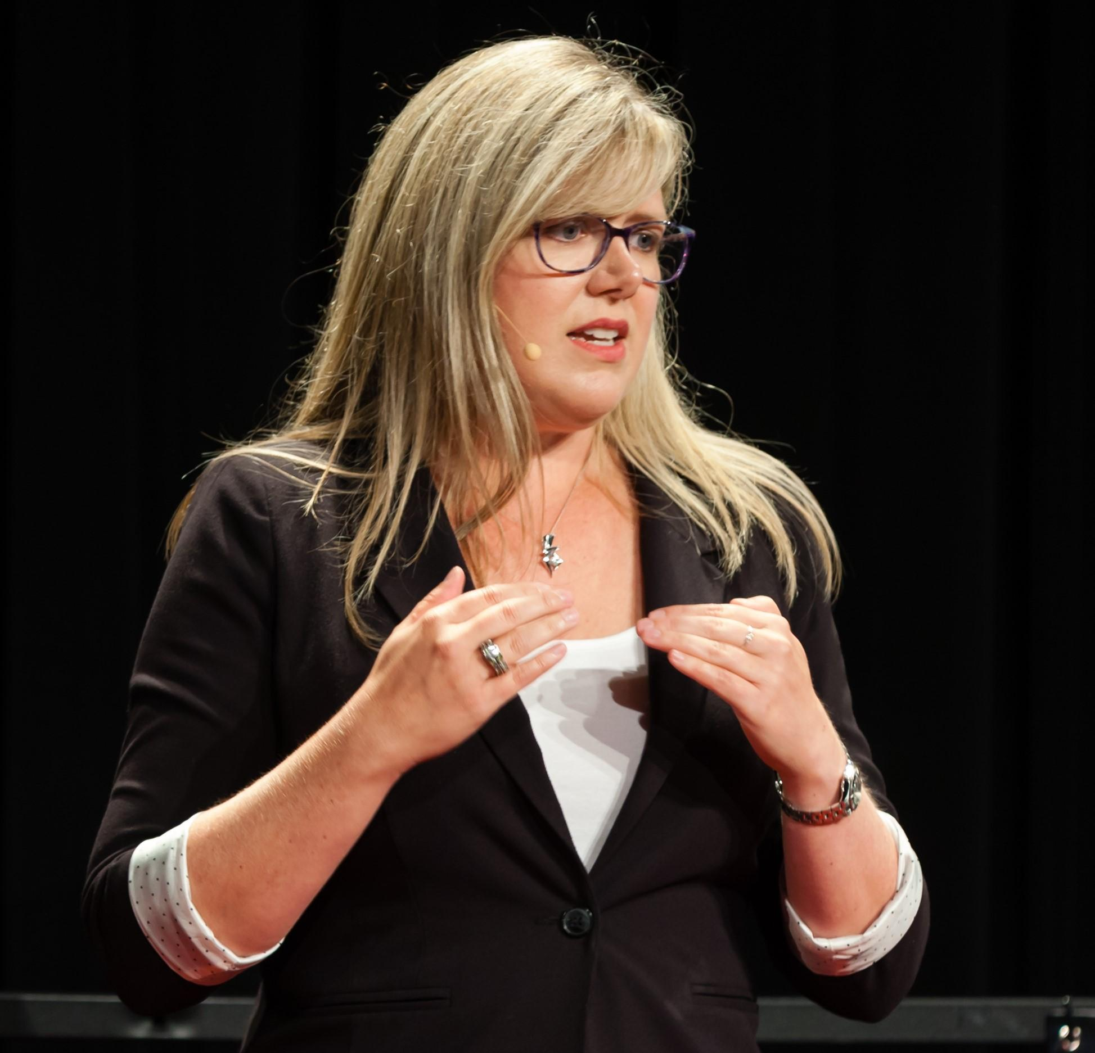
Why Should You Listen to Me?
25 years in entrepreneurship
5 years teaching at UC
EY Entrepreneur of the Year
Legion Logistics
LINK nky
Also, a personal life

Slide 4
That’s nice, but why, really?
Grew up in a tiny town
Working class
First person to graduate college
Always dreamed big
Said yes to lots of things (too many)
Goal-setter my whole life

Slide 6
Big Scary Examples
Write a book by the end of 2022.
Run 10 marathons in the next 10 years.
Sell my business in 2035 for $2 million.
Pay off my house by the time I’m 50.

Slide 7
What is YOUR Big Scary?
It has to be YOURS
Don’t worry if it’s not big enough for someone else
It has to be exciting (because it is going to be HARD)
Spend real time on this part

Slide 8
Questions to Ask
What brings you joy?
What makes the time fly?
What is TRULY important to YOU?
What will give you the life you want now AND later?

Slide 9
Thoughts to Avoid
I SHOULD want X thing
Shouldn’t my goal be all about MONEY?
Wait, my goal IS all about money…..
If I just sacrifice X for the next 20 years, I can have Y.

Slide 10
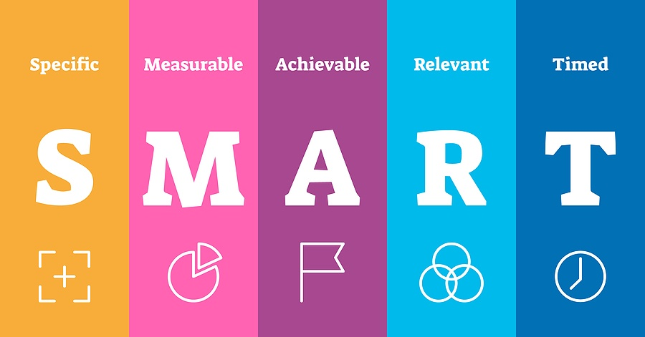

Slide 11
Typical Goals
Grow my business.
Lose weight.
Get more referrals.
Spend more time with my family.

Slide 12
SMART Goals
Increase revenue 10% this fiscal year.
Lose 40 pounds by my 41st birthday.
Get five referral customers by May 31st.
Eat dinner with my family five nights a week.

Slide 14
Tell EVERYONE? Or tell no one?
Two schools of thought
What will motivate you?
Try it out on strangers first
Don’t let anyone pee in your Wheaties

Slide 15
How do you make it happen?
Break it into chunks
Set deadlines
Hold yourself accountable
Remind yourself WHY you are doing it

