Slide 1



Mirror &
Momentum:
Your Career
Insights take
Action

Slide 2
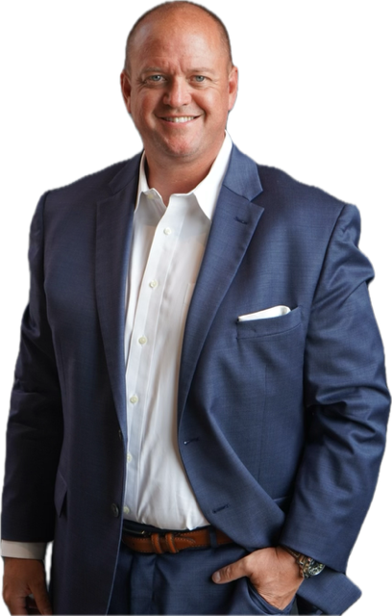


Jason Zygadlo

Slide 3

Megan Leasher

Slide 4

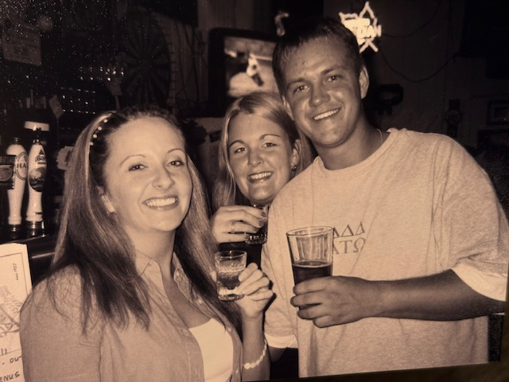

Slide 5

Learning Objectives
Part 1: Megan
Part 2: Jason
Know who you are and what value and impact you bring to the table
Differentiate yourself to stand out and land the job you want

Slide 6
Who is Megan Leasher?
An award-winning organizational psychologist
Thought leader in talent development, leadership, people strategy; executive coach and advisor
Founder of Disruptive Journeys, an organization dedicated to helping individuals + organizations thrive in the face of disruption
Published in Forbes, U.S. News and World Report, The New York Post, Parade
Named an HR Rising Star by Human Resource Executive Magazine, Cincinnati 40 Under 40

Slide 7
Who is Megan Leasher?
An Ohioan by birth, a Kentuckian by calling
Married to Steve, residing in the Port of New
Lover of cold-weather travel + mission trips
Board Member, Commonwealth of Kentucky Science and Engineering Fair
Owner of 19 pairs of Converse Chuck Taylors

Slide 8

Notes:
This is disruption. Is it good? Is it bad? Is it scary? The answer is yes. My job is to help you leverage it as the fuel for your next step
Mention offerings

Slide 9

Uncovering Strengths, Passions, and Experience
Notes:
Set Context: Many people separate “who I am” from “what I do.” Your purpose is discovered when they intersect.

Slide 10






Disruption Map
Experiences
work + personal
Strengths
Passions
work + personal
work + personal

Slide 11
Notes:
Activity: Disruption Map
Solo work (5 min): Fill in all columns. Goal for now is speed and quantity; generate all that is top of mind.
Solo work (2 min): Denote 2-3 themes that span personal and professional (circle commonalities and name each cluster)
Table (5-10 min): Share one surprising overlap that catches your attention (e.g., “I realized my hobby of coaching my kid’s team reflects how much I love mentoring at work.”)
Full group debrief (4 min): Ask for overlap examples that caught participants’ attention. What happens when you stop separating personal and professional, and look at yourself as a whole person?

Slide 12
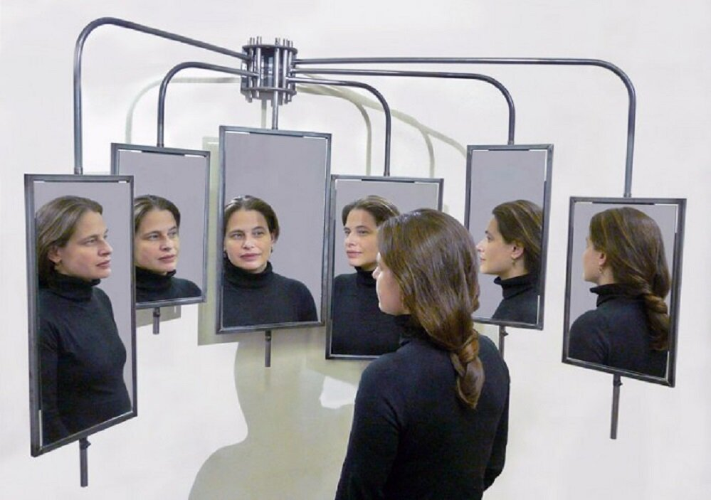
Mirrors of Disruption
One
Two
Leaders with low self-awareness are 79% more likely to derail in their careers.
People often underestimate their top strengths by up to 50% compared to how others see them.
Three
Four
360 feedback helps identify up to 2x more blind spots than self-assessments alone.
When feedback is delivered in a trusting relationship, people are more likely to apply it and sustain change.
Notes:
There’s nothing like not having a job to make you feel alone. Here is where you need community the most.

Slide 13
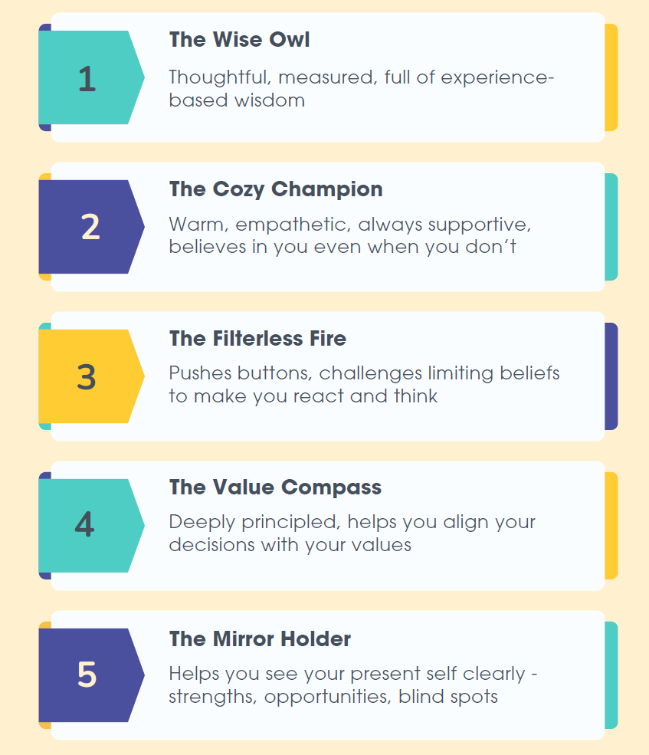
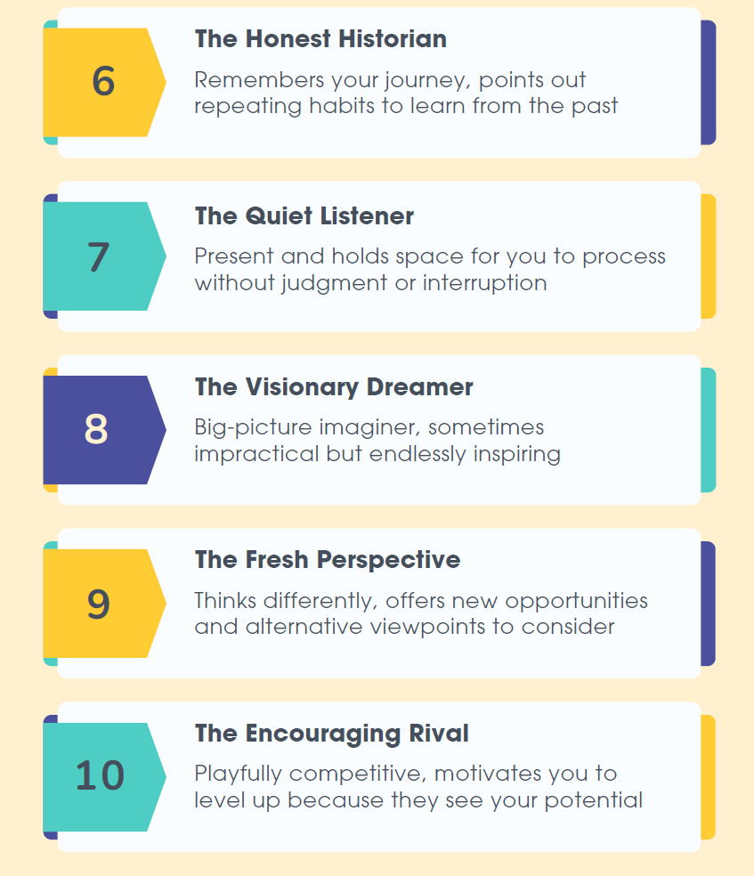
Notes:
Activity: The Mirrored Disruption
Share personas of the mirrors (aka people in our lives) we need to face to disrupt our current thinking and perceptions of ourselves
Solo work (2 min): Write down 3 people who need to be your mirrors
Share examples of powerful questions to ask your mirrors
Solo work (2 min): Have them write down one question you need to ask them (e.g., “What do you see as my superpower?”).
Full group debrief (3 min): Invite 1-2 to share a key mirror they realized they need / questions to ask.

Slide 14

What Might I Ask?
What help + advice do you rely on me for?
What things are hard for you, but you think are easy for me?
When have you seen me “in the zone” or lose track of time?
What would you name as my top values?
What do I talk about all the time—even when no one asked?
To what do I bring extra energy or enthusiasm?
What legacy do you think I want to leave?
What else…?

Slide 15




Speak Your Journey
Purpose
Insights
Message
Verbalize
What overlaps in your Disruption Map?
What have your mirrors provided?
What story do they tell about your impact?
How do I tell it?

Slide 16
Megan Leasher
megan@disruptivejourneys.com
linkedin.com/in/meganleasher

Slide 17
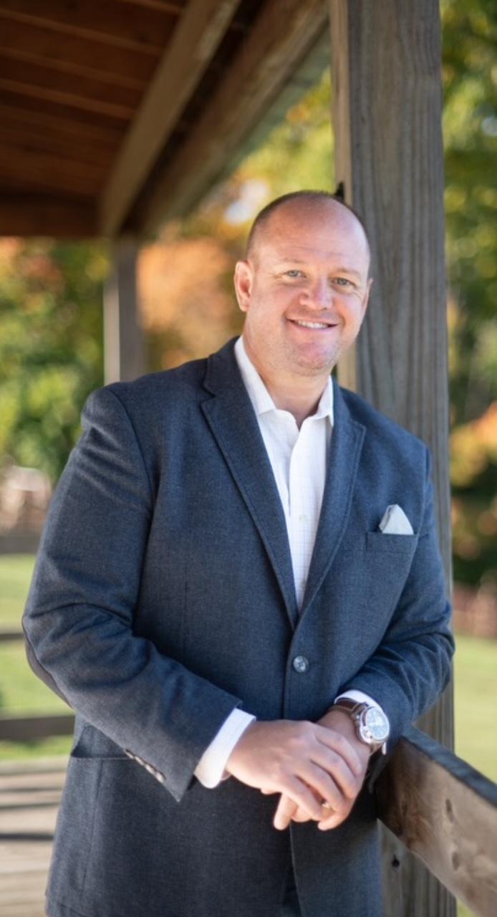

Who is Jason Zygadlo?
Nearly 20 years of experience in medical device sales/ sales leadership
Built a reputation for standing out in highly competitive markets
Founder of build.your.own.brand., a company that helps individuals and organizations discover and amplify what makes them unique, different, and memorable
Graduate of Kent State University, active member of the National Board of Directors of the Alumni Association
Founder of ZIGGYSTRONG, a nonprofit supporting patients through and beyond treatment

Slide 18

Who is Jason Zygadlo?
Author of Amazon best seller- BUILT NOT BORN: A Playbook For turning setbacks Into Success
Married to Chelsea- 2 Children Kaylie and Jay
College Sports Fan, Traveling, Concerts, Lake Erie

Slide 19
It’s time to build…
CONFIDENCE CREATIVITY
CREDIBILITY

Slide 20
The Memorable Approach To My Job Pursuit That Changed Everything
Pharmaceuticals
Medical Devices

Slide 21

Building Confidence and Credibility
Journal of Applied Psychology:
Job candidates who displayed higher confidence during interviews were significantly more likely to be hired, even when their actual competence was the same as less confident applicants.

Slide 22
How Do You Build Confidence and Credibility?
Be Prepared
  Study the company
  Practice questions
  Have questions drafted
  Know how to close the interview
  Be able to back up what you talk about
Know yourself and your interviewer
Be yourself!

Slide 23

Most Importantly: You need to find a way to break out from the sea of sameness…Creativity

Slide 24
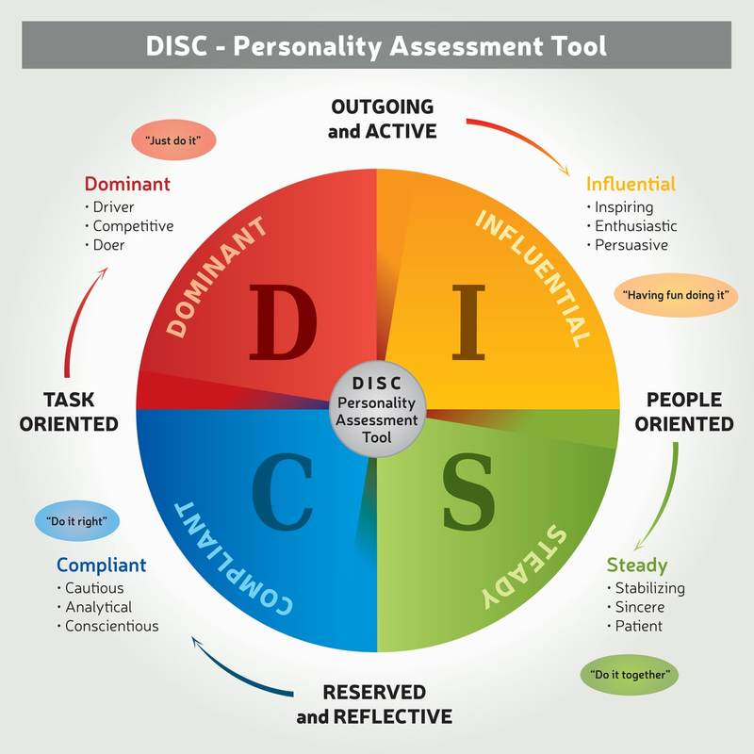
Know Yourself

Slide 25
DiSC Questions / Positioning
Here are the four (4) statements that will generally identify the DiSC Assessment of someone. When an interviewee is trying to “sell themselves” to the interviewer and the organization they represent, they can generally identify the DiSC Assessment placement of the interviewer by having them indicate which of these four statements best aligns to them:
D - I’m an action-oriented person who is most comfortable when in charge.
I - I’m a ‘people’ person who values friendships in my work relationships and likes to build consensus.
S - I’m calm and cool under pressure and like to make logical rather than emotional decisions.
C - I like to study lots of information before making decisions.
Once the interviewee can identify the DiSC identification, they can speak the language of the interviewer and how to best sell themselves.
Here are some best-known tips for talking to each of the DiSC types:
Notes:
Keep an electronic copy on a flash drive so it is always available for updates – do the updates – may pitch our offer here
Hard copy – make it nice – folder – binder – make multiple copies and ALWAYS take them with you to the interview

Slide 26
Talking to a High D
• They need to feel in control / lead …remember that, but also show confidence as they respect it.
• They are TASK oriented …show how you make them win better, faster etc than they will without you.
• Be ‘to the point’ …be direct in your communication.
• High D’s make decisions, so ask them for one positively.
Talking to a High I
• They need to feel there is a relationship …if they are not ‘valued enough as a person, this will come across.
• Show them that you care about them. Speak in lighter tones… as though with a friend.
• Let them speak, try and be open. They enjoy conversing, and will want to know about you, not just what you do.
• They will make decisions, often based on the person and how much they like them
Talking to a High S
• They need to TRUST you, and your offering. Take it slow, and show proof and character.
• They will not respond well to being put on the spot. Where possible, position them on when the decision point is expected, and what information you’ll give to support that.
• Like the ‘I’s, they value relationship, so be their friend.
Talking to a High C
• They need to have the detail to feel comfortable. It is likely they will have lots of questions. Answer them, or give supporting evidence ahead of time.
• Provide case studies. Examples, and where possible direct evidence that relates to THEIR circumstance.
• Tough to close, but follow up consistently, and help them decide with solid proof.
Notes:
Keep an electronic copy on a flash drive so it is always available for updates – do the updates – may pitch our offer here
Hard copy – make it nice – folder – binder – make multiple copies and ALWAYS take them with you to the interview

Slide 27
Let’s Discuss

Slide 28
Know the Interviewer(s)
Research
Research the company
Know their core values, mission statement, leadership, etc.
Review their presence on the internet and watch any videos and get a feel for who they are as a company
Browse
Browse on Linkedin to see what they post and who their employees are
Network
Network with employees or former employees to speak to

Slide 29
Art and Psychology of Questions
How to show you are listening
01
How to show you can implement the things they mention in their answers to you
02
Creative and thought-provoking questions – let’s discuss some examples
03

Slide 30

Questions You May Be Asked
What are your greatest strengths and weaknesses?
How will your past managers describe you?
What motivates you as a sales person?
What are your career goals?
Describe your ideal manager
Have you had negative experiences dealing with clients and how did you handle it?
What is your greatest professional success so far?
What motivates you?
Have you ever failed to reach a sales quota? What led to that?
Do you prefer to work on a team or on your own?
What could you give a 5 min presentation on w/no prep?
What question have I not asked you that you want me to?
How did you prepare for this interview?
**Give me an example of how you have invested in your professional development in the last 12 months

Slide 31
Types of Questions to Ask
2-3 characteristics of the best people in that company? Those that win the club trips? Take notes on this and be sure to follow up in thank you referencing these items so the hiring manager knows you listened when he listed these items – highlight them, bigger font so it sticks out
Interviewing internal?
Tell me how you got to where you are today?
Recommendation of a book/podcast to help me learn and grow? Buy the book
Where do you see the company in 5 years?
Culture of the company? Culture of leadership?
Top competitors?

Slide 32
Types of Questions to Ask
Leadership style?
In 12 months, what would describe success?
What do new employees find surprising after hired
Any important people to reach out to in the comp?
Why is this position open?
What are the biggest challenges with this position? Opportunities?
Financial status of the company? Venture backed? Secure funding?
Connect on personal level – hobbies/interests etc. connect with that

Slide 33
How to Close an Interview
Most important thing I will talk about
Pleasantly aggressive.
Close the sale.
Be bold.
Final question to you is this: “I just want to ask you, based on what we have talked about, can you see me on the team? I would love to join you and be in this role…”
“Of the candidates you have interviewed thus far, where do I rank among them? I want to be the top and what can I share that will help you see I am the right person for the job?”
Maybe have some practice time with a partner

Slide 34
Let’s Discuss

Slide 35

Breaking out of the sea of sameness – one way is to have a brand (resume, interview, social media, etc.)!

Slide 36
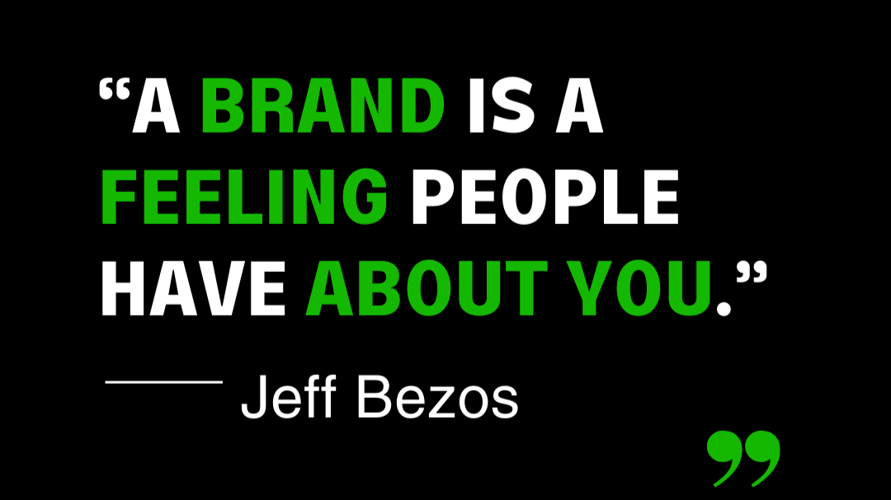

Slide 37

How to Create a Brand in the Job Market
Create a list of:
  Key Strengths – What are you naturally good at?
  Skills in Action – When have you used these strengths to make an impact?
  Lived Experience – What personal or professional experiences shaped who you are today?
  Wins + Proof – What have others said about you? What results have you created?
  Professional Passions – What kind of problems energize you to solve?
  DOCUMENT EVERYTHING!!!

Slide 38
Sell Your Brand in Your Interview
Talk about what makes you unique and valuable
1
Use stories and examples
2
Be authentic
3

Slide 39

Breaking out of the sea of sameness – one way is to create a Portfolio/ Legacy List!

Slide 40
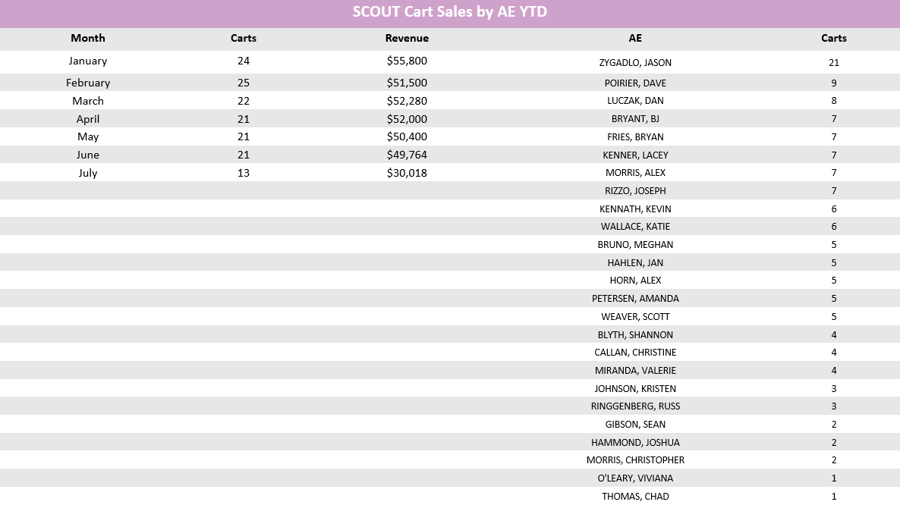
Create a Portfolio: Brag Book
From: Ronda S Price <Ronda.Price@aultman.com>
Sent: Thursday, December 9, 2021 3:04 PM
To: Jason Zygadlo <jason.zygadlo@merit.com>
Subject: RE: External: Re: Aultman BCC HELP!
Thank you, Jason,
Appreciate the way you handle things 😊
Sorry I was so occupied by meetings!
-Ronda

Slide 41
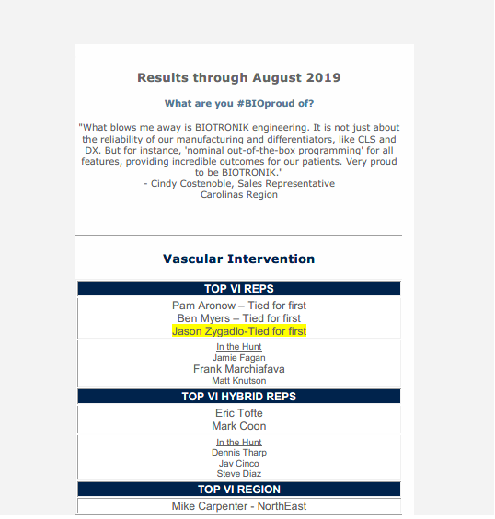
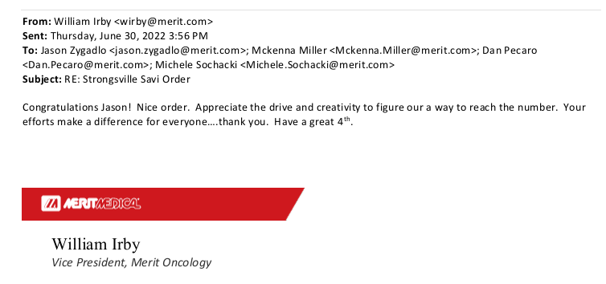
Create a Portfolio: Brag Book

Slide 42
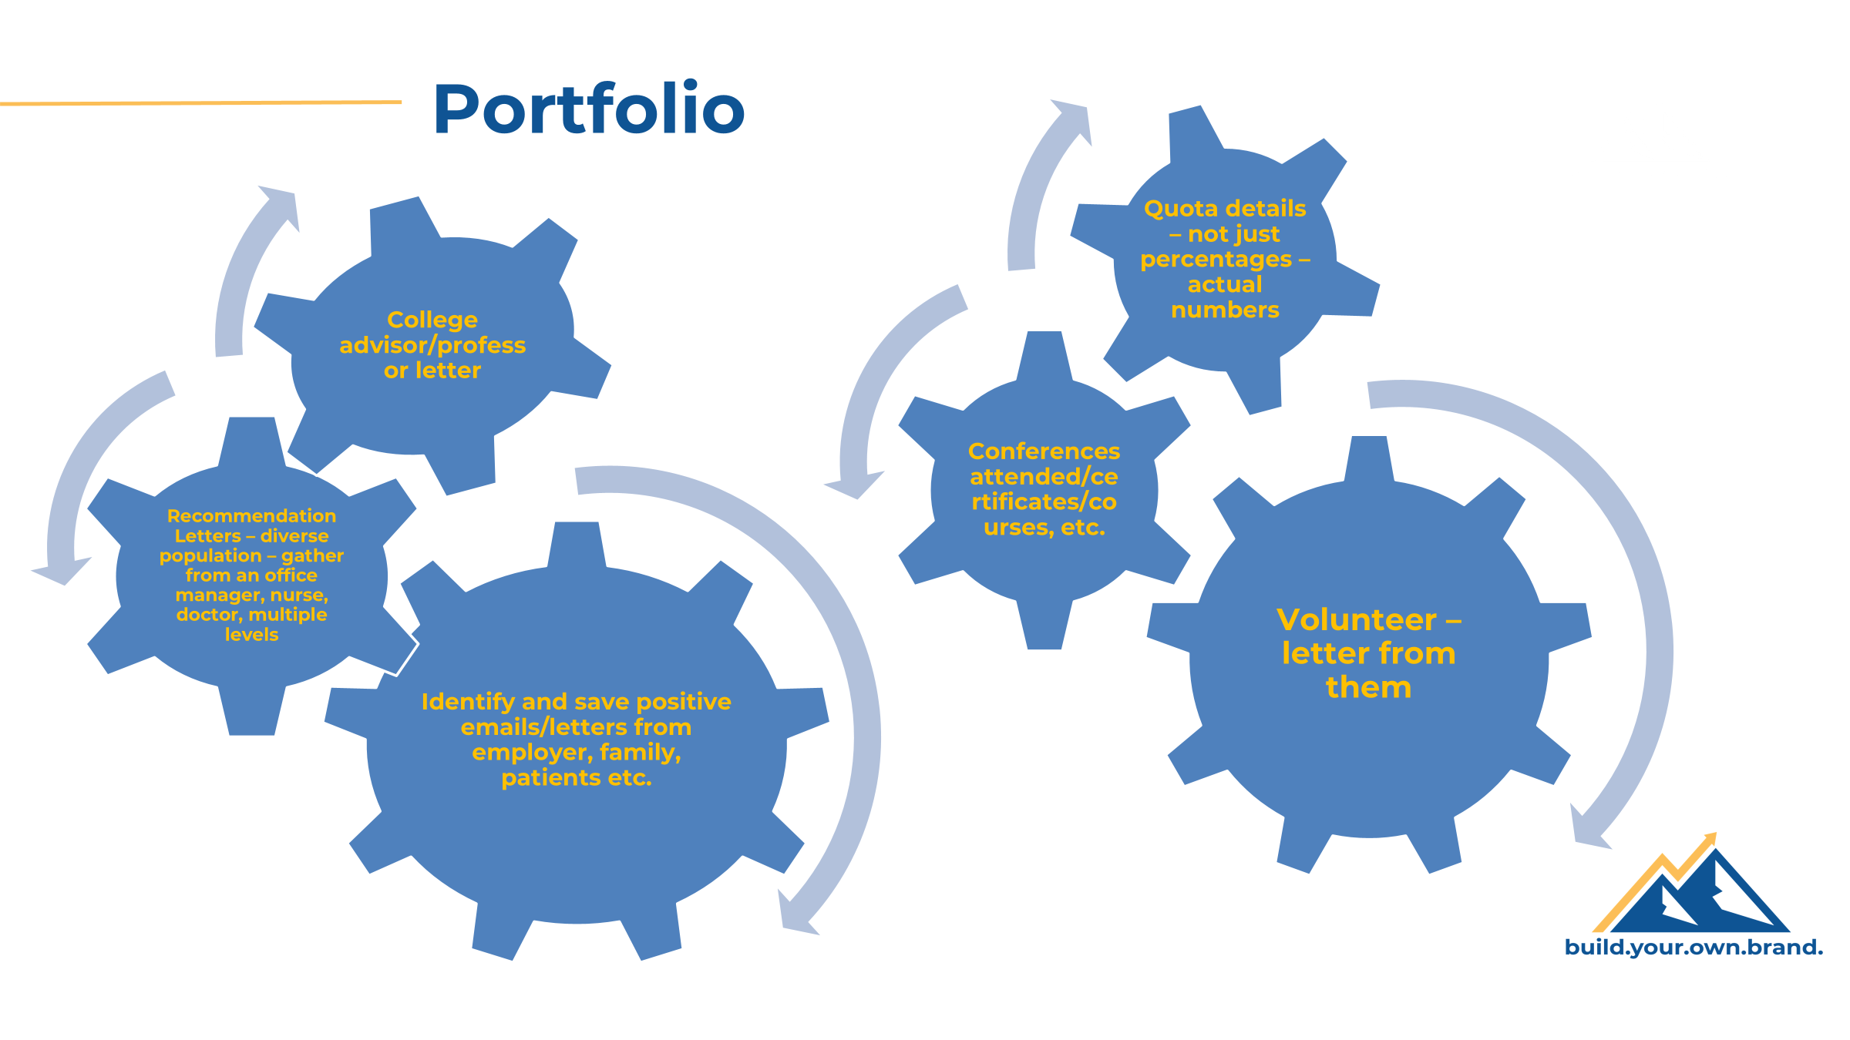

Slide 43
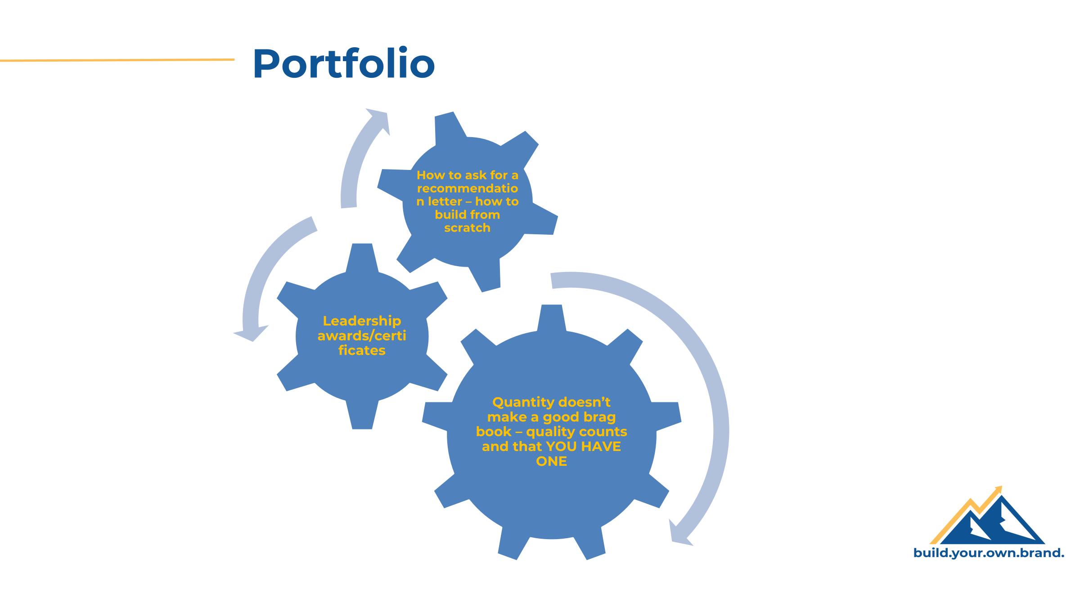

Slide 44


Slide 45
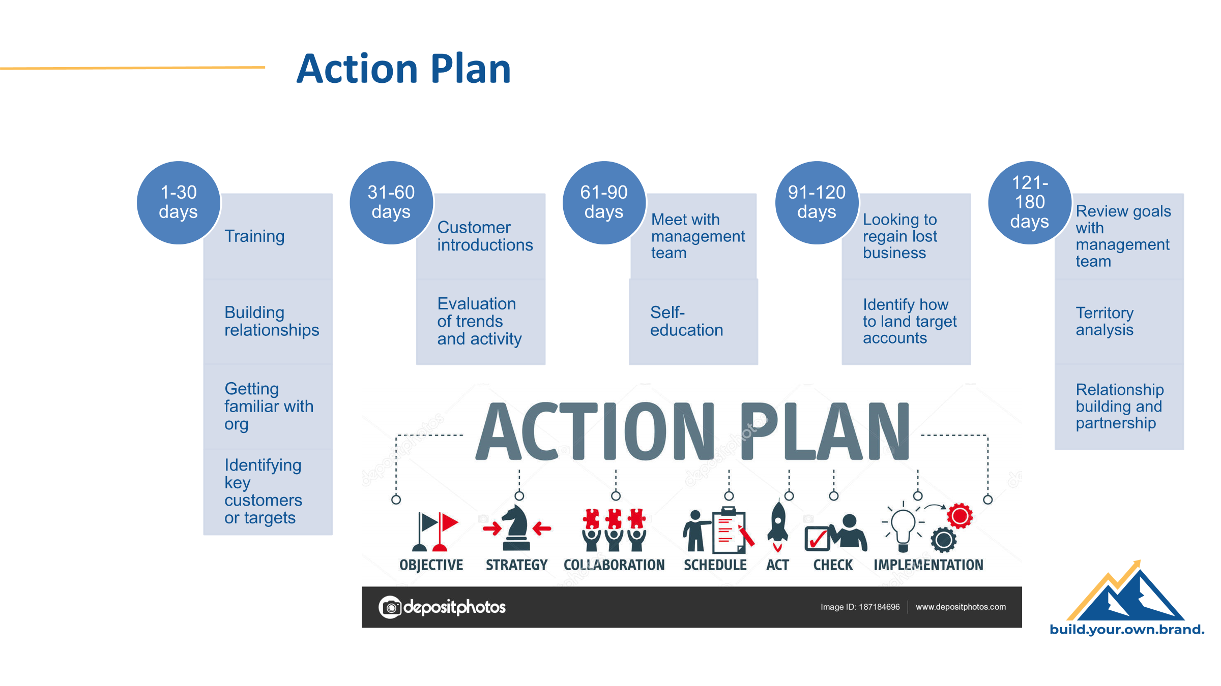

Slide 46
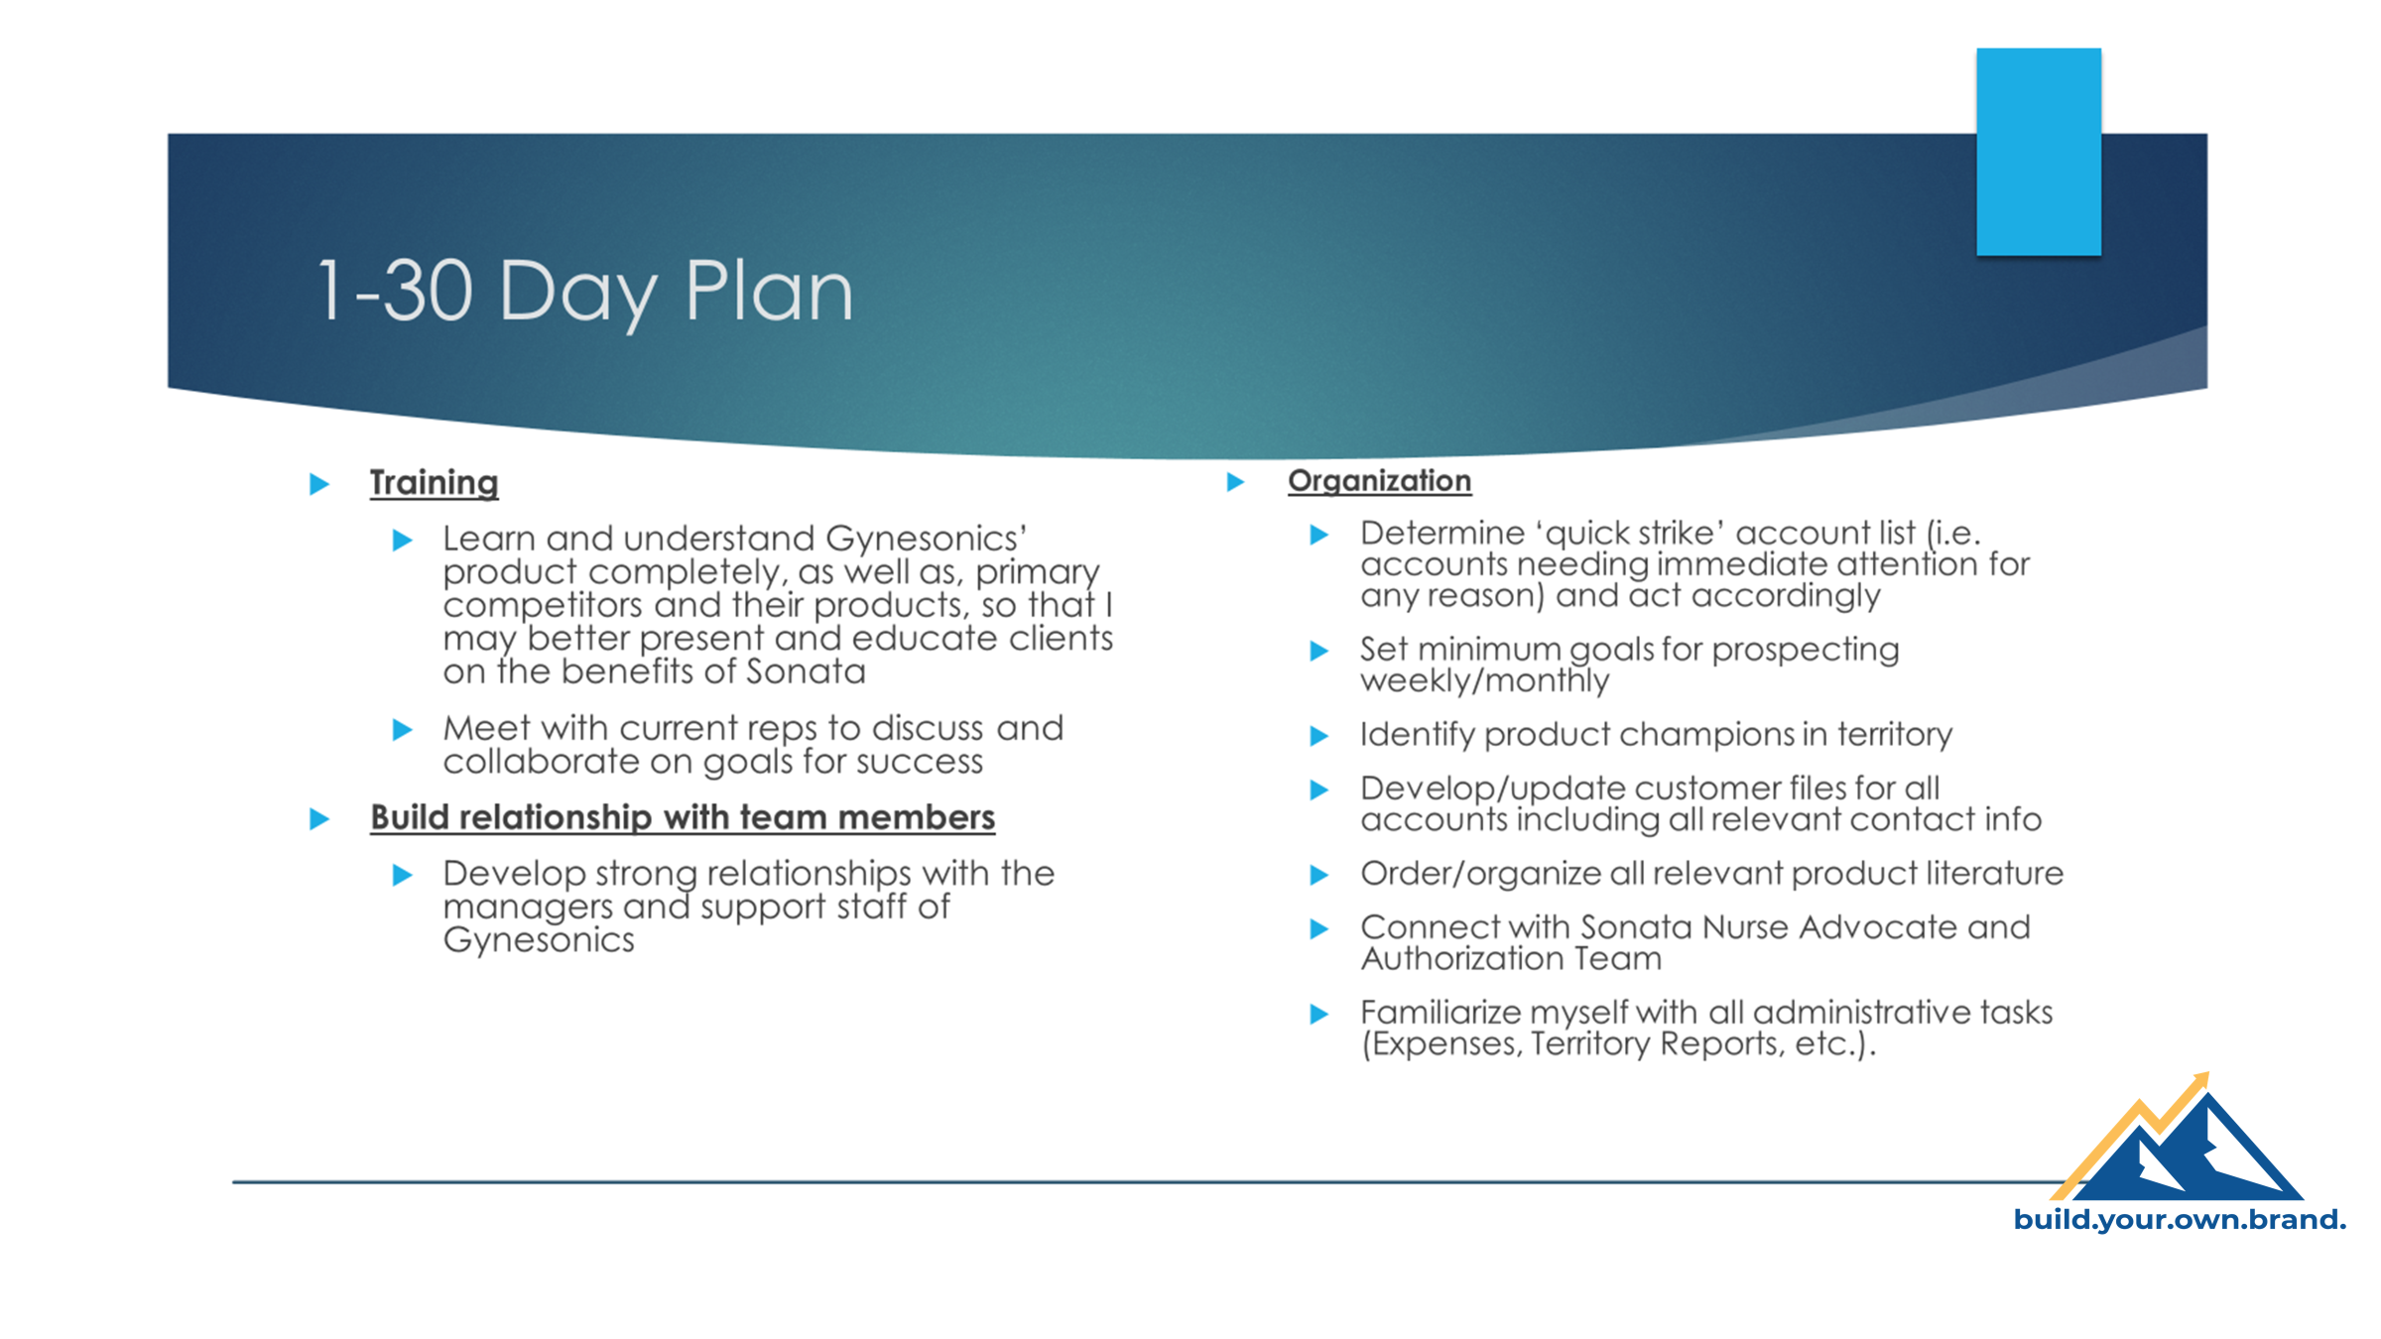

Slide 47

Breaking out of the sea of sameness – another way is personalized videos

Slide 48
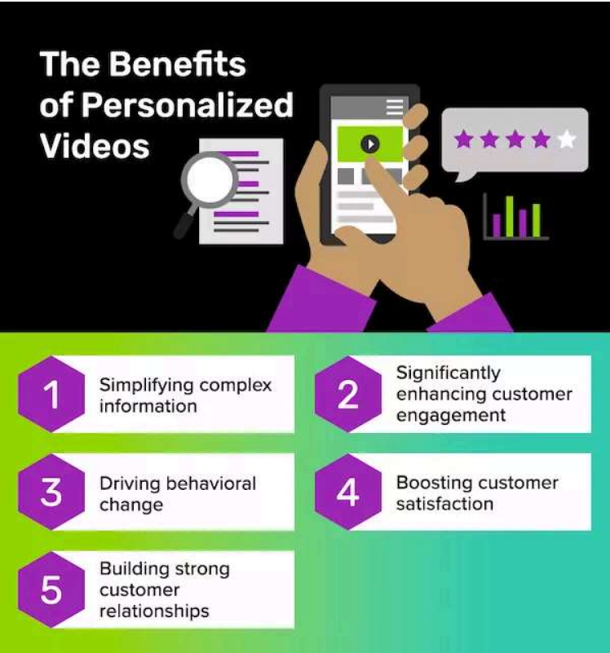
Personalized Videos

Slide 49

Personalized Videos
Data shows that using personalized videos results in 202% more conversions of customers than those without.
Customers will pay a 16% price premium for a great customer experience.
49% of buyers purchased something they didn’t initially intend to after receiving a personalized touch point.
44% will become repeat customers after receiving a personalized experience.
Sources: https://www.questline.com/blog/benefits-of-personalized-videos/ and https://www.idomoo.com/blog/how-personalized-video-transforms-customer-experience/

Slide 50
Personalized Videos
Thank you after the interview
Way to reach out to employees or former employees
Reach out to peers on your team at work
Anything you would send an email for - the possibilities are endless.

Slide 51

How are we using LinkedIn??
This Photo by Unknown Author is licensed under CC BY-SA-NC

Slide 52
In Closing
Important to Differentiate Yourself
Everyone is different and will build their brand in their own unique ways – MAKE IT YOUR OWN!
Deliver the message in a way you are comfortable and confident in telling your own story.

Slide 53
People Do Business With People They…
Know
Like
Trust

Slide 54



Contact Information
Jason A. Zygadlo
216-956-9696 mobile
jason@careercoachbyob.com
https://www.careercoachbyob.com
LinkedIn, Facebook, Instagram

