Slide 1

Wellbeing as Your Secret Weapon: Thriving While Job Hunting
Jessica Morris, MBA, ATC
RYTT Solutions, founder
Notes:
---
Job hunting can be a challenging and stressful experience. This presentation will explore how prioritizing wellbeing can help you navigate the job search process more effectively and maintain resilience throughout your journey.
Image source: Microsoft 365 content library

Slide 2

Understanding the Importance of Wellbeing During Job Search
How do you feel?
  80% of job seekers say it affects their mental health
  Average job search: 3–6 months
  75% feel ghosted at some point
  78% report high stress during their search
Notes:
The job search process brings emotional and psychological challenges that can affect your success. Recognizing common pitfalls like stress, burnout, and self-doubt is essential to maintaining your wellbeing and improving your chances of finding the right opportunity.

Slide 3

Job Seeker Burnout
Physical- sleep disturbances, fatigue, lowered immune system
Mental- imposter syndrome, lack of confidence, depression, anxiety
Behavioral- rushed applications, poor interviews, procrastination

Slide 4

Why prioritize well-being while job searching?
25%
Candidates with stronger resilience practices secure positions 25% faster than those experiencing burnout
65%
Improvement in outcomes when candidates maintain consistent mental well-being practices
40%
Decline in application quality and personalization when candidates experience burnout

Slide 5
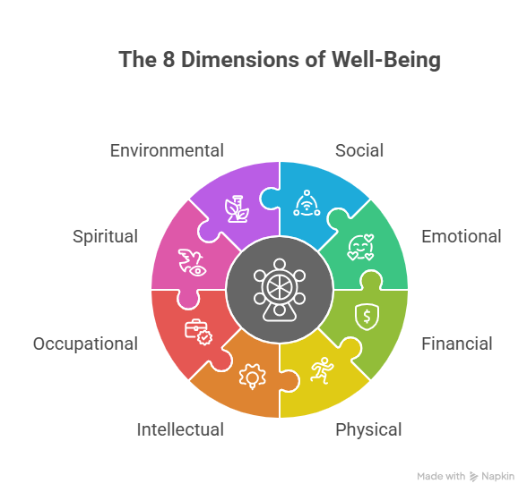
What is Well-Being?
Notes:
---
Job hunting often involves uncertainty and rejection that can impact your mental health. It's normal to experience anxiety, frustration, and self-doubt during this period, which can affect motivation and confidence.
Image source: Microsoft 365 content library

Slide 6

Building a Strong Wellbeing Foundation
Notes:
Creating healthy routines and self-care practices is key to sustaining wellbeing. Physical health, a positive mindset, and resilience form the foundation that supports you through the challenges of job hunting.

Slide 7
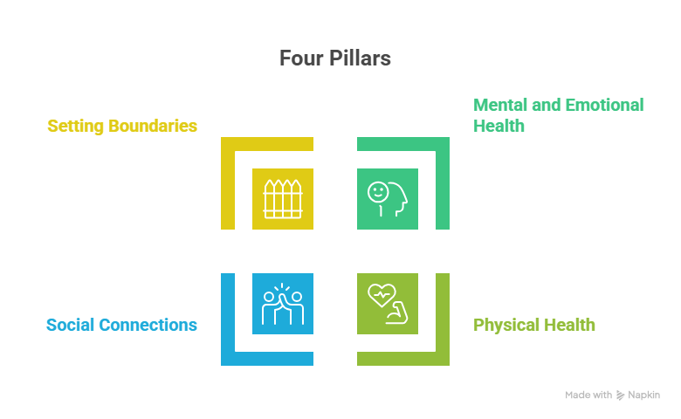
Notes:
---
Maintaining wellbeing enhances focus, decision-making, and resilience, which are crucial for a successful job search. A healthy mindset can help you stay motivated and manage setbacks constructively.
Image source: Microsoft 365 content library

Slide 8


Mental and Emotional
Rejection-Proof Mindset
Rejection = Redirection
Small wins
Mindfulness (interview anxiety)
Growth- build skills
Affirmations
Journaling

Slide 9


Physical
Routine that fuels energy
Inputs (water, walks, sleep) + outputs (applications)
Positive effects on your mood (food, nature)
Self-care

Slide 10


Social
Network
Support + Cheerleaders
Hobbies
Accountability

Slide 11


Boundaries
Saying no to energy drains
Life balance
Time blocks

Slide 12

Interview Superpower-
Energy (Wellbeing)
Confidence
Energy
Increase creativity
Increase focus
Emotional stability
Notes:
---
Stress and burnout can drain your energy, while self-doubt can undermine your confidence. Recognizing these pitfalls early enables you to take proactive steps to protect your mental and emotional health during the job search.
Image source: Microsoft 365 content library

Slide 13

Grind to Growth
Notes:
Setbacks are inevitable but can be powerful learning experiences. Maintaining motivation, adapting your approach, and recognizing progress turn challenges into stepping stones.

Slide 14

Finding Balance
Organize Your Schedule
Break Tasks into Goals
Prevent Overwhelm
Rest and Work Cycles
Notes:
---
Organizing your schedule and breaking tasks into manageable goals prevents overwhelm and helps maintain steady progress.
Image source: Microsoft 365 content library

Slide 15
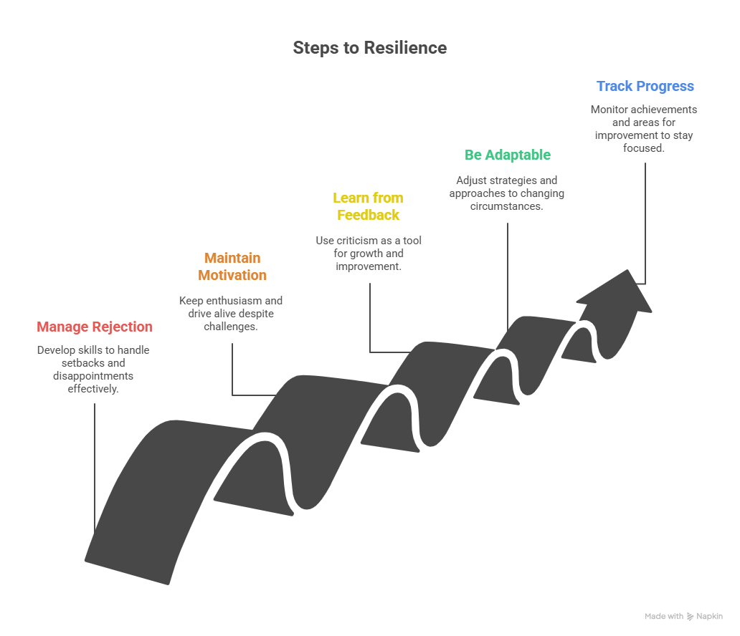
Notes:
---
Rejection is part of the process; managing it positively prevents discouragement. Keeping focus on long-term goals helps sustain motivation.
Image source: Microsoft 365 content library

Slide 16

Personal Plan
Self-Evaluation
Planner
A plan for overwhelming days
Positive coping mechanisms
Resources (Books, Apps, Podcasts)
1-1-1 1 win, 1 act of care, 1 connection
20-20-20 20 minutes of movement, joy, and growth
Words of Affirmation
Notes:
Wellbeing habits developed during your job search can support ongoing career growth. Creating balance and committing to continuous development are important for lasting success.

Slide 17

Transferring Wellbeing Habits Into Your New Role
Self-Care Routines
Stress Management Techniques
Work-Life Integration
Lifelong Learning
  .
Notes:
---
Applying self-care routines and stress management techniques in your new job promotes satisfaction and productivity.
Image source: Microsoft 365 content library

Slide 18
Conclusion: Thriving Through Wellbeing in Your Job Search
Wellbeing Enhances Success
Prioritizing personal wellbeing improves focus and resilience during the job search process.
Transform Challenges to Growth
Viewing job search challenges as opportunities fosters personal and professional growth.
Sustained Long-Term Career
Sustained wellbeing practices support a fulfilling and lasting career journey.
Notes:
Prioritizing wellbeing is a powerful strategy that enhances your job search success and prepares you for a fulfilling career. Embrace these practices to transform challenges into growth opportunities and sustain your long-term career journey.

Slide 19
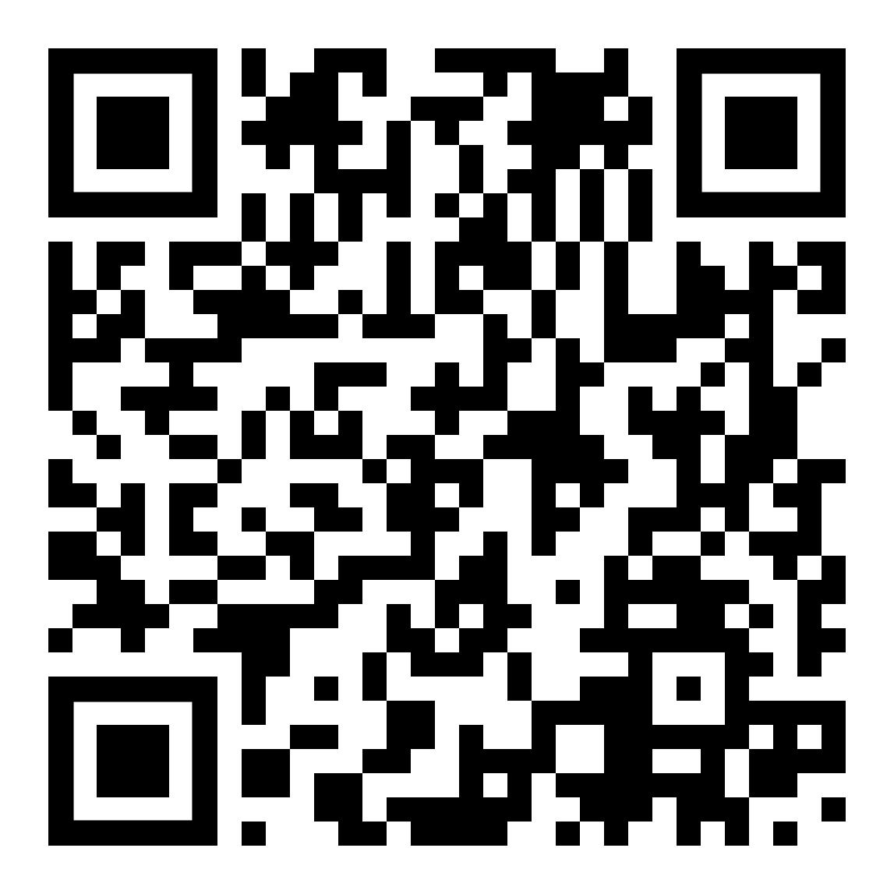


Connect with me!
One free 30-minute health coaching session only for today’s attendees. Book by 10/31
Stress management
Improved sleep
Weight management
Nutrition
Time management
Exercise
Jessica Morris, MBA, ATC
Jessica@ryttsolutions.com

