Slide 1
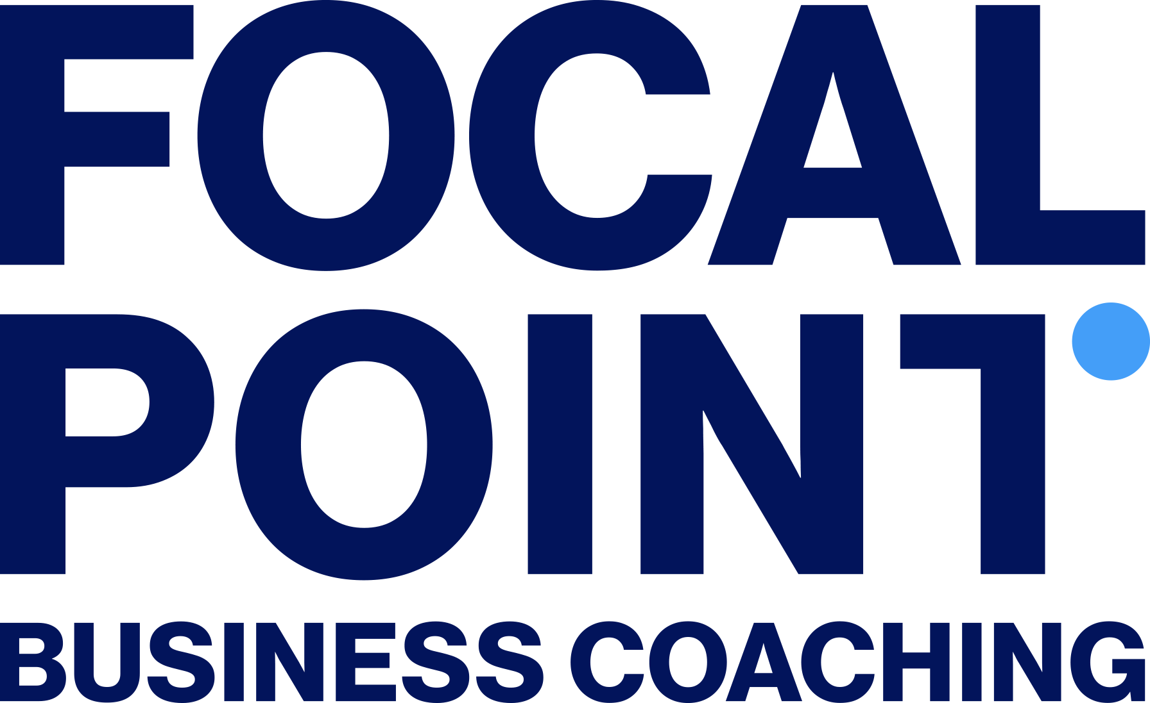

Positive Thoughts—Positive Results:
Creating a Growth Mindset for the New Year
Highlighting the powerful connection between thoughts, beliefs, actions, and results for NKYAG job seekers, small business leaders, and entrepreneurs.
Doug Walker
Focal Point Business Coaching of Dayton
NKYAG, 21 January 2026
Notes:
Happy New Year ( for the last time time this year . . .)
I wish each of you a better 2026 than 2025. And more to the point my goal here is to *EQUIP* you to set a better 2026 in motion.
Now, why am I here?

Slide 2
Objectives
Demonstrate how thoughts influence beliefs, actions, and ultimately results.
Bolster job-seekers’ confidence in interviews.
Provide proactive steps for entrepreneurs/small business leaders to build business skills including
  Focus
  Self-management
  Dealing with setbacks
Build networking skills, confidence.
Notes:
This is by no means a substitute for some of the great workshops the Library offers:
Shout-out to
--John Rhoads (Fundamentals of Networking)
--Patricia Borne (30-Second Introduction)
--Mikaela Brungs (Mastering the Art of Informational Meetings)
--Linda Lane, Steve Tracy (Interviewing Skills)
–Alisha Copley (Ace Your Next Job Interview)
--John Schlipp (Small Business Resource Collaborative) (SBRC)
When you do the things these folks and the other volunteer coaches suggest, if you approach it with a positive, proactive growth mindset, you increase your probability of achieving and even exceeding your goals
The tell preachers that to preach a sermon you need to tell the people what you’re going to tell them, Tell them, then Tell them what you told them. I just told you what I’m going to tell you. Now you have to sit through the actual telling . . .

Slide 3
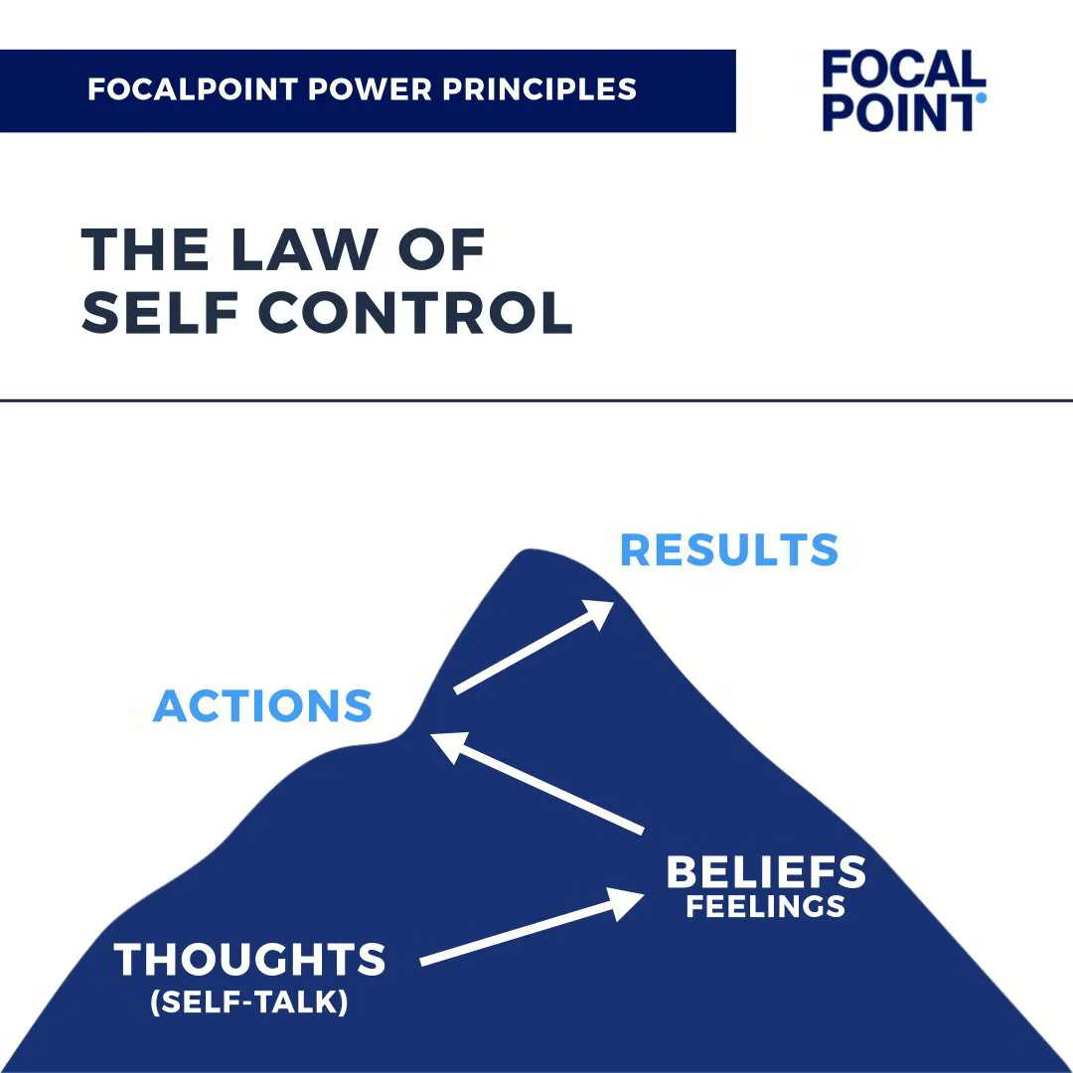
Climbing the Mountain
Notes:
This principle comes from Brian Tracy, one of the founders of Focal Point, and is called The Law of Self-Control. This principle teaches us that success starts with mastering our thoughts because they set the foundation for everything else we do. Let’s explore how this works.
First, think of this mountain as the journey to achieving your goals. It starts at the bottom with your thoughts, which drive your beliefs, which in turn shape your actions, ultimately leading to your results at the top.

Slide 4
Step By Step
Results (Goal):
  Finally, our actions produce results.
Actions (Activity):
  Our beliefs drive our actions.
Beliefs (Feelings):
  Our thoughts shape our beliefs and feelings.
Thoughts (Self-Talk):
  Everything starts with our thoughts.
Notes:
Now let’s look at the steps up the Mountain of Success (starting at the bottom . . .)
Thoughts (Self-Talk):
Everything starts with our thoughts—what we tell ourselves about our abilities and situations.
Swing Thought
Beliefs (Feelings):
Our thoughts shape our beliefs and feelings, determining whether we feel capable or uncertain.
Actions (Activity):
Our beliefs drive our actions—confident beliefs lead to productive and purposeful actions.
Results (Goal):
Finally, our actions produce results. Positive thoughts lead to positive results because they drive the right behaviors.
Let me stop here and ask you to react . . .
Some of you are felling this a little bit . . .
Some of you will be skeptical
I would be, frankly. I’m a bit of a skeptic

Slide 5
Power of Thoughts
KEY TAKEAWAY
  There’s a direct relationship between our thoughts and the results we achieve.
  Positive thoughts build confidence, lead to effective actions, and produce successful outcomes.
Notes:
Going back to the base of the mountain of success:
The key takeaway here is that there’s a direct relationship between our thoughts and the results we achieve. It’s not just what we do that matters—it’s how we think about what we’re doing that determines success.
It’s not just answering the interview questions “correctly.” It’s leaving the interviewer with a sense that you answered them in ways that show’s you’d be an asset to the team if they hired you..
It’s not just making a pitch to a potential client and hitting the number of pitches you set as a goal this week. It’s leaving your customer or potential client with an impression that you’re trying to help them solve a problem and not just checking a box or close a sale.

Slide 6
Talk Amongst Yourselves
What’s one negative thought you’ve noticed recently, and how did it impact your actions or results?
What’s an example of a positive thought that helped you achieve success in the past?
Notes:
Ask for examples from the room.
I recently attended a workshop John Schlipp organized at the Covington branch on making presentations and one of the concepts that stuck a chord with me is that most of the time there’s at least as much wisdom in the room as there is on the stage.
Let me hear from you . . .

Slide 7
Guard Your Thoughts
We must guard our thoughts carefully because they influence everything else.
And because negative self-talk can quickly derail us.
Good news, we can only hold one thought—positive or negative—at a time.
Notes:
We must guard our thoughts carefully because they influence everything else. Negative self-talk leads to negative results, while positive self-talk drives success.
Negative self-talk can quickly derail us, but the good news is that we can only hold one thought—positive or negative—at a time. By actively replacing negative thoughts with positive ones, we can change our beliefs, actions, and ultimately, our results.
Self-talk is an easy way to replace negative thoughts with positive ones.
What are some other ways we might replace negative thoughts with positive ones?

Slide 8
Let’s Engage
What are some common negative thoughts or self-talk patterns you notice in yourself or teams you’ve worked on?
How do these thoughts affect your confidence or the actions you take?
What would happen if you actively replaced those negative thoughts with empowering, positive ones?
Can you think of a recent time when positive self-talk helped you achieve a goal?
Notes:
Lion King scene

Slide 9
Apply to Real-Life Scenarios
Career Transition Example:
  Your last job interview was a disaster, at least that’s how it felt. After you send a ‘Thank You,’ and if they do indeed hire someone else, you’re left to wonder what went wrong.
Business Example:
  Imagine a business owner facing declining sales. Negative thoughts like 'This market is too tough' lead to hesitation and lack of action.
Notes:
Career Transition Example:
--Your last job interview was a disaster, at least that’s how it felt. After you send a ‘Thank You,’ and if they do indeed hire someone else, you’re left to wonder what went wrong.
--Proactively contacting the hiring manager and requesting constructive feedback can provide concrete steps to improved performance the next time around.
Business Example:
--Imagine a business owner facing declining sales. Negative thoughts like 'This market is too tough' lead to hesitation and lack of action.
--But reframing these thoughts to 'I can adapt and find new opportunities' builds confidence, leading to proactive steps like exploring new markets or improving customer outreach. These actions create better results.

Slide 10
Apply to Real-Life Scenarios (cont.)
Personal Example:
  Think of a personal goal like a fitness goal.
Your Own Example:
  What affirmations or positive self-talk strategies could you start using today to build confidence?
Notes:
Personal Example:
Think of a personal goal like getting in shape.
--Negative self-talk like 'I’ll never stick to this' leads to giving up.
--But positive thoughts like 'I’m making progress every day' reinforce consistency, leading to long-term results.

Slide 11
Actionable Takeaways
Guard Your Thoughts:
  Your brain can only hold one thought at a time—make it a good one.
Practice Positive Self-Talk:
  Adopt affirmations like 'I can do this' or 'I like myself' to rewire your thinking.
Monitor the Chain Reaction:
  By mastering your thoughts, you take control of your outcomes.
Notes:
Guard Your Thoughts:
Actively replace negative thoughts with positive ones. Your brain can only hold one thought at a time—make it a good one.
Practice Positive Self-Talk:
Adopt affirmations like 'I can do this' or 'I like myself' to rewire your thinking.
Monitor the Chain Reaction:
Remember, your thoughts drive beliefs, shape actions, produce results.
By mastering your thoughts, you take control of your outcomes.

Slide 12
Suggested Reading
The 32 Unbreakable Laws of Money and Succes: Transform Your Life and Unlock Your Unlimited Potential
Get Smart!
Think Big
The Laws of Power
  Brian Tracy
Mindset
  Carol Dweck
20-minute Networking Meeting The 20-Minute Networking Meeting
  Nathan A. Perez, Marcia Ballinger, PhD

Slide 13
KCPL Workshops
Northern Kentucky Accountability Group (NKYAG)
Interviewing Skills Workshop / Ace Your Next Job Interview
The Fundamentals of Networking
Mastering the Art of Informational Meetings
Side Hustle Without the Hustle
Public Speaking: Presentations That Connect
Toastmasters
The 5 Steps for Staying the Course w/ Dr. Angie Taylor
  (10/8/25 NKYAG presentation)
Small Business Resource Collaborative (SBRC)

Slide 14

Let’s talk . . .
Notes:
Questions?
Feedback?
Pushback?

